Slide 1
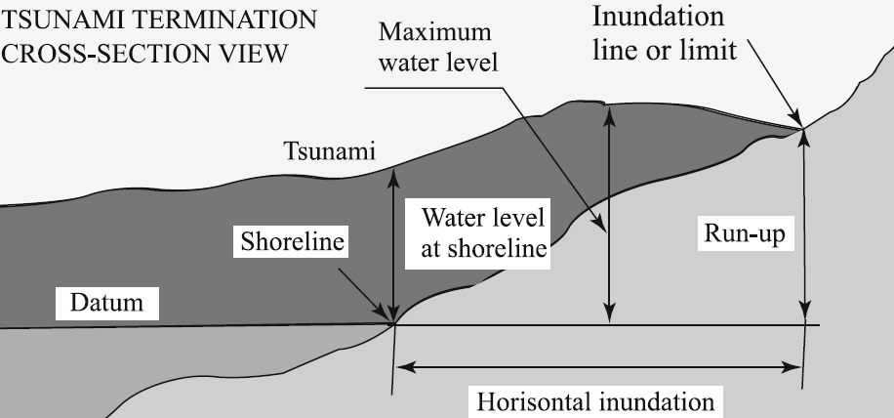
Tsunami
height
Horizontal inundation distance
The Datum is the tidal sea level
at the time of the tsunami occurrence
Adapted from Levin (2016)
The Maximum water level may be located
at the shoreline, or at the inundation limit,
or anywhere in between

Slide 2
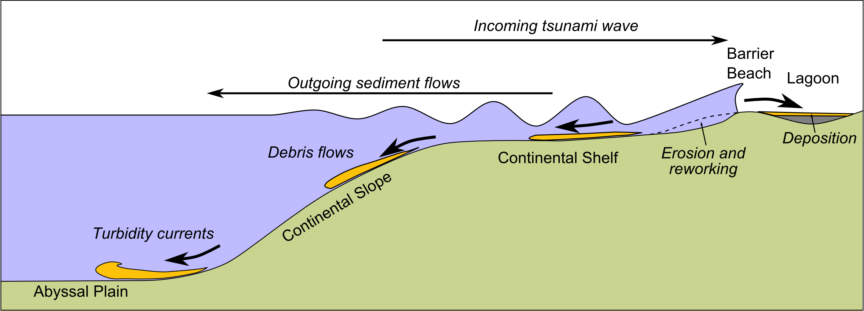

Slide 3
