Slide 1
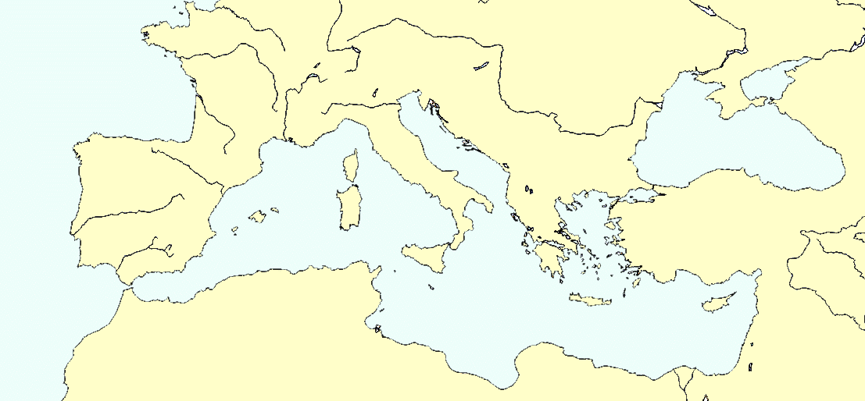
Image initiale (Janvier 2017)
Notes:
The whole Med could be seen as a Roman harbour !
Read & comment !

Slide 2
Main hubs & local hubs (mentioned 5 and more times by ancient authors)
Notes:
The whole Med could be seen as a Roman harbour !
Read & comment !

Slide 3
Main hubs & regional hubs (deduced from main flows of goods imported by Romans)
Notes:
The whole Med could be seen as a Roman harbour !
Read & comment !

