Slide 1
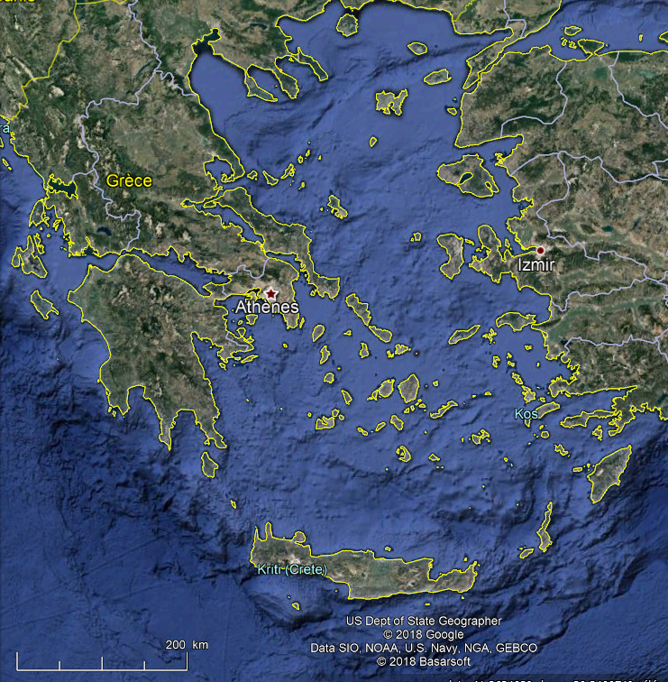
Local Spheres in the Aegean Sea
Local sphere
Main centre in Local sphere

Slide 2
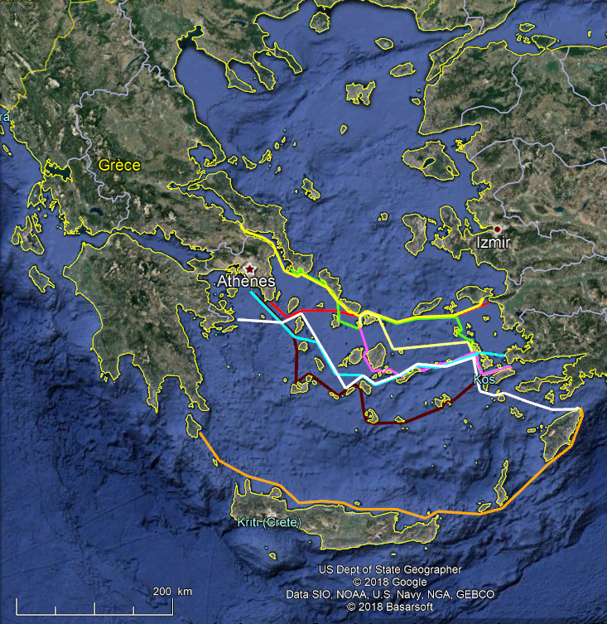
Local Spheres in the Aegean Sea with main sailing routes
Stadiasm. 273
Stadiasm. 280
Stadiasm. 281
Stadiasm. 282
Stadiasm. 283
Strabo, 14.1.13
Rod Heikell
Ps Skylax north
Ps Skylax south
Local sphere

Slide 3
Main areas in the Aegean Sphere
Main area in Aegean sphere

