Slide 1
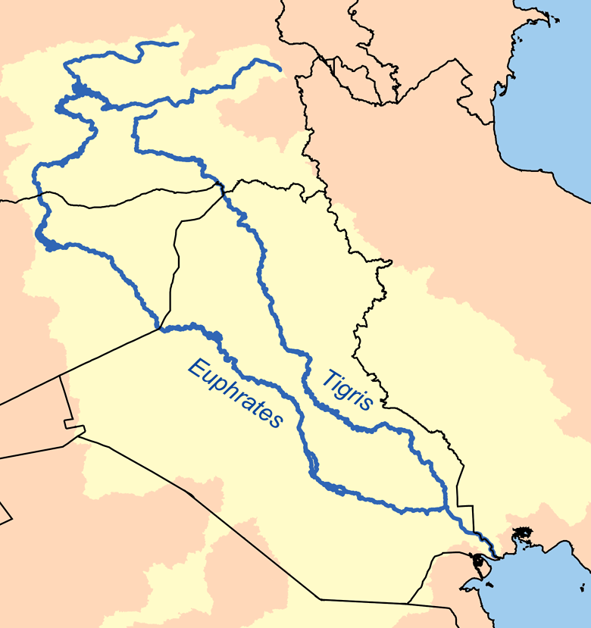
Zagros Mountains
Iran
Iraq
Kuwait

Slide 2
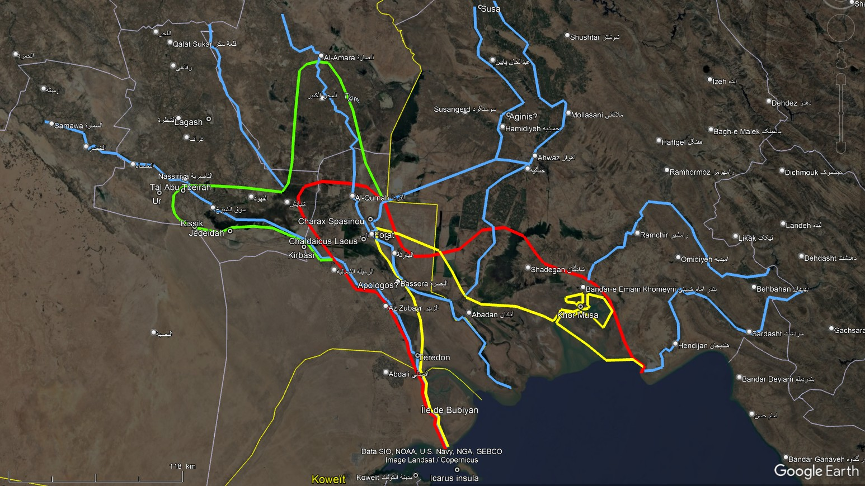
Tigris
Choaspes
Koprates
Archaic Tigris
Coastline
2500-2000 BC
Euphrates
Eulaeus
Mogaeus
Coastline
2000-1000 BC
Hedyphon
Coastline
1000-500 BC
Pasitigris
Oroatis
Euphrates

Slide 3
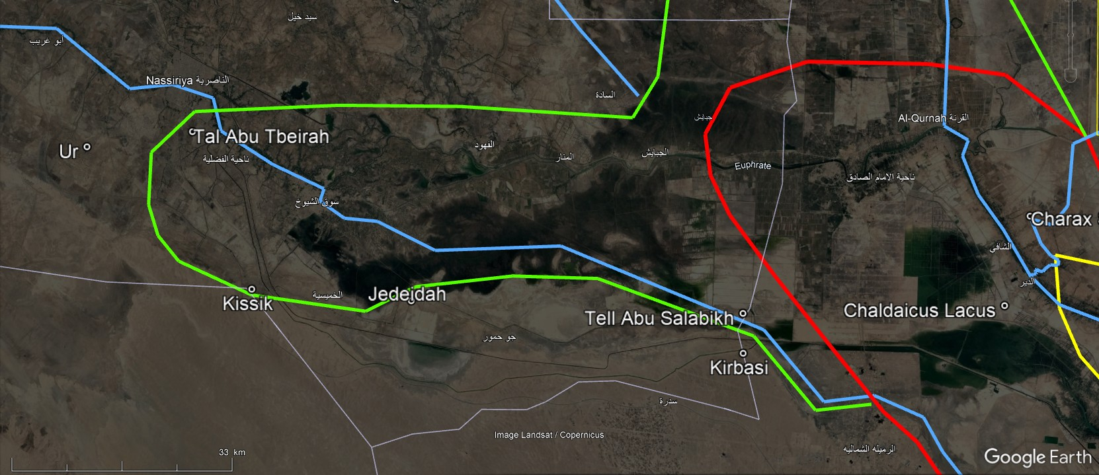
Archaic
Tigris
Coastline
2000-1000 BC
Tigris
Euphrates
Coastline
2500-2000 BC
Coastline
1000-500 BC

Slide 4
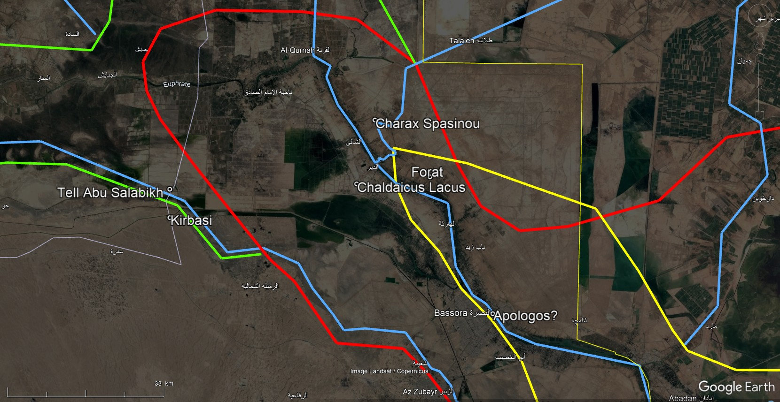
Tigris
Eulaeus
Coastline
2000-1000 BC
Euphrates
Coastline
1000-500 BC
Mogaeus
Pasitigris

Slide 5
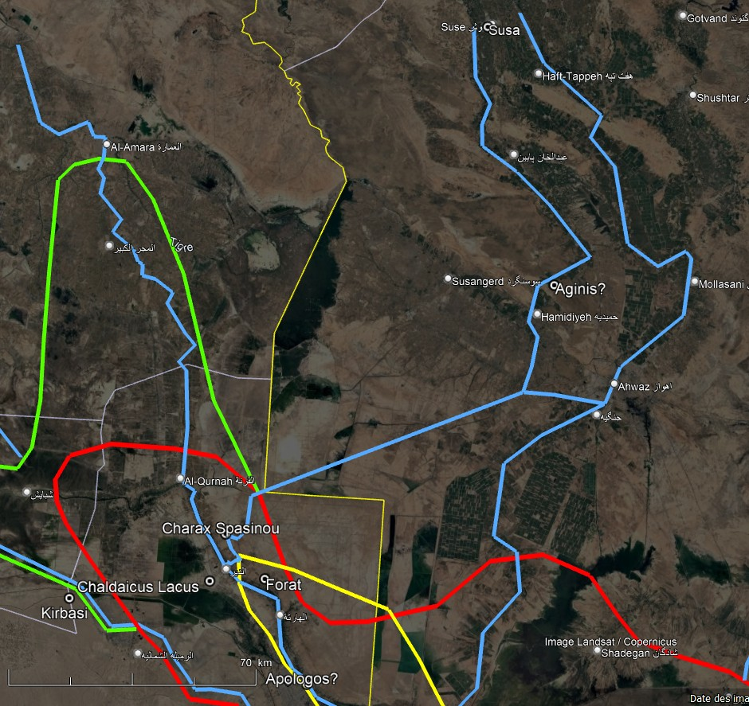
Tigris
Koprates
(Dez)
Choaspes
(Karkheh)
"Kh1"
Eulaeus
(Palaeo-Karun "K2“)
Coastline
2000-1000 BC
Mogaeus
(Karun "K3-K3b" )
Pasitigris
Coastline
1000-500 BC

Slide 6
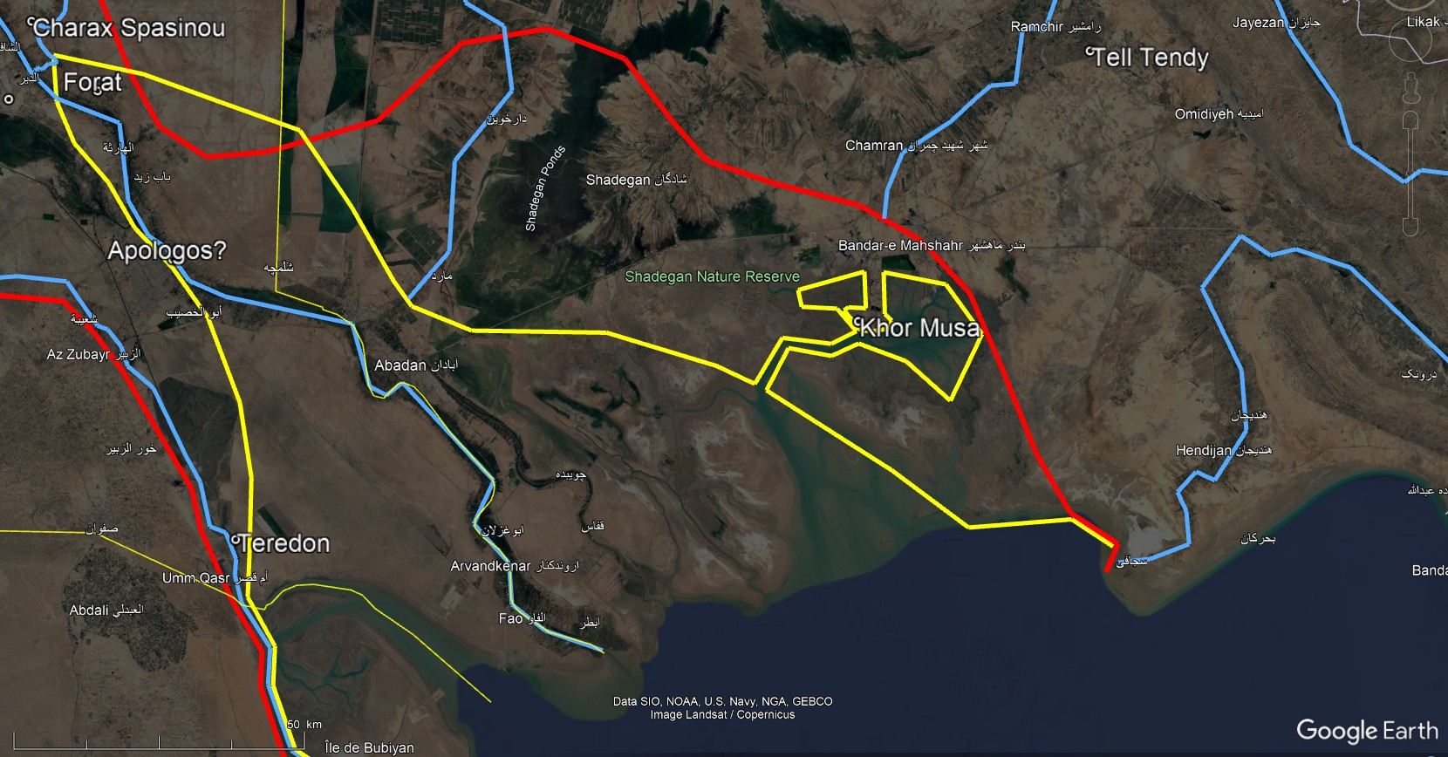
Hedyphon
Coastline
2000-1000 BC
Mogaeus
Coastline
1000-500 BC
Pasitigris
Oroatis

Slide 7
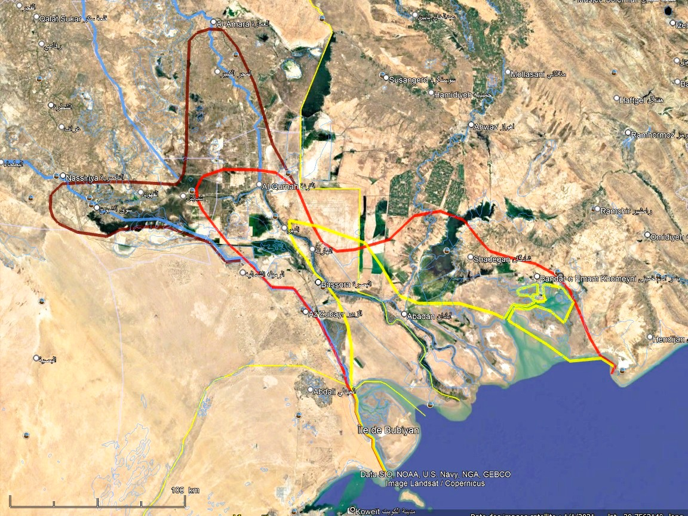
Tigris
Archaic Tigris
Coastline
2500-2000 BC
Euphrates
Coastline
2000-1000 BC
Coastline
1000-500 BC

Slide 8
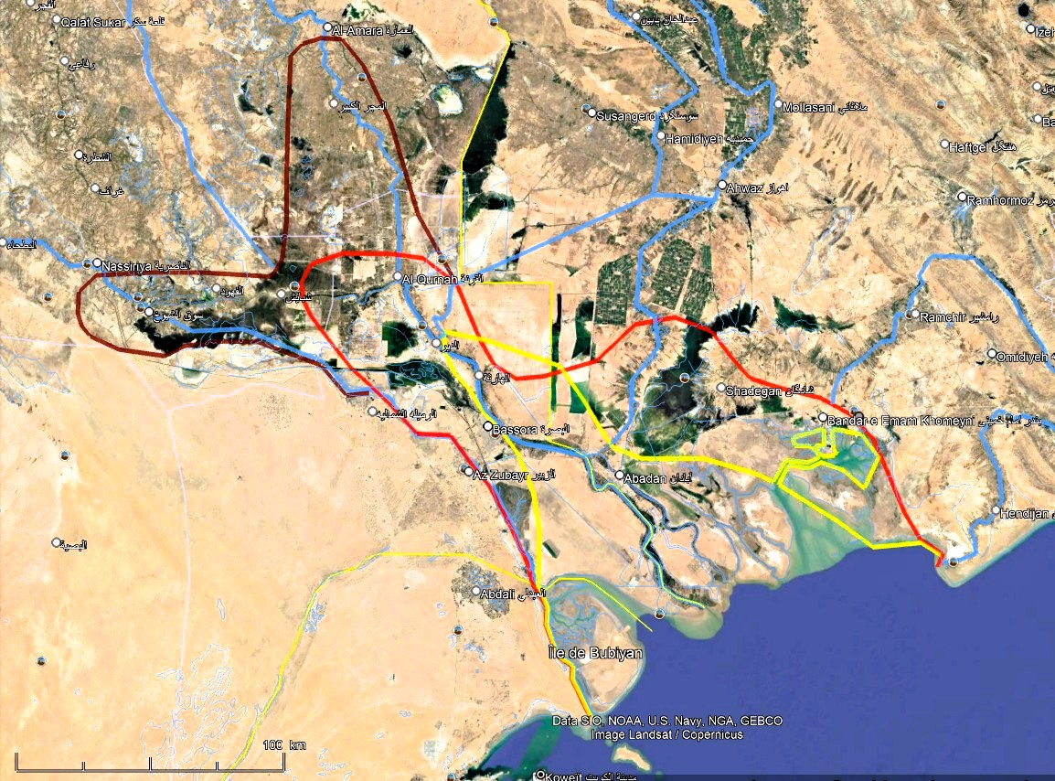
Tigris
Susa
Choaspes
Koprates
Archaic Tigris
Lagash
Euphrates
Eulaeus
Ur
Mogaeus
Hedyphon
Charax Spasinou
Oroatis
Pasitigris
Euphrates
Icarus

