Slide 1
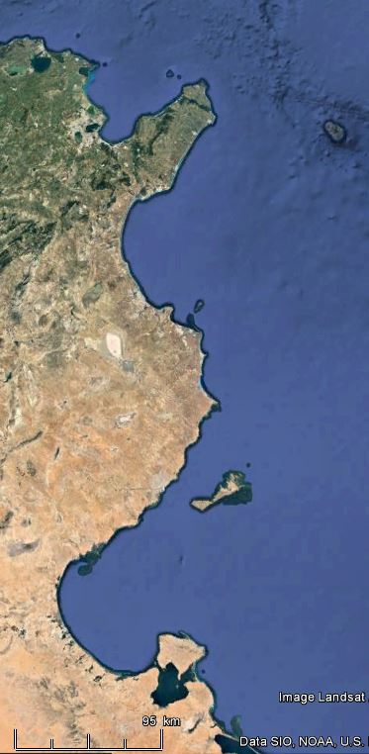
Nabeul (Neapolis)
Monastir (Ruspina)
Lamta (Leptiminus)
Bekalta (Thapsus)
Mahdia (Gummi)
Salakta (Syllectum)
Ras Boutria (Acholla)
Sfax (Taphrura)
Gabès
(Tacapae)
Djerba Mellita
Ras Segala (Gidaphta?)

Slide 2
Sea Water Level
Sea Bed
Rubble mound BW
Vertical BW
Sea Water Level
Sea Bed
Vertical BW with mound
Vertical BW on mound

