Slide 1
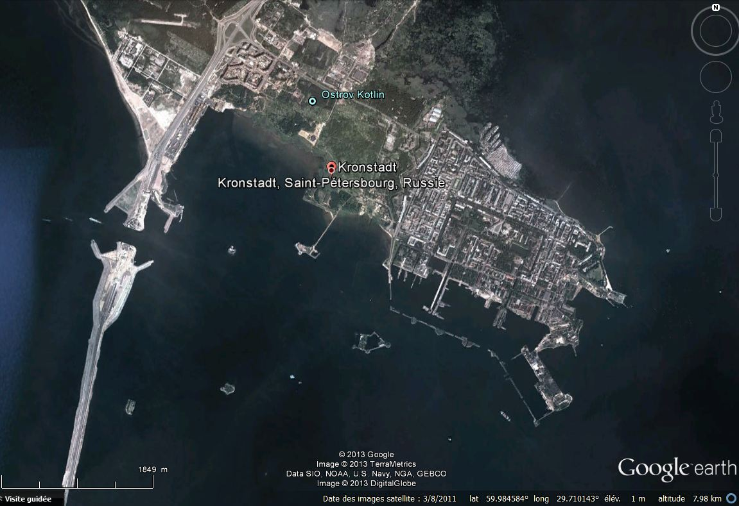
Naval Cathedral
Fort Alexander 1
Fort Paul 1
to downtown St Petersburg

Slide 2
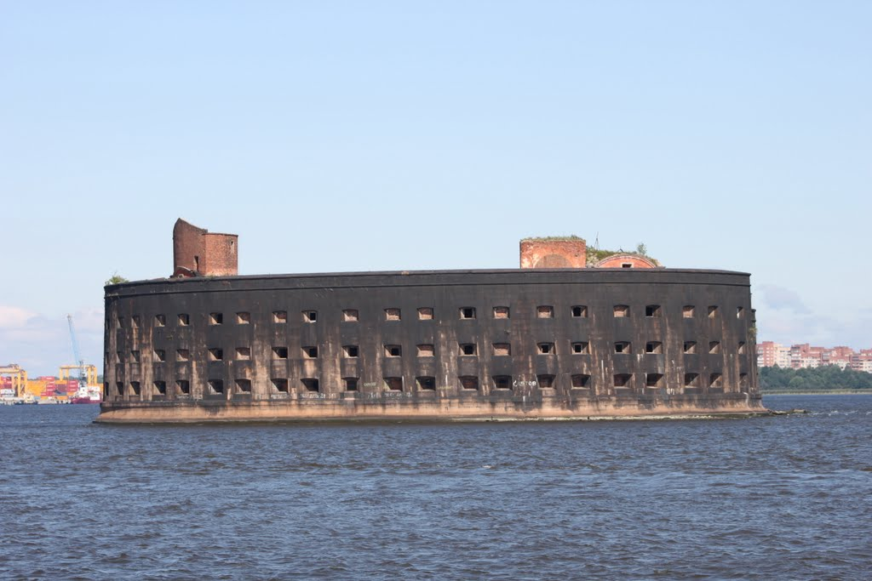
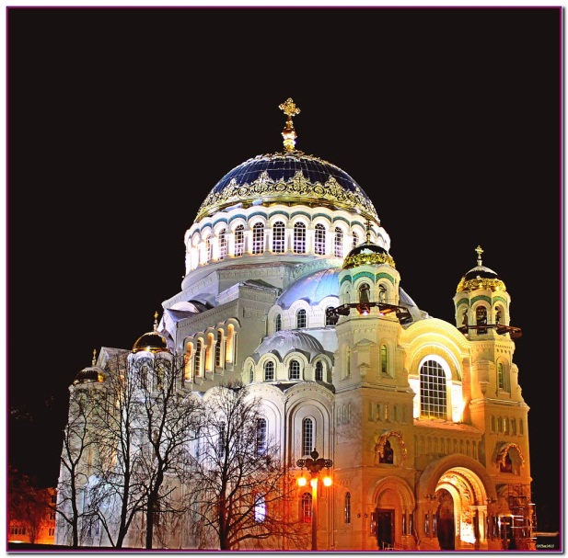
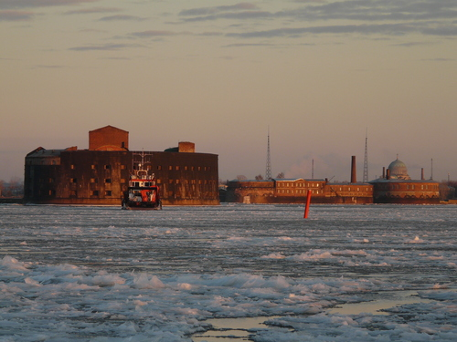
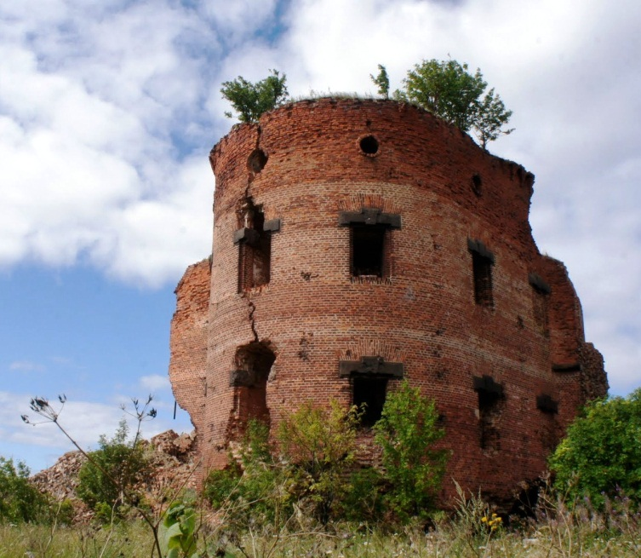
Fort Alexander 1
Naval Cathedral
Fort Paul 1
View on Fort Alexander 1
and Naval Cathedral

Slide 3
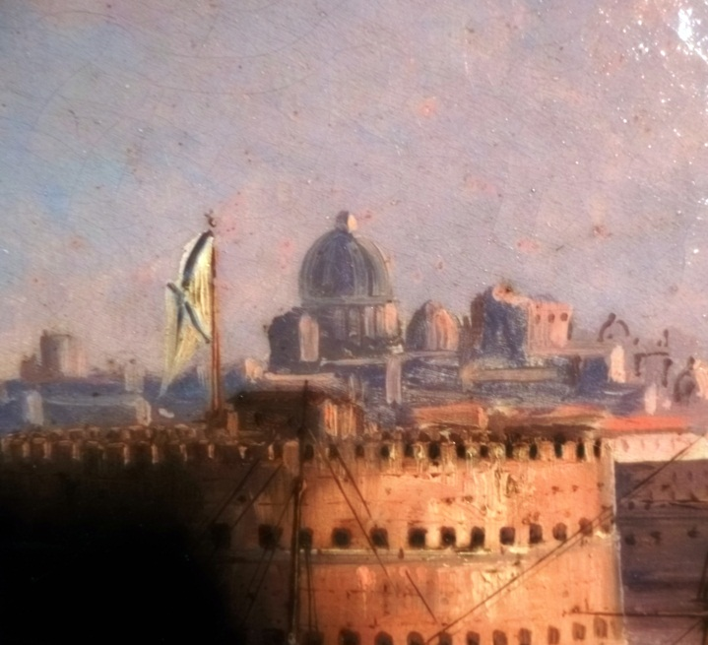
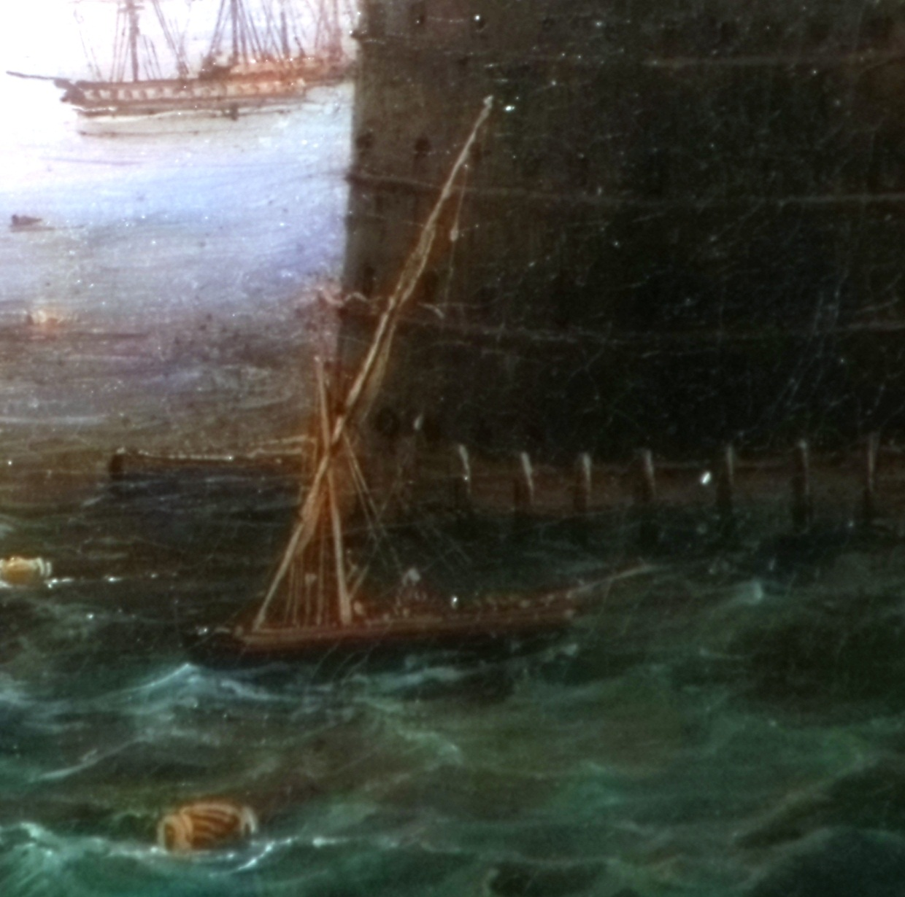
Russian Navy flat with blue St Andrew’s cross,
aligned with large dome in background
Small ship with lateen sail,
among the last ones on the Baltic
in the 19th century

Slide 4
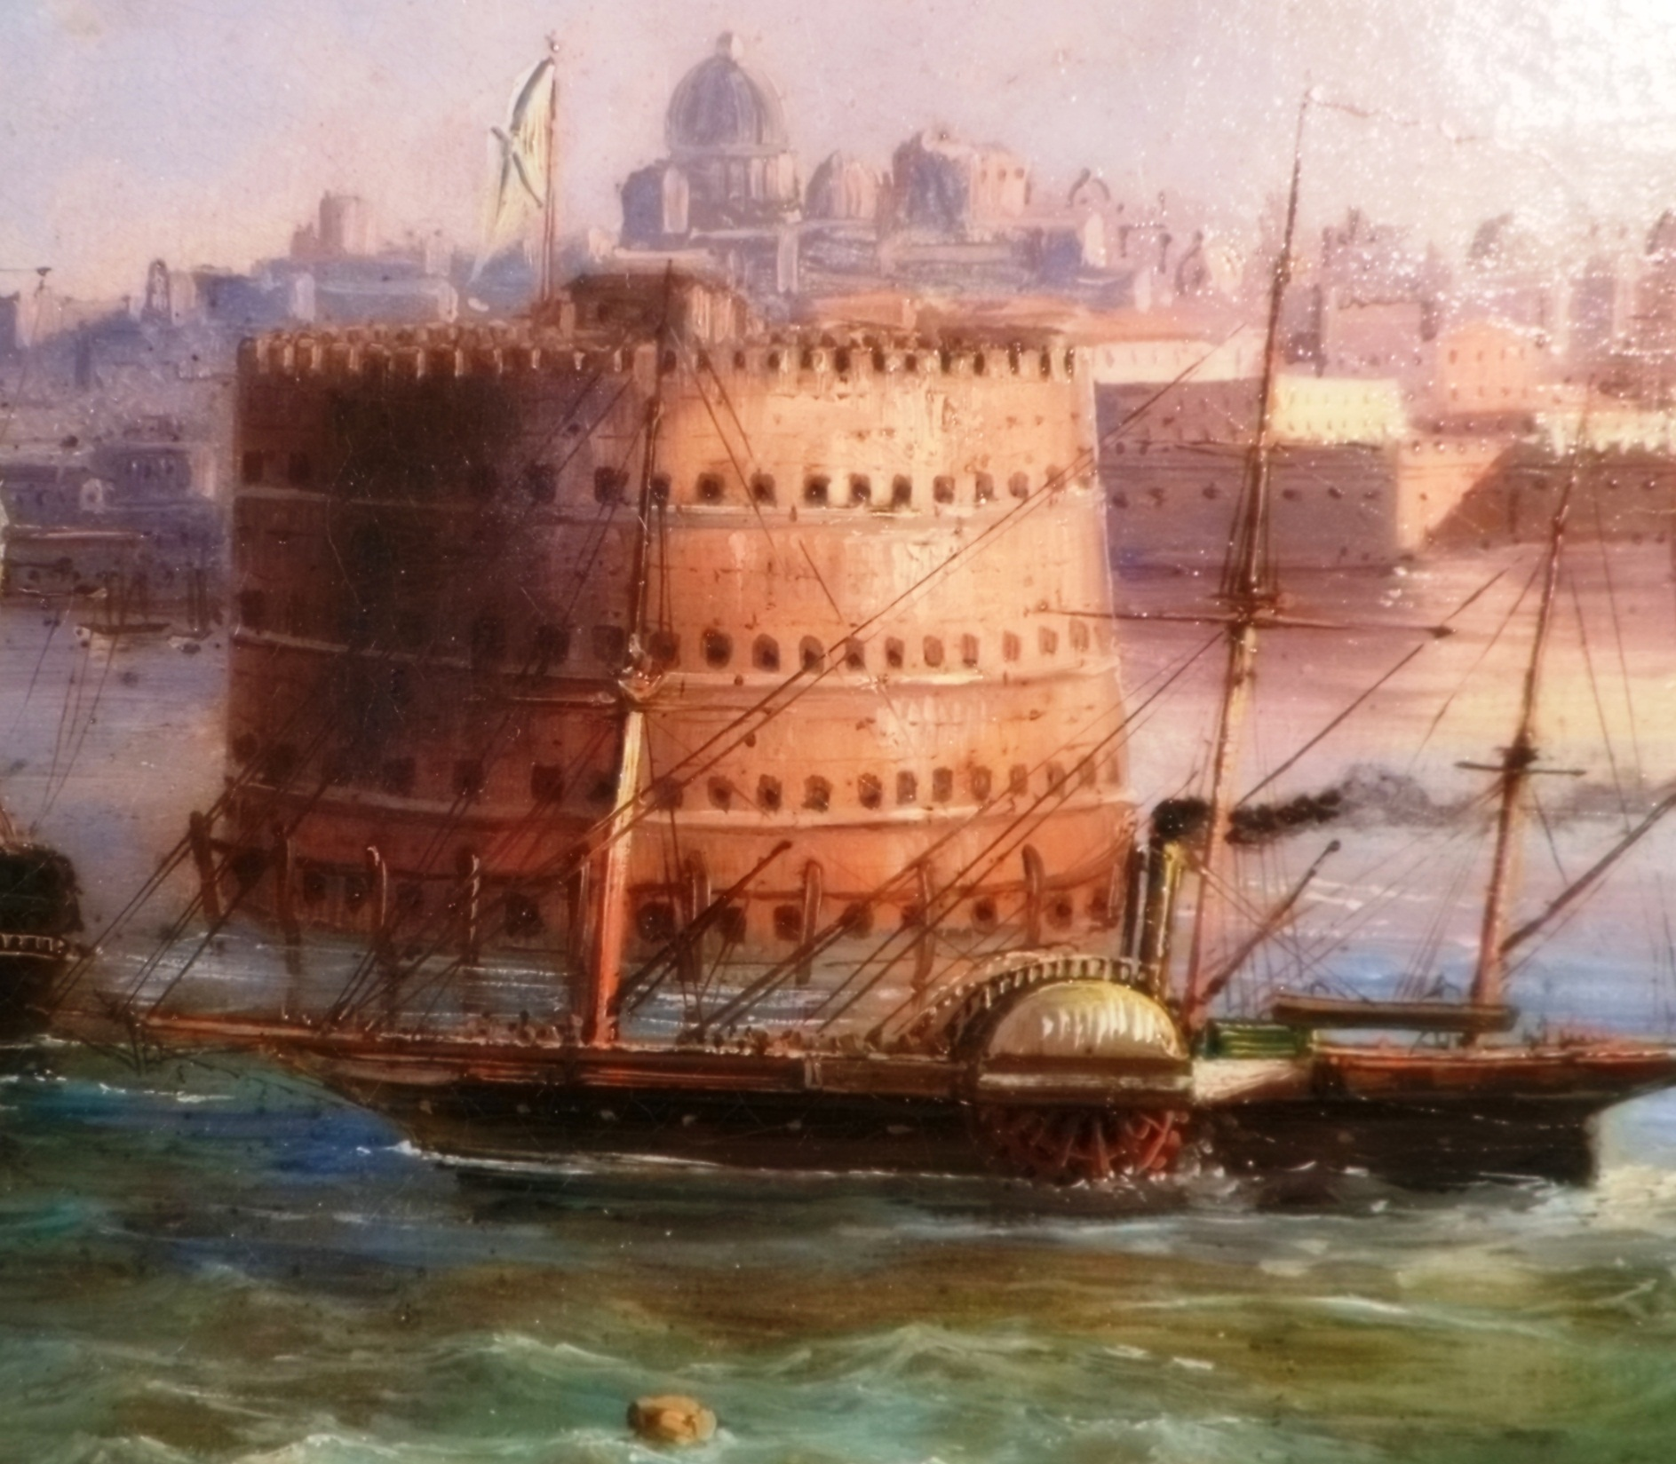
Seagoing paddle-wheel steamship

Slide 5
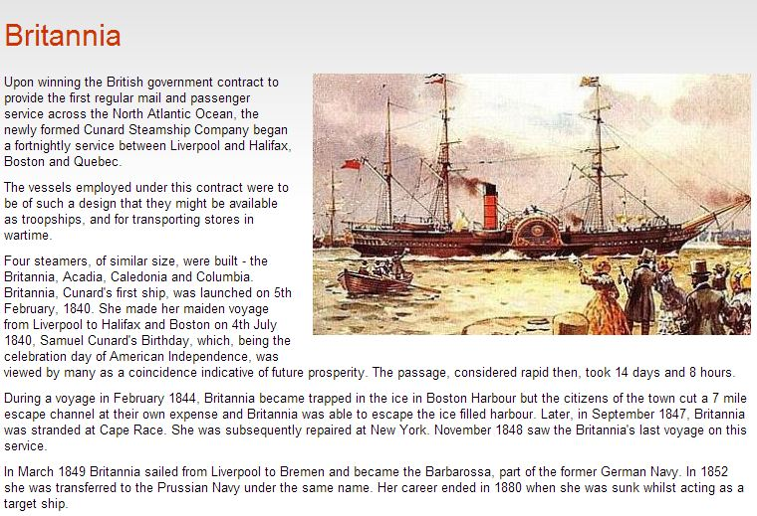
Description of RMS Britannia from Cunard (see red/black funnel)
This ship was perhaps seen in St Petersburg as the German or Prussian
Navy ship Barbarossa?
The painting would then be dated between 1849 and 1880.

