Slide 1
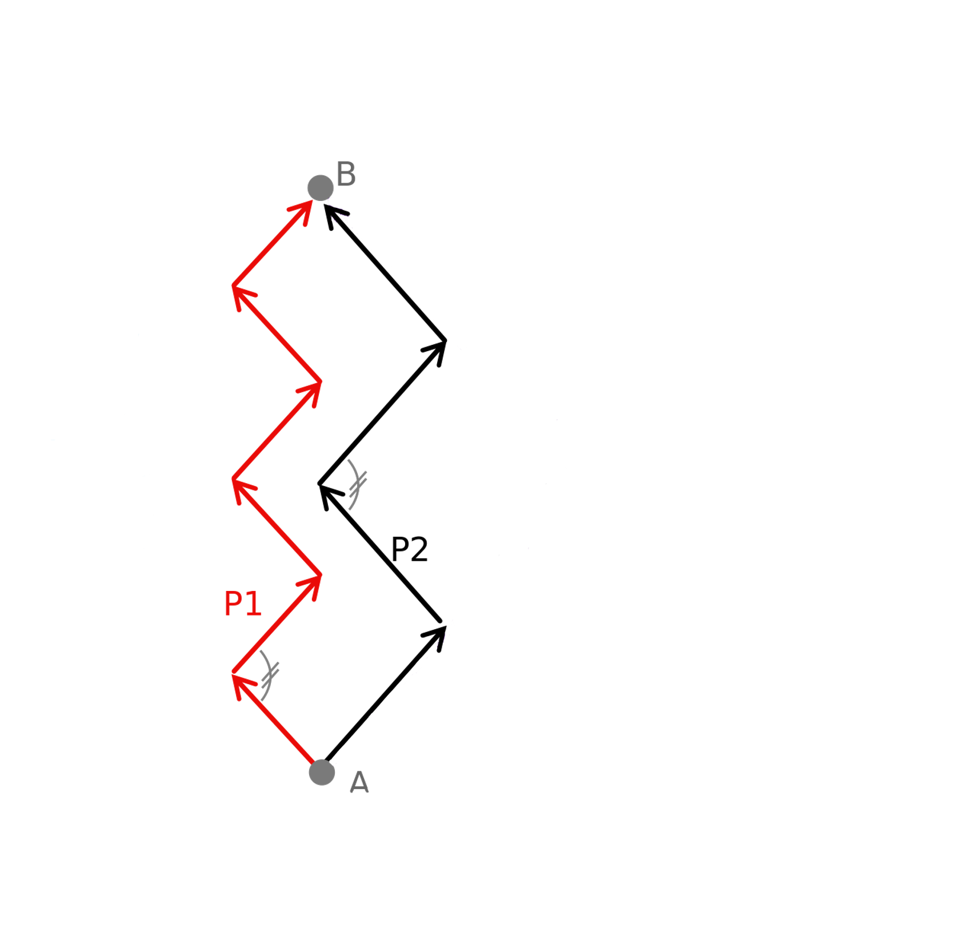
True Wind Direction
Vmg
Vmg
P3
Sailing to windward from A to B

Slide 2
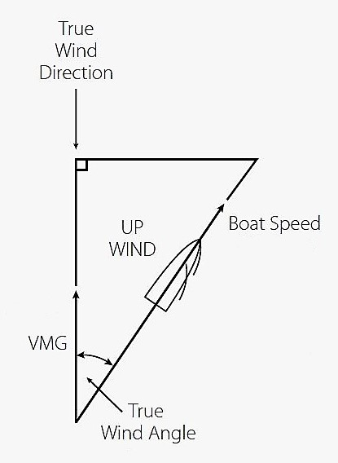
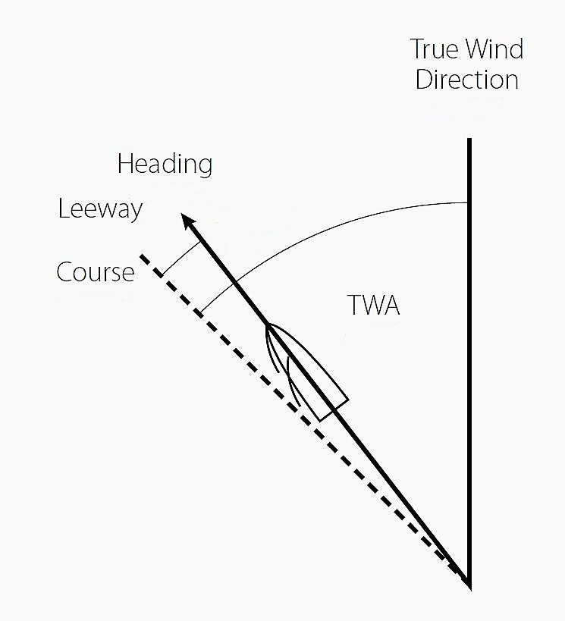
True Wind Direction
True Wind Direction

