Slide 1
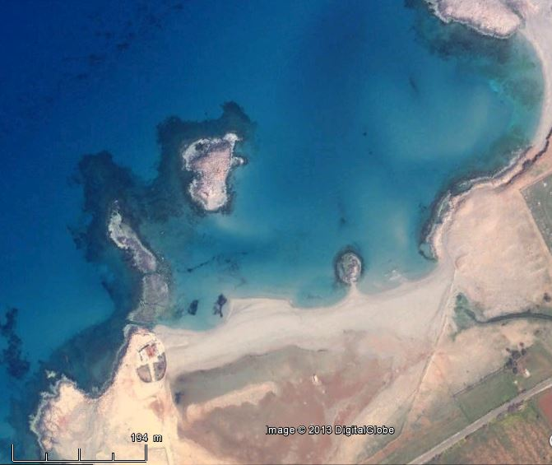
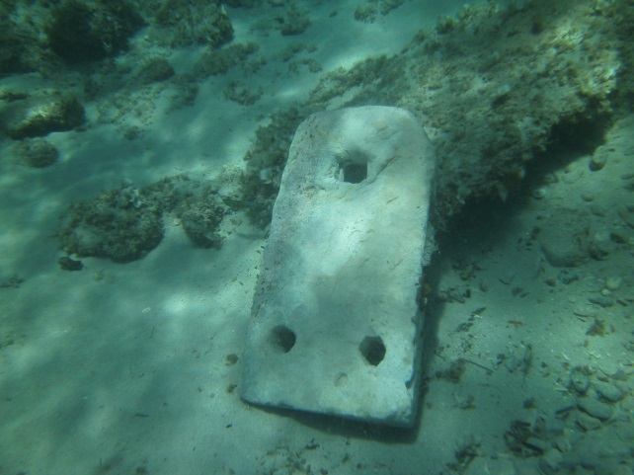
Hanieh anchorage
on 18/3/2009
Anchorage
Channel 2
Channel 1
Notes:
EL HANIEH ANCIENT ANCHORAGE
El Hanieh is located 25 km NW of Bayda (El Beïda) in Cyrenaica (Libya)
at 32.835° of latitude North, 21.51° of longitude East.
It is believed to be the ancient Aptouchou Hieron, or Aptoucha.
The sheltered area is around 150 x 100 m, that is 1.5 hectares.
A number of ancient stone anchors were found there in the sixties by the diver Jean-Pierre Misson. More than 12 stone anchors have been retrieved, to date.
He also identified two channels cut into the rock on rock outcrop located on the western side of the site.
The present document shows his pictures and finds. It makes heavy use of Google Earth imagery at various dates.

Slide 2
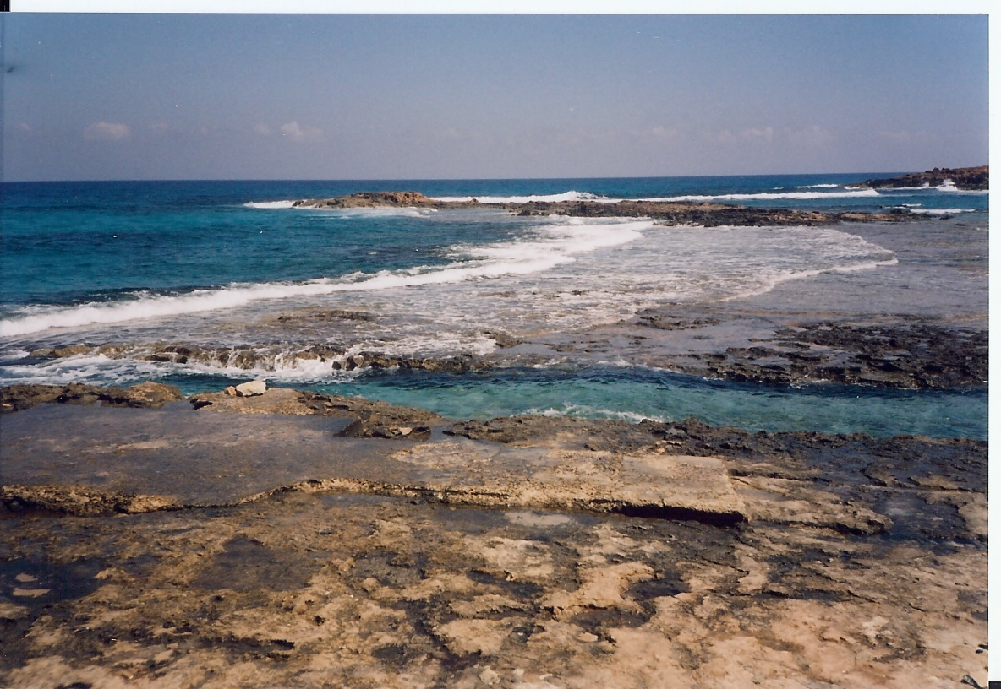
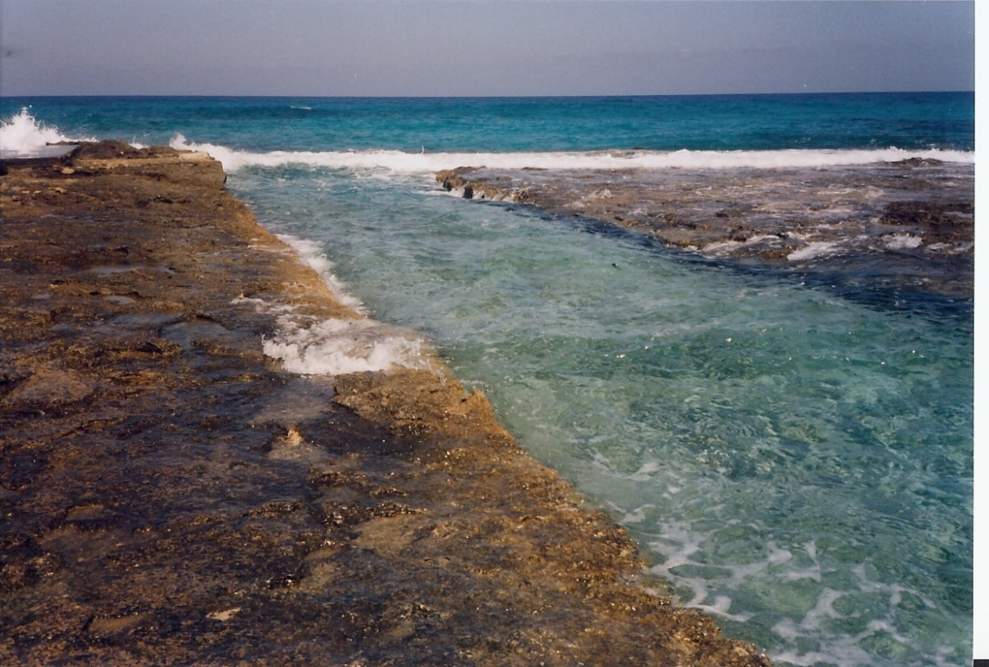
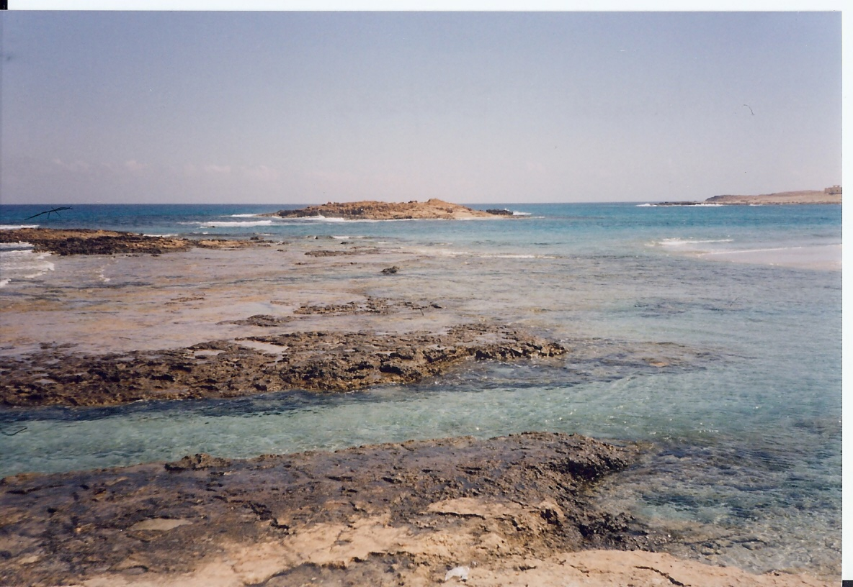
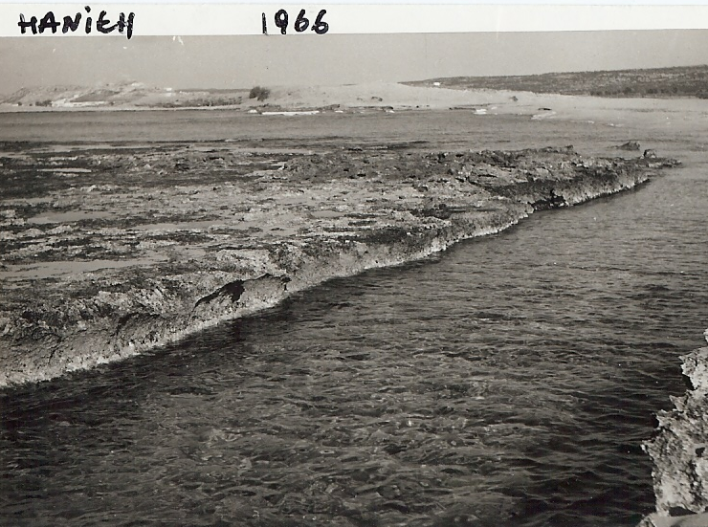
Hanieh channel 1
on 5/10/2010
Channel 1:
Horizontal bottom
Length: 40 m
Width: 4 m
Central groove: 8 x 8 cm
Notes:
The southernmost channel, « channel 1 », is shown on these pictures.
It is remarkably horizontal with a length of around 40 m and a width of 4 m. In addition, a square groove of nearly 10 cm runs in the centre of the bottom of the channel, on the whole length.
It is considered too horizontal to be a slipway.
It would be nice to be able to move ships to the west side of the rock outcrop when (fairly rare) NE waves set in, but the water depth is too small for a ship to be sailed in this channel, particularly as the sea level rose by around 0.50 m since antiquity. Tectonic movements of the underground are not know of in this area.
So we are left with a question as to its use. Perhaps just an older de-silting channel that was later replaced by channel 2.

Slide 3
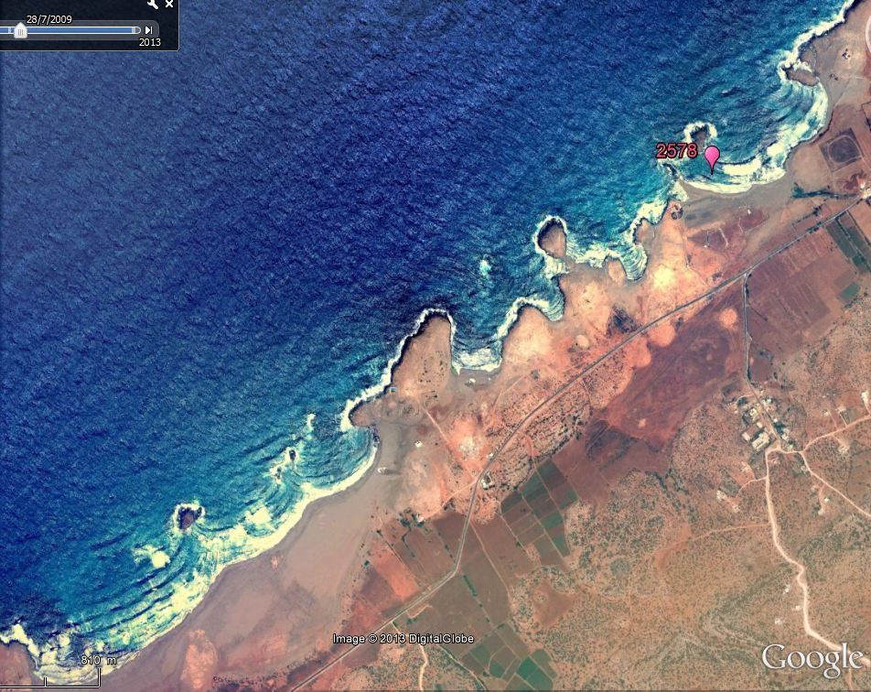
N to NE waves
on 28/7/2009
N to NE waves
Notes:
On July 28, 2009, remaining swell from N to NE was seen by the satellite and reported by Google Earth. This seems to be a fairly infrequent event.

Slide 4
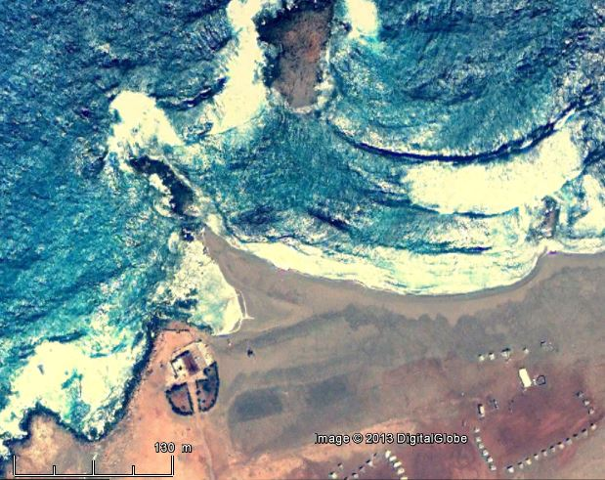
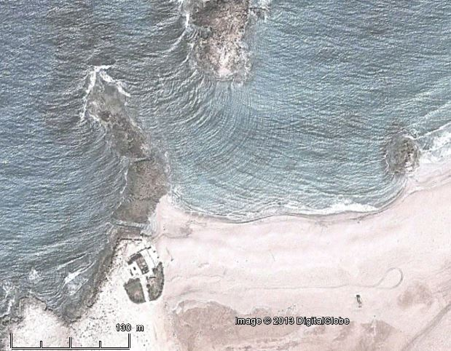
N to NE waves
N to NE
weather
morphology
wave breaking
N to NE waves
Littoral drift
28/7/2009
Littoral drift
1/3/2013
Notes:
A detailed picture of wave action during this 2009 event illustrates the littoral drift (sediment movement along the coast generated by wave action). It can be seen that channel 1 is closed by sand accumulation. Channel 2 is still open.
The March 1, 2013 picture shows a similar, but milder, wave pattern. Waves are refracting and diffracting around the islet showing a double pattern of waves inside the anchorage area which explains sand movements along the coast line.

Slide 5
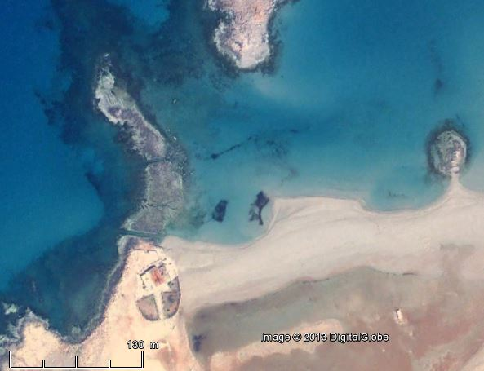
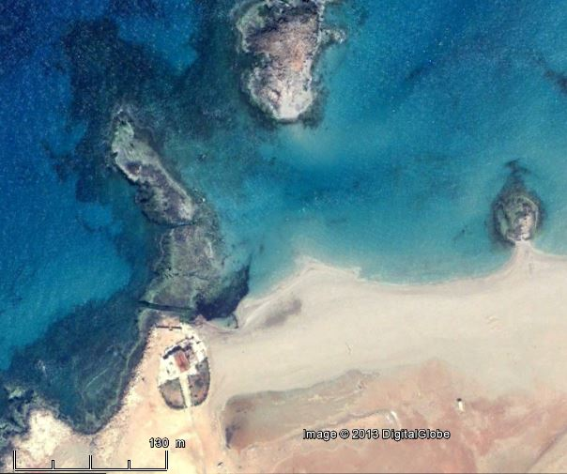
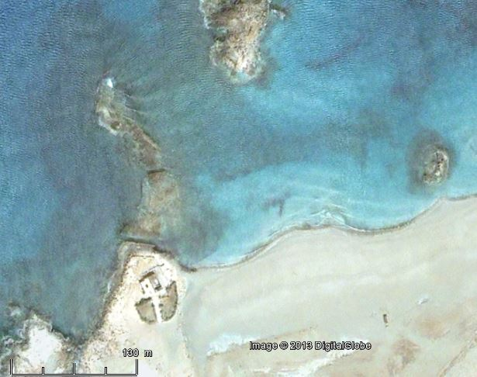
Channel 2
Channel 1
Tombolo effect
18/3/2009
Tombolo effect
29/3/2009
Calm
weather
morphology
19/3/2013
Notes:
Three pictures are available in calm weather conditions, showing morphological features above and under water.
Sand tends to reach out towards the islets as a consequence of the local shelter provided by the islets. This morphological feature is called a tombolo and shows very clearly the mean direction of approach of waves: N to NW.

Slide 6
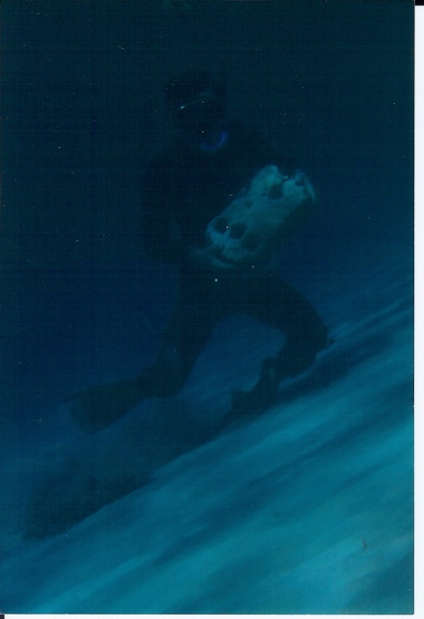
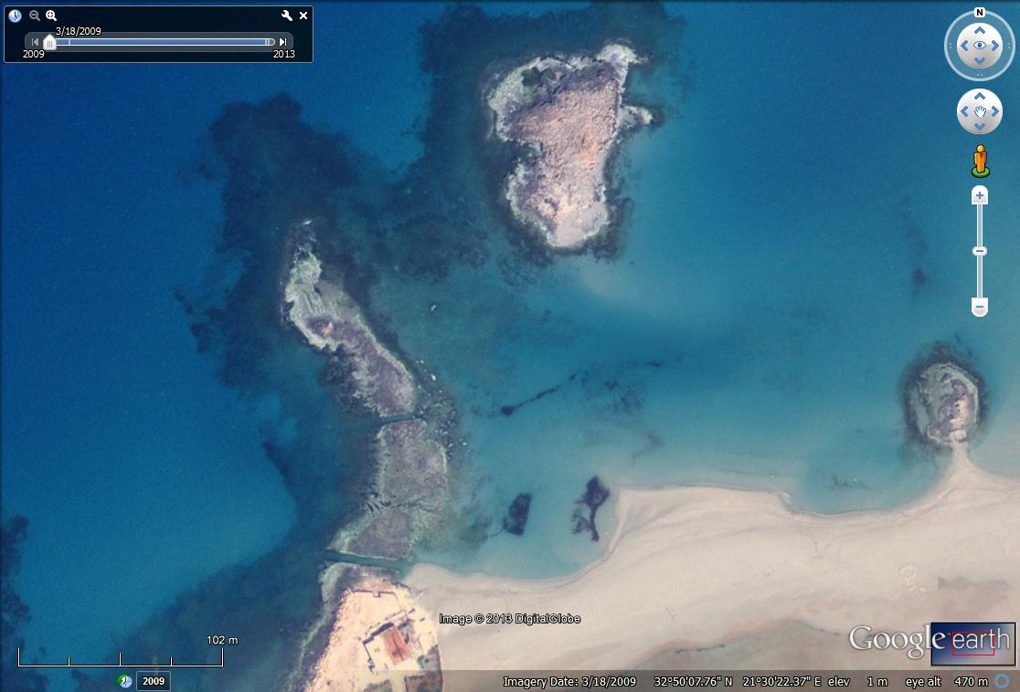
Prevailing NW waves
35-40°
- 1 m
Current from
de-silting
channel
40 m
200 m
- 4 m
- 2 m
Slope =
angle of
repose
- 1 m
18/3/2009
Notes:
Channel 2 was identified by JP Misson as a de-silting channel cleaning the anchorage area from sand deposits.
The current in this channel is due to waves incoming from the N to NW direction.
This current seems to have maintained the anchorage area at a water depth of around 4 m over a length of around 200 m and a width of around 40 m. This is remarkably efficient!
The South slope of the anchorage area is made of sand staying at its angle of repose of 35-40° as can be seen on the underwater picture.
The stretch between the rock outcrop on the west side and the northern islet is around 1 m deep and consists of rock that might possibly be the remains of an ancient breakwater.

