Slide 1
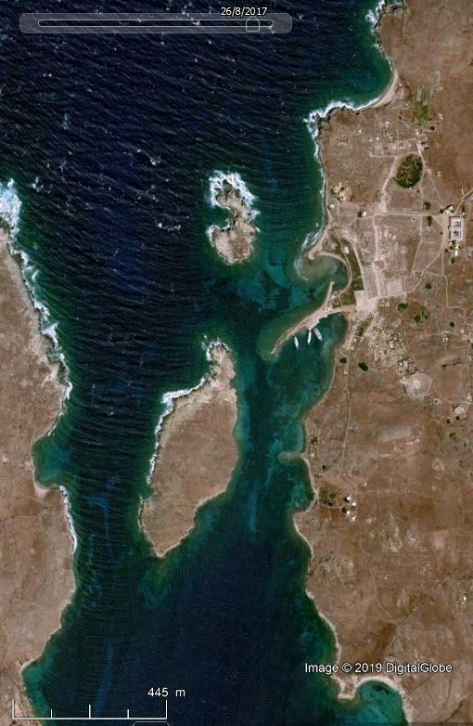
Skardhana bay
Lesser Remmatia
Grand Môle, ancient large mole
Sacred Port
Modern breakwater
Commercial port
Pointe des pilastres
Larger Remmatia
Isle of Delos
Isle of Rheneia
Fourni bay

Slide 2
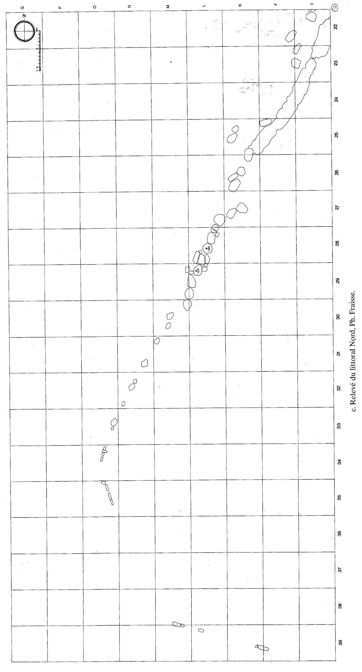

Slide 3
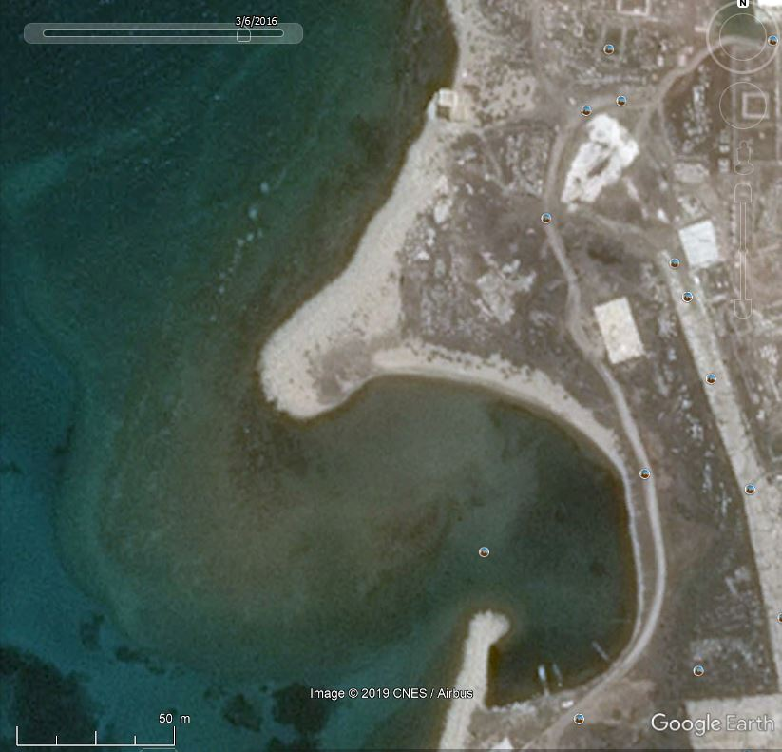

Slide 4
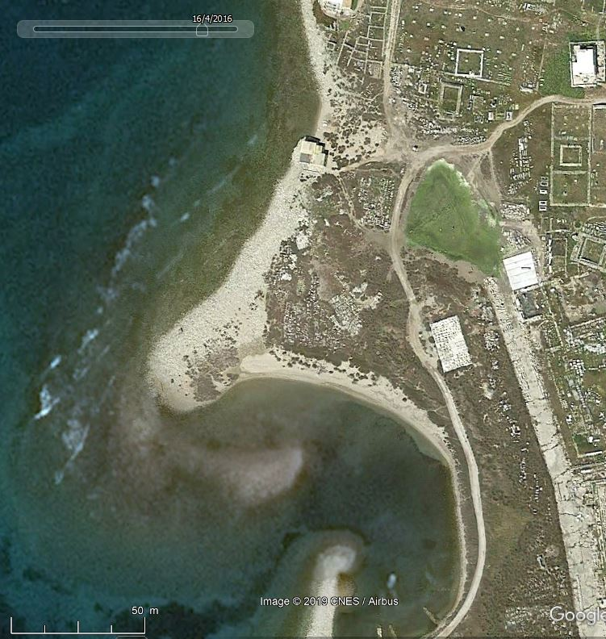

Slide 5
