Slide 1
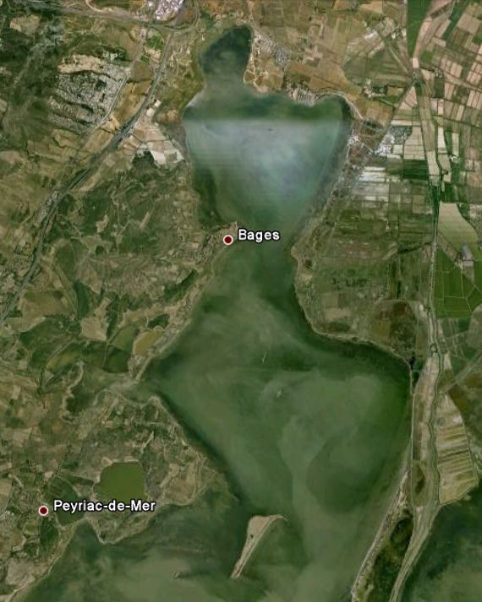
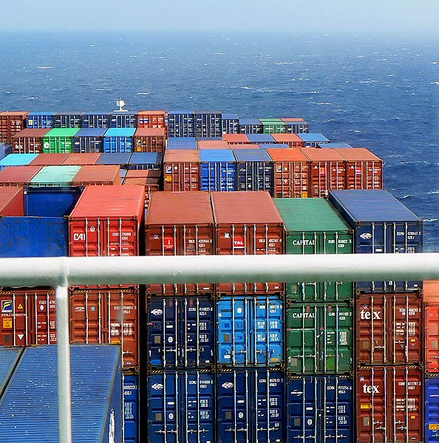
Bages
Narbo
La Nautique
Castélou
What do you see??
Captain, what do you see? Nothing within 500 m!
North
Ile de la
Margotte
Ile de
Planasse
Notes:
What do you see from the bridge of a ship ??
Modern ship: nothing within 500 m !
Ancient ships nearing Narbo: not much either !

