Slide 1
Ashdod
Geological Profile
N
Geological Profile

Slide 2
Ashdod

Slide 3
Ashdod

Slide 4
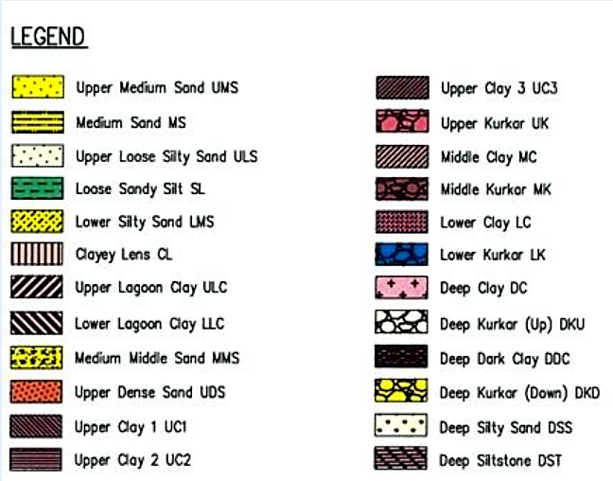
Ashdod
Good nearshore foundation conditions:
At a water depth of 5 to 10 m, on top of the kurkar ridge, the geological profiles show a thin layer of Medium Sand resting upon a 10 m thick layer of Dense Sand.
The kurkar layer underneath is 15-20 m thick.
But the 3 kurkar layers rest on clay layers which are not called “stiff clay”.

Slide 5
Ashdod
Weak breakwater foundation conditions :
At a water depth of 10 to 20 m, below the existing main breakwater, the geological profiles show Medium Sand and liquefiable Loose Silty Sand and Sandy Silt on the first 20 m below the sea bed.
These layers rest upon more stable Dense Sand.
All of these layers rest upon compactable clays UC1, UC2, UC3.
Even the 3 underlying kurkar layers rest on clay layers which are not called “stiff clay”.

Slide 6
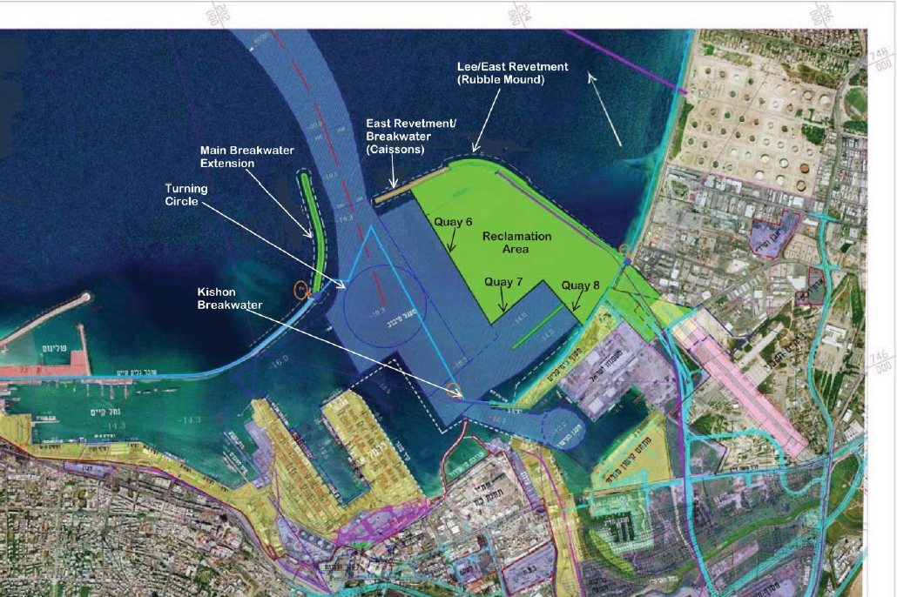
Haïfa
N
Geological Profile

Slide 7
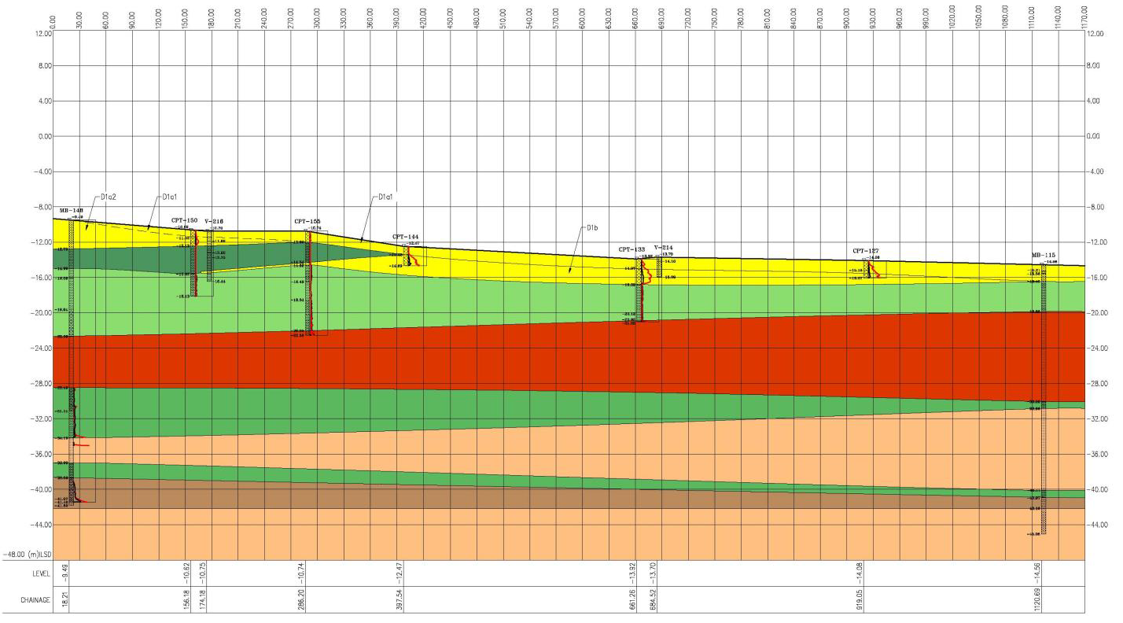
Haïfa Geological Profile along Quay 6

Slide 8
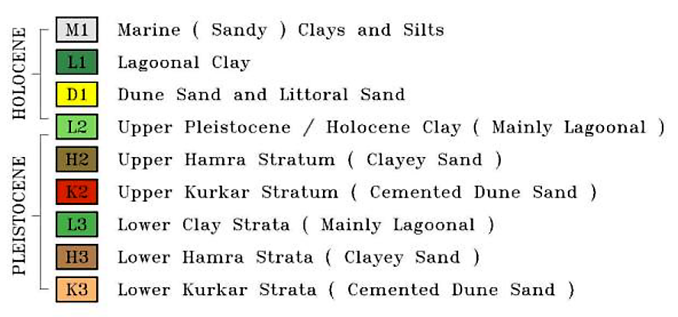
Haïfa
Weak quay foundation conditions :
At a water depth of 10 to 12 m, the geological profile shows
Several meters of D1 sand resting upon several meters of soft L1 lagoonal clay. A 5-8 m layer of L2 clay is resting upon a 5-8 m layer of K2 kurkar resting on older clay layers.

Slide 9
Caesarea Maritima
Caesarea is located between Ashdod and Haïfa.
Ashdod and Haïfa show many geological similarities:
Weak sea bed layers consisting of (loose) sand,
resting on clay layers,
resting on one or several kurkar layers,
resting on older clay layers.
The upper sandy sea bed layer may be considered liquefiable.
The upper clay layer may still have potential for consolidation.
The deeper clay layers may further consolidate if loaded by a new structure like a breakwater.
New corings and geotechnical studies conducted at Caesarea might enable quantification of subsidence that could possibly occur during the two millennia after construction of Herod’s port structures.

Slide 10
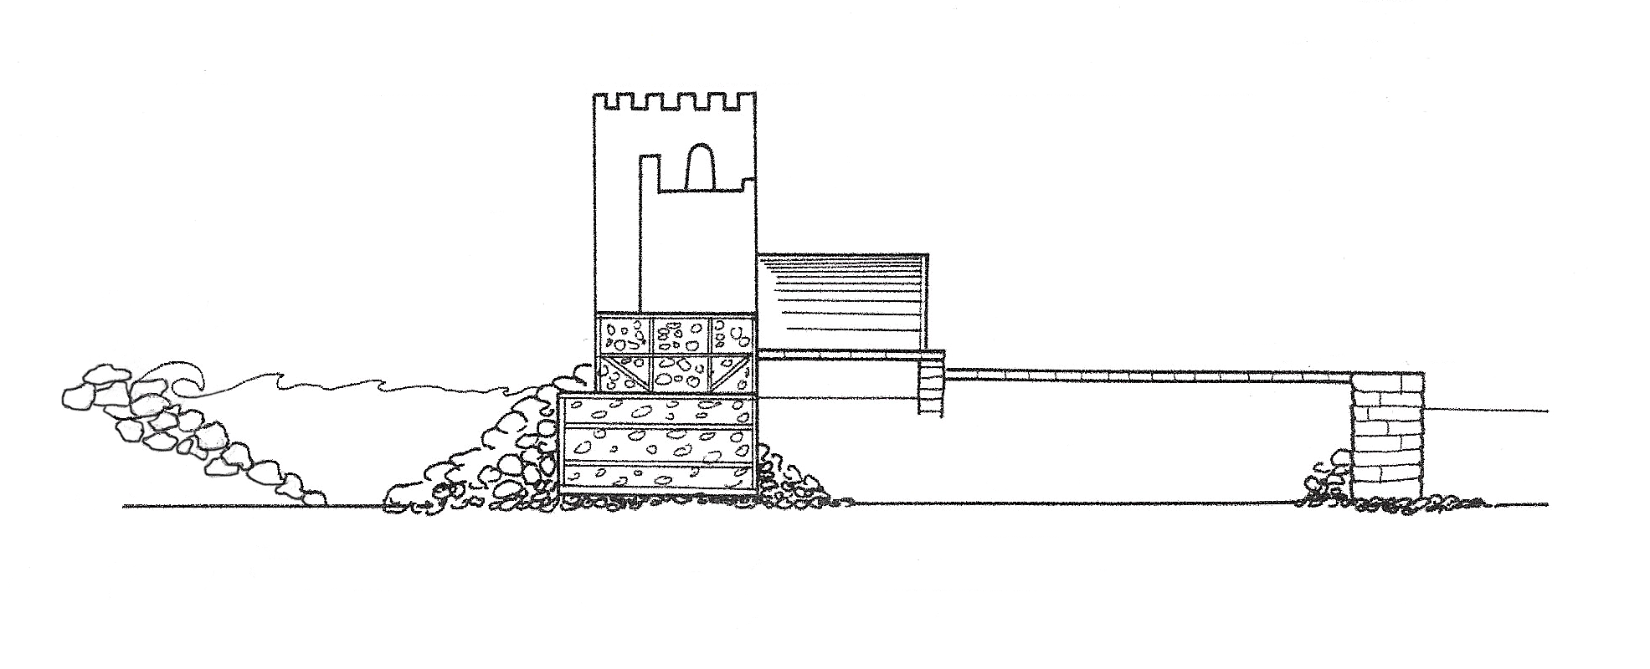
Present MSL
-5 / -6 m (area E)
-5 / -6 m (area C)
BW
sand
-8.5 m
20 - 30 m
5 m
ca. 20 m

Slide 11
Main
BW
Inner quay
‘’stable’’ MSL
Roman
BW
-2.5 m
-3.0 m
6 m tectonic subsidence
Present
-8.5 m
Main
BW
Inner quay
‘’stable’’ MSL
Roman
BW
-3.0 m
-8.5 m
6 m liquefaction subsidence
Present

Slide 12
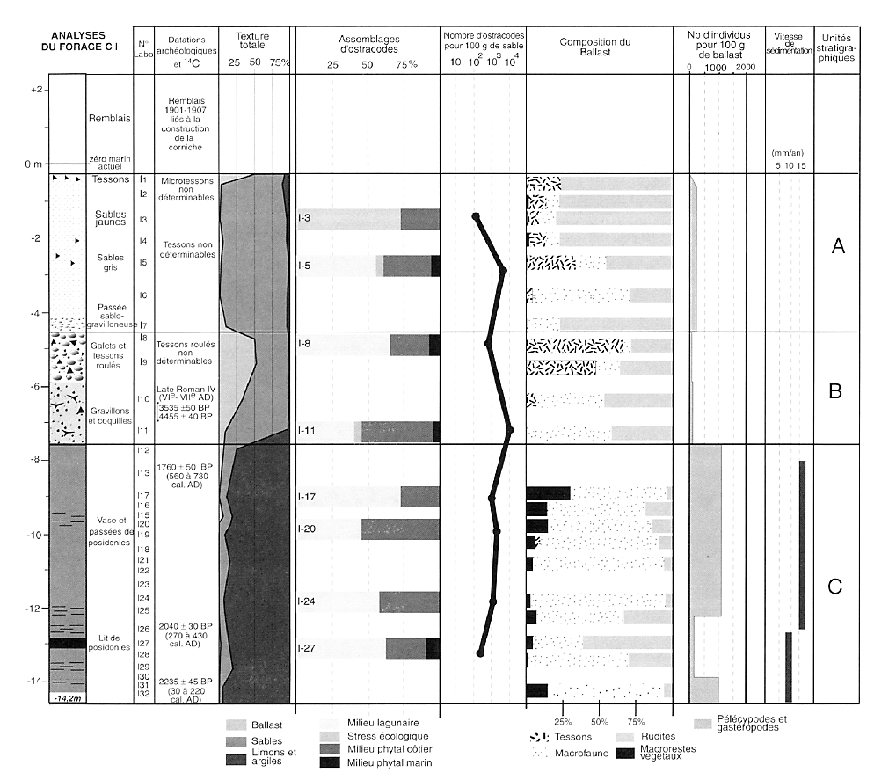
Alexandria
Core C1 31.2000°N 29.8944°E

Slide 13
Alexandria
Core C1 taken on land at the French Consulate of Alexandria:
Suppose the whole Portus Magnus area subsided 5 to 6 m in the 9th c. In that case, the top of the clay layer at -7.5 m (C unit) would have been at -2.5 to -1.5 m in Late Antiquity (560-730 cal AD) which corresponds to a sedimented harbour.
On top of this clay layer, we find 3 m of coarse materials (B unit) with mixed dating possibly corresponding to tsunami deposits.
We know about several earthquakes in Late Antiquity and Middle Ages that might have triggered both the sudden subsidence and the tsunami.
More, and deeper, corings would be needed to know more about subsidence in Alexandria’s Portus Magnus. Antirhodos island would be of particular interest as it is a kurkar ridge possibly resting on older clay layers, like in Ashdod.

Slide 14
SOURCES GOIRAN, J-P., et al., 2000, Évolution des rivages d'Alexandrie à l'Holocène récent, marge occidentale du delta du Nil, Egypte, in: Méditerranée, tome 94, 1-2-2000, Ports antiques et paléoenvironnements littoraux. pp. 83-90.
OREN, N., et al., 2018, Engineering and Environmental Impact of Dredging for Container Terminal, Bay Port, Haifa, Israel.
PAPARIS, B., 2017, New Marine Container Terminal at Haïfa & New Marine Container Terminal at Ashdod, AAPA - American Association of Port Authorities, 2017 Facilities Engineering Seminar
October 24-26, 2017.

