Slide 1
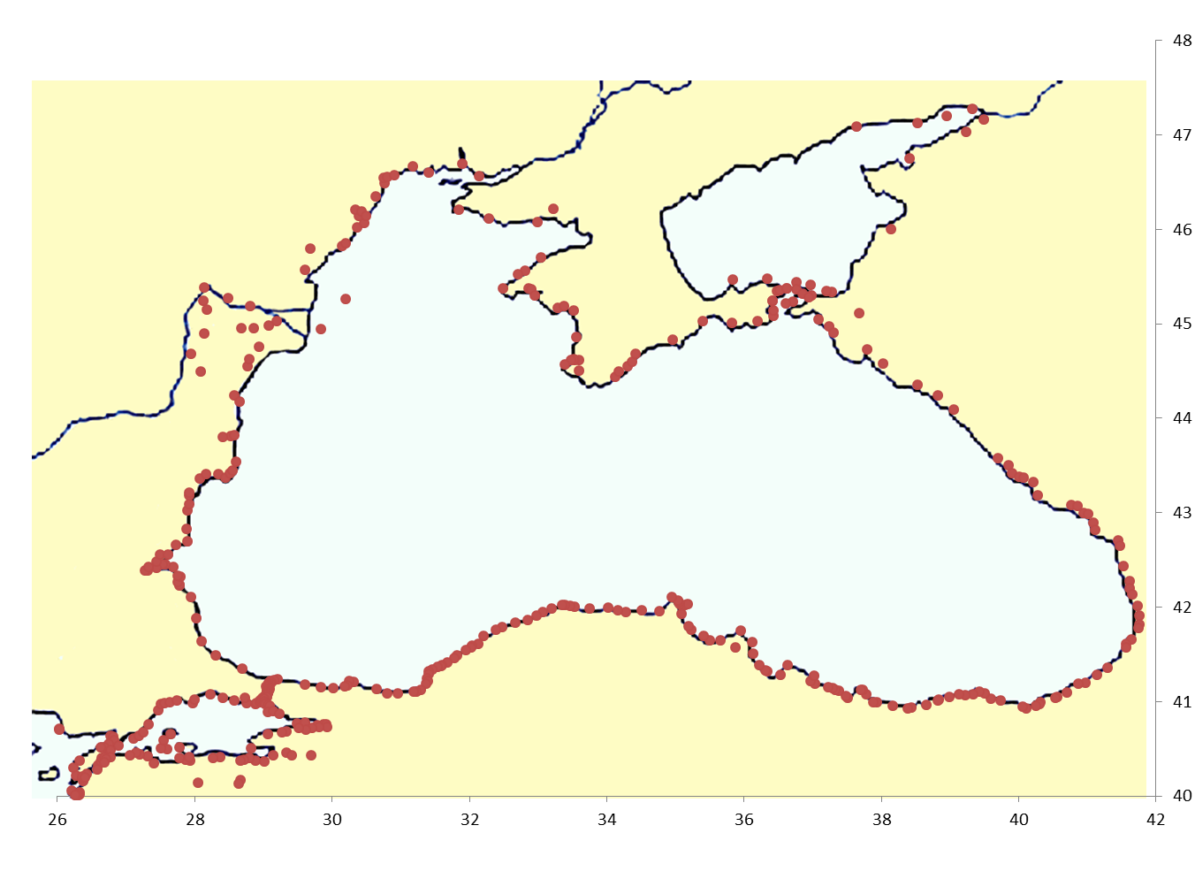
Scale:
100 nautical miles
1000 stadia
185,2 km
R. Don
R. Dniepr
Odessa
AZOV SEA
R. Danube
Latitude (deg. North)
Crimea
Kerch
Sebastopol
Novorossiysk
Constantza
Sotchi
Varna
BLACK SEA
Burgas
Sinop
Samsun
Batumi
Istanbul
Eregli
Trabzon
MARMARA
SEA
Çanakkale
Longitude (deg. East)

Slide 2
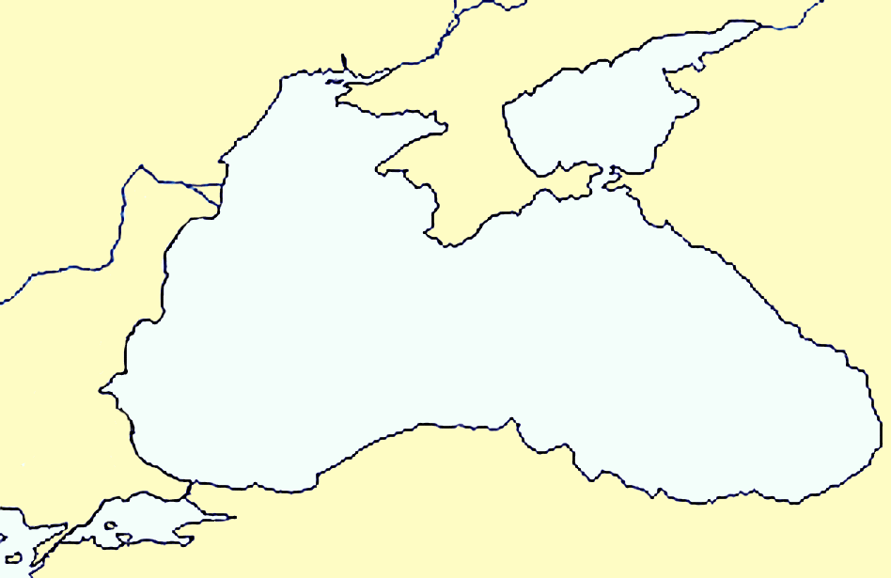
Scale:
100 nautical miles
1000 stadia
185,2 km
R. Don
R. Dniepr
Odessa
AZOV SEA
R. Danube
Latitude (deg. North)
Crimea
Kerch
Sebastopol
Novorossiysk
Constantza
Sotchi
Varna
BLACK SEA
Burgas
Sinop
Samsun
Batumi
Istanbul
Eregli
Trabzon
MARMARA
SEA
Çanakkale
Longitude (deg. East)

Slide 3
Scale:
1000 Roman stadia
100 nautical miles
185 km
R. Dniepr
R. Don
Odessa
AZOV SEA
R. Danube
Latitude (deg. North)
CRIMEA
Kerch
Sebastopol
Novorossiysk
Constantza
Sotchi
Varna
BLACK SEA
Burgas
Sinop
Samsun
Batumi
Istanbul
Eregli
Trabzon
MARMARA
SEA
Çanakkale
Longitude (deg. East)

