Slide 1
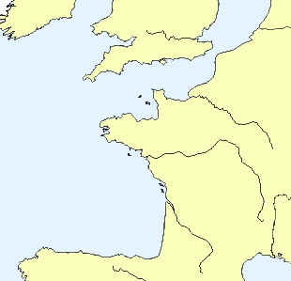
NORTH SEA
Rotterdam
R. Rhine
Scale:
1000 Roman stadia
100 nautical miles 185 km
Calais
CHANNEL
R. Seine
Latitude (deg. North)
Brest
R. Loire
Nantes
ATLANTIC OCEAN
Bordeaux
R. Garonne
La Coruna
Longitude (deg. East)

Slide 2
MER du NORD
Rotterdam
R. Rhin
Echelle: 1000 stades romains
100 milles nautiques 185 km
Calais
MANCHE
R. Seine
Latitude (deg. Nord)
Brest
R. Loire
Nantes
OCEAN ATLANTIQUE
Bordeaux
R. Garonne
La Corogne
Longitude (deg. Est)

Slide 3
MER du NORD
Rotterdam
R. Rhin
Echelle: 1000 stades romains
100 milles nautiques 185 km
Calais
MANCHE
R. Seine
Latitude (deg. Nord)
Brest
R. Loire
Nantes
OCEAN ATLANTIQUE
Bordeaux
R. Garonne
La Corogne
Longitude (deg. Est)

Slide 4
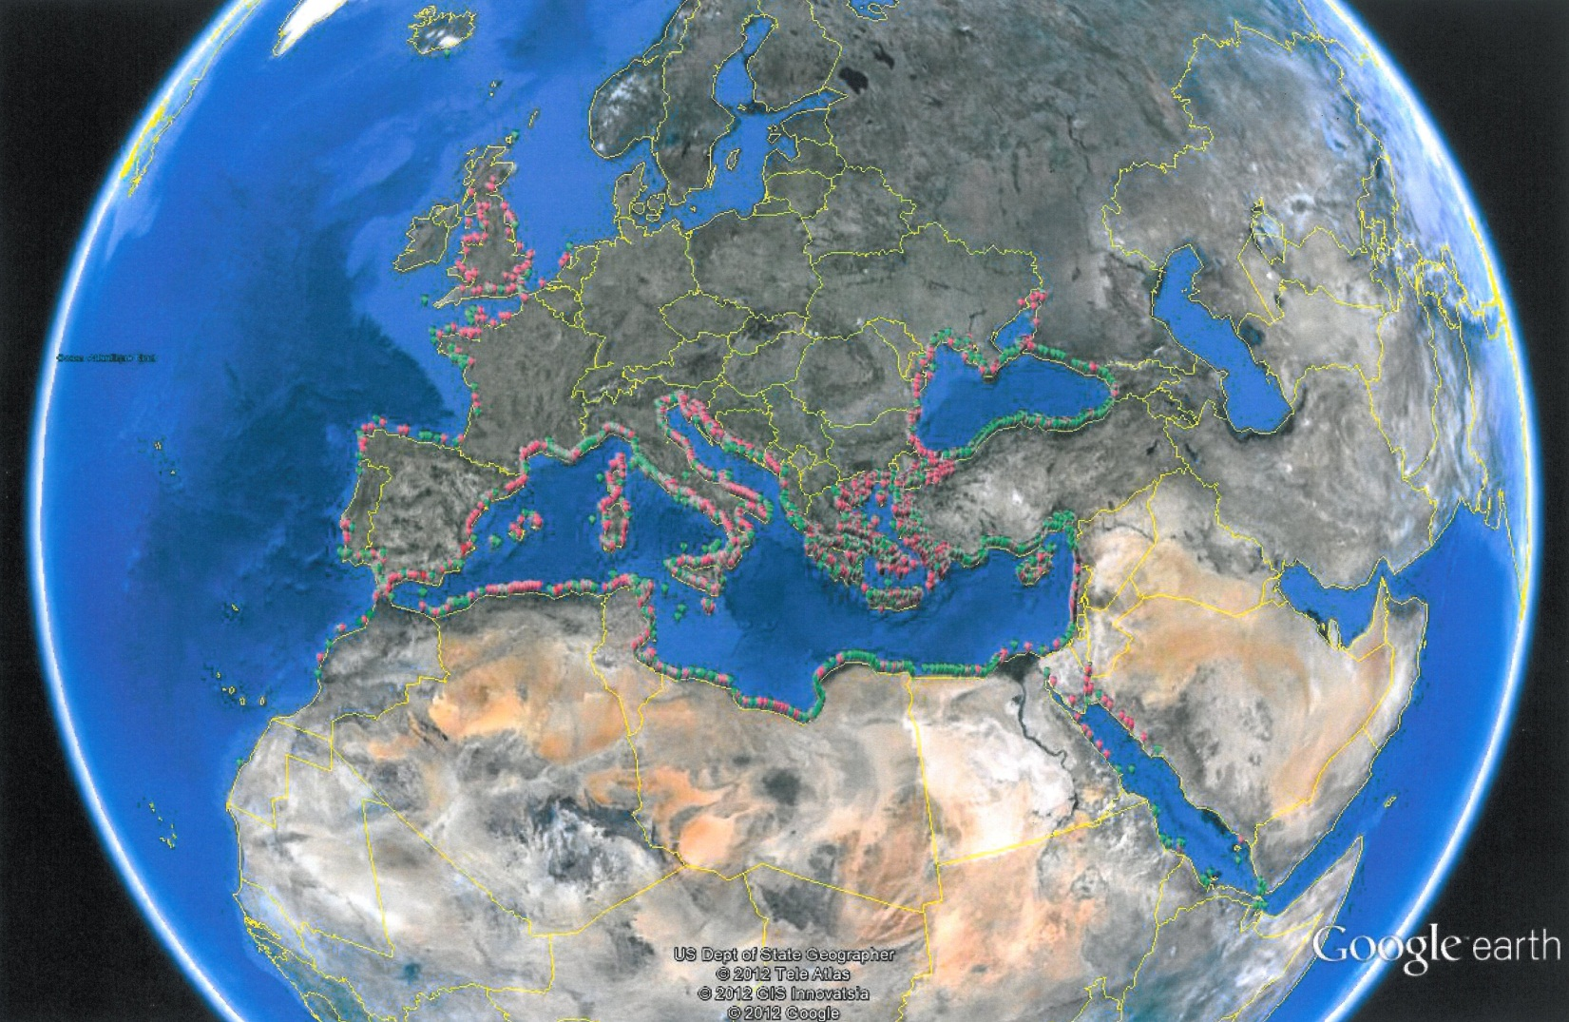
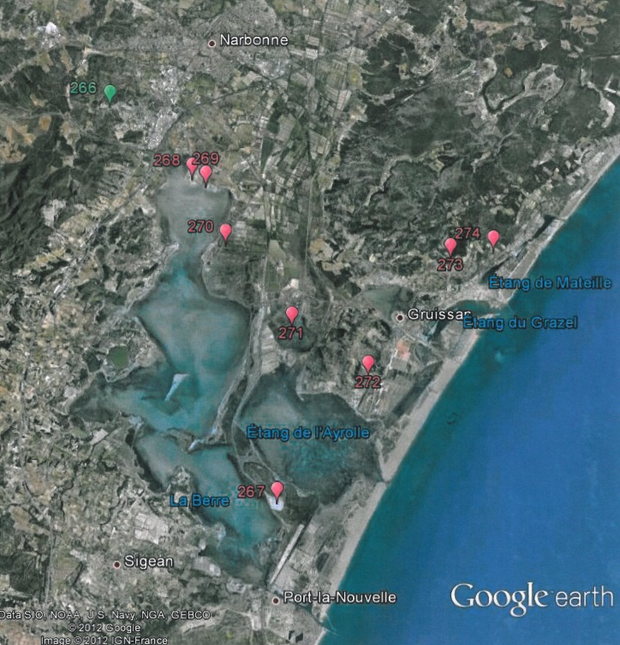
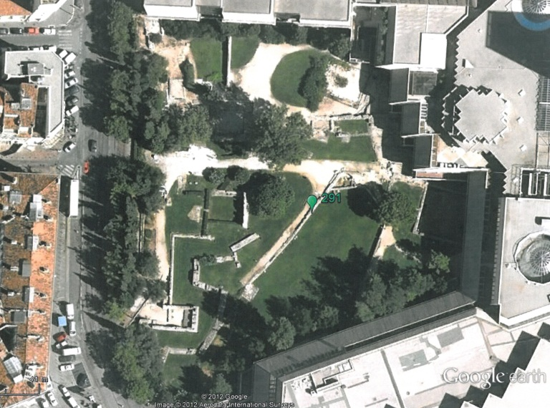
Ancient Ports Geolocation
4500 ancient
coastal settlements
harbours
ports
Zooming in with Google Earth

Slide 5
www.AncientPortsAntiques.com
This web site presents work done to collect, identify and locate ancient harbours and ports.
It is based on a study of existing documentation and does not aim to find other unknown ports.
The result is a list of around 4500 ancient ports based on the writings of 81 ancient authors and a many modern authors, incl. the Barrington Atlas.

Slide 6
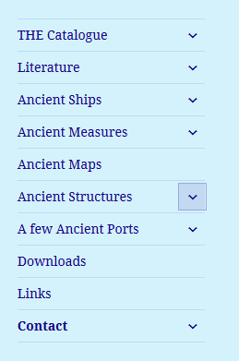
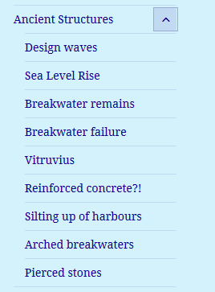
www.AncientPortsAntiques.com

Slide 7
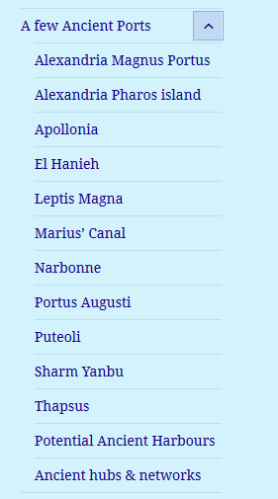
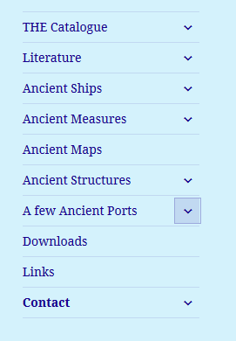
www.AncientPortsAntiques.com

Slide 8
Ancient sites between R. Rhine and La Coruna
COUNTRY | sites
The Netherlands | 14
Flanders | 4
France West | 119
Spain North | 31
Total | 168
Average of one every 10 nautical miles

Slide 9
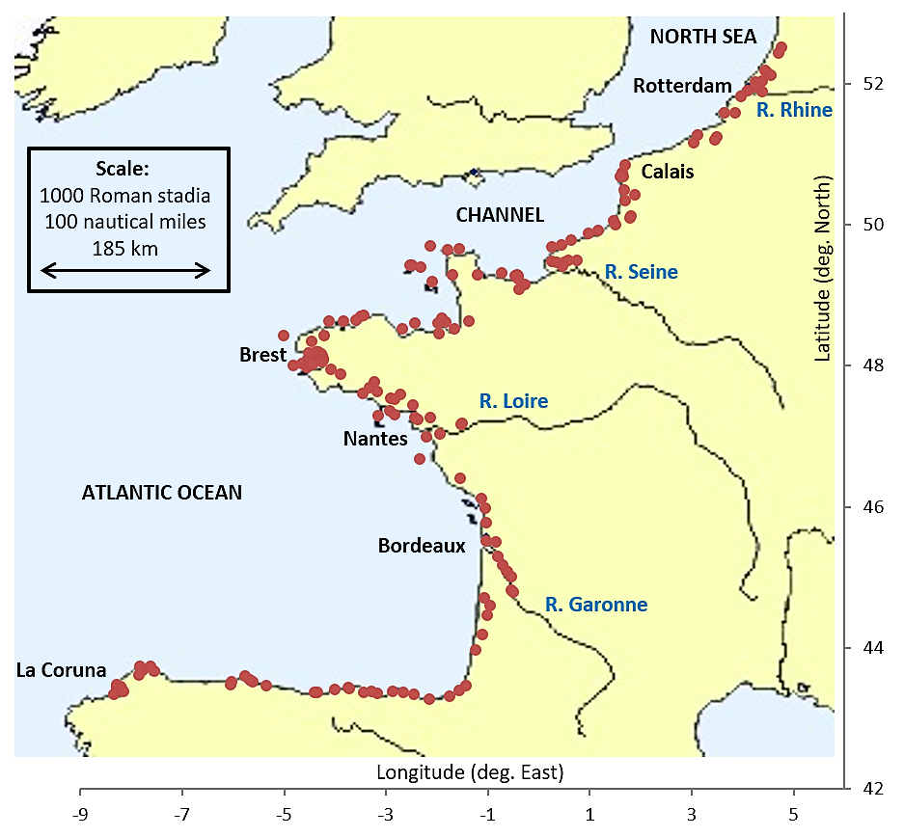
Ancient Harbours on the Atlantic Arc

Slide 10
Areas for potential Ancient Harbours on the Atlantic Arc

Slide 11
Areas for potential Ancient Harbours on the Atlantic Arc
Between Ostende and Calais: Ostende, Nieuwpoort, Dunkerque, Gravelines, Calais
Cotentin: R Ay, Regnéville, Granville,
Brittany’s north coast between St Brieuc and Le Conquet: R Trieux, Tréguier, Baie du Kernic, Aber Benoît, Aber Wrac’h, Portsall, Aber Ildut,
Brittany’s south coast between Audierne and Lorient: Loctudy, Bénodet, Cap Coz, Concarneau, Pouldohan, R Aven, R Bélon, Brigneau, Merrien, Guidel,
The Loire estuary downstream of Nantes,
Vendée: St Gilles Croix de Vie, Sables d’Olonnes,
Poitou-Charentes: ile de Ré, ile d’Oléron,
Aquitaine: Cap Breton,
Asturias, east and west of Gijon: Pechon, Llanes, San Antolin de Bedon, Ribadesella, Villaviciosa, Aviles, Luarca, Navia, Ribadeiro.
Galicia, rias north and south of La Coruna: Viviero, Barqueiro, Cedeira, Betanzos, Camarinas.

Slide 12
Some Potential Ancient Harbours listed here may be recognised by some expert as ancient harbours already known to him and the present author will be delighted to hear about that in order to remove such places from the list of ‘potential’ ancient harbours …

Slide 13
Merci de votre attention

