Slide 1
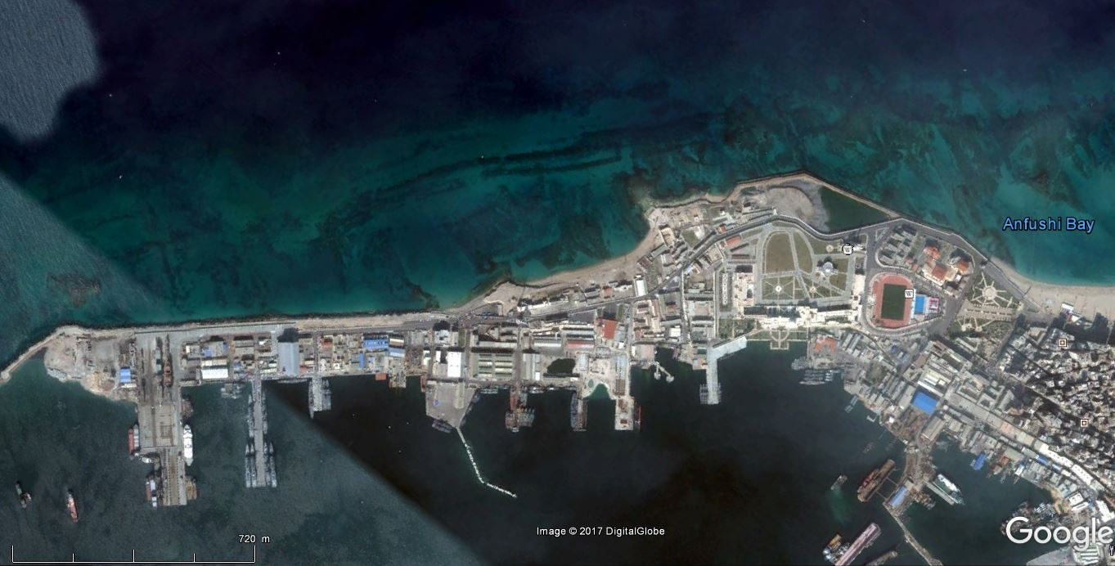
Gaston Jondet 1916
Google Earth 20/1/2015
N

Slide 2
Gaston Jondet 1916 on
Google Earth 20/1/2015
northern basin 5 to 8 m
east reef
N
‘outside basin’
offshore breakwater
north breakwater
beach/1 m basin
‘outside basin’
eastern basins
creek
western basin
port authority
beach/1 m basin
Abou Bakar reef
small basin
harbour basin breakwater offshore remains
harbour main entrance ca 8 m depth
SW breakwater
SE breakwater
Scale

Slide 3
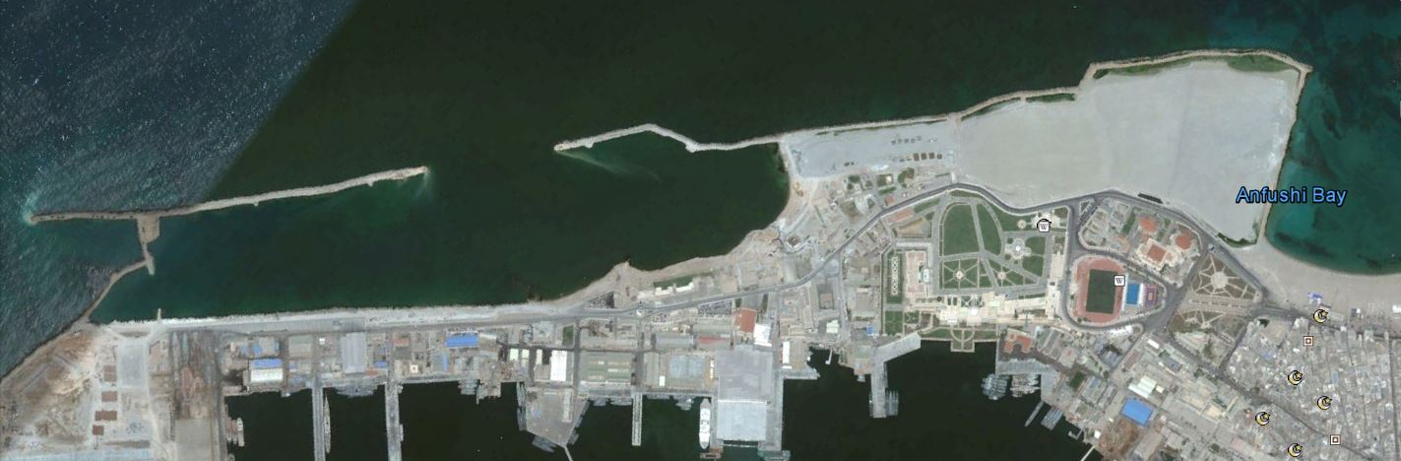
New 2017 land reclamation on Pharos island
Google Earth 20/1/2015
N
Google Earth 16/4/2017
ancient breakwaters
Land reclamation
new breakwaters
new breakwater

