Slide 1
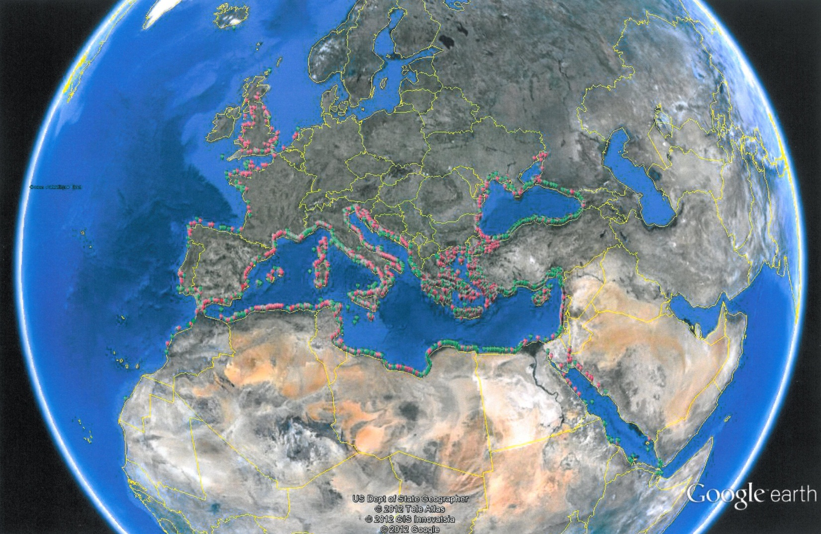
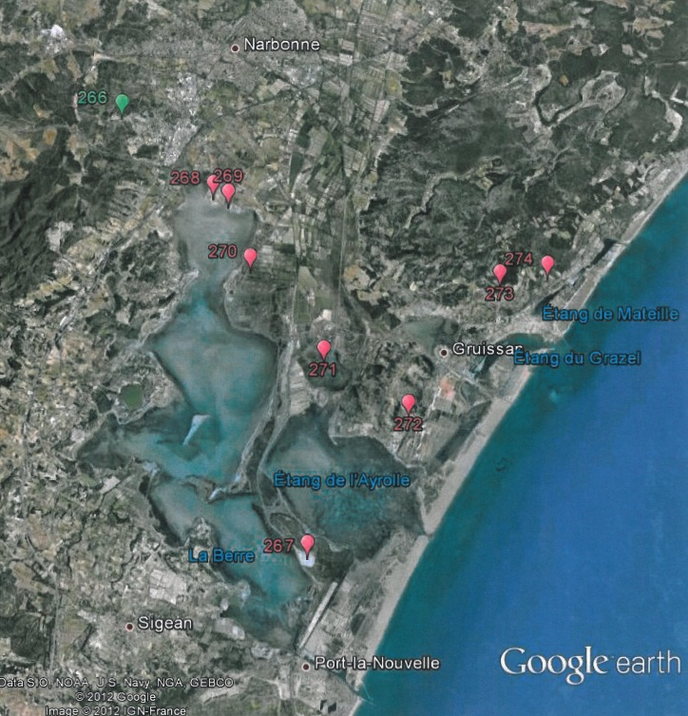
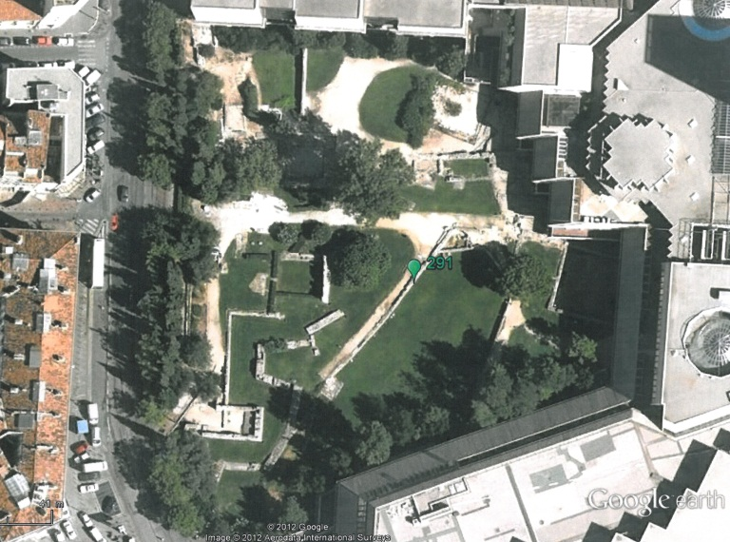
Ancient Ports Geolocation
3500 ancient
coastal settlements
harbours
ports
Zooming in with Google Earth

Slide 2
www.AncientPortsAntiques.com
This web site presents work done to collect, identify and locate ancient harbours and ports.
It is based on a study of existing documentation and does not aim to find other unknown ports.
The result is a list of around 3500 ancient ports based on the writings of 66 ancient authors and a some modern authors, incl. the Barrington Atlas.

Slide 3
Would you believe that a shelter that is considered today as ‘excellent’ from a nautical point of view would not have been used in ancient times, at least as a bad weather refuge shelter?
The aim of the present study is to list ‘Potential Ancient Harbours’ from a comparison of ‘excellent’ modern shelters and recognised ancient coastal settlements

Slide 4
A list of 229 sites was obtained from the comparison of ancient and modern shelters
COUNTRY | PAH
Spain & Portugal | 11
Baleares islands | 19
France West & South & Corsica | 4
Italy, Sicily, Sardinia, other islands and Malta | 12
Adriatic Sea | 55
Greece & Crete | 31
Black Sea | 3
Turkey West & South | 8
Red Sea & Oman & Somalia | 84
Levant, Cyprus & North Africa | 2
Total | 229

Slide 5
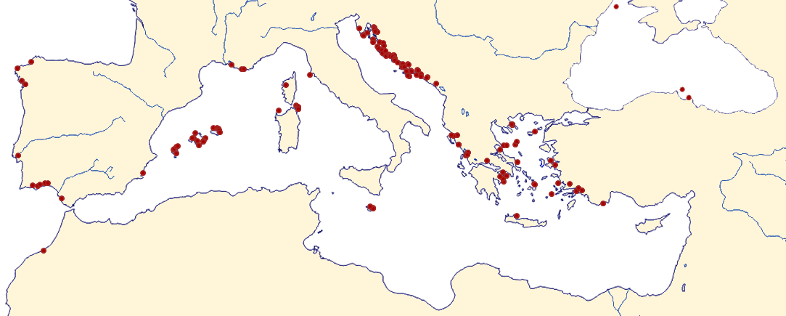
Potential Ancient Harbours in the Mediterranean area

Slide 6
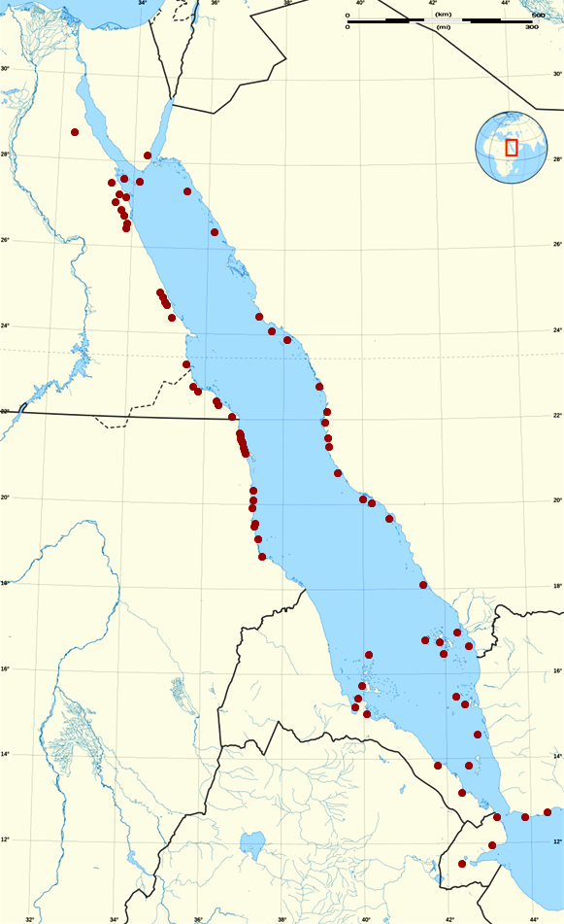
Potential Ancient Harbours in the Red Sea

Slide 7
Some Potential Ancient Harbours listed here may be recognised by some expert as ancient harbours already known to him and the present author will be delighted to hear about that in order to remove such places from the list of ‘potential’ ancient harbours …

Slide 8
xxxxxxxxxxxxxxx

Slide 9
xxxxxxxxxxxxxxx

