Slide 1
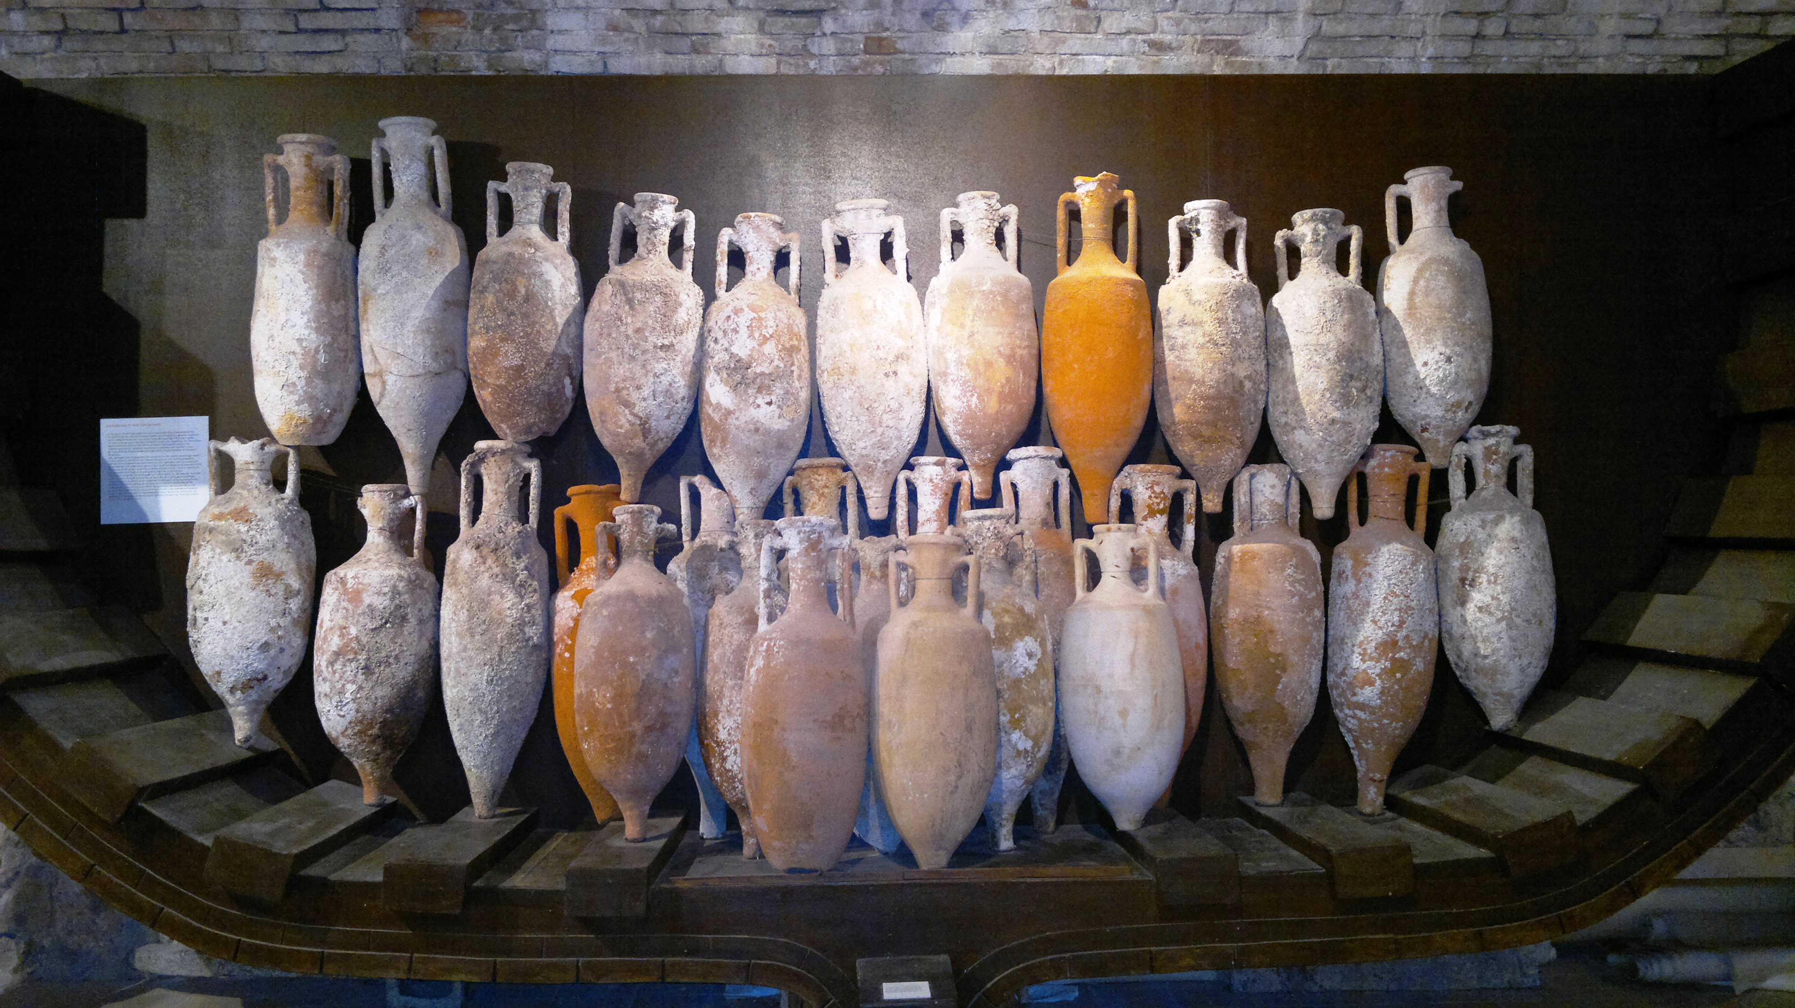
From Amphora to TEU: Journey of a container An engineer’s perspective
Arthur de Graauw
Portuslimen: Rome’s Mediterranean Ports (RoMP) BSR – Roma – 27/1/2017
Notes:
First of all, thanks a lot to Simon & Pascal for inviting me here.
…. Yes I am a port & coastal engineer … trying to understand something about ancient ports !
Comparing ancient & modern maritime logistics is a vast subject, so I have to be a bit schematic. See my paper for more details
In order to keep you awake I’ll start with technical details on ships & sailing, but I’ll conclude with some more general aspects.
So I’ll go from detail to general.

Slide 2
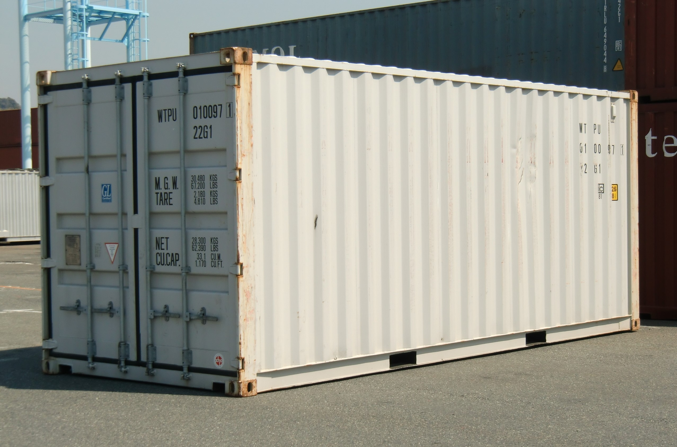
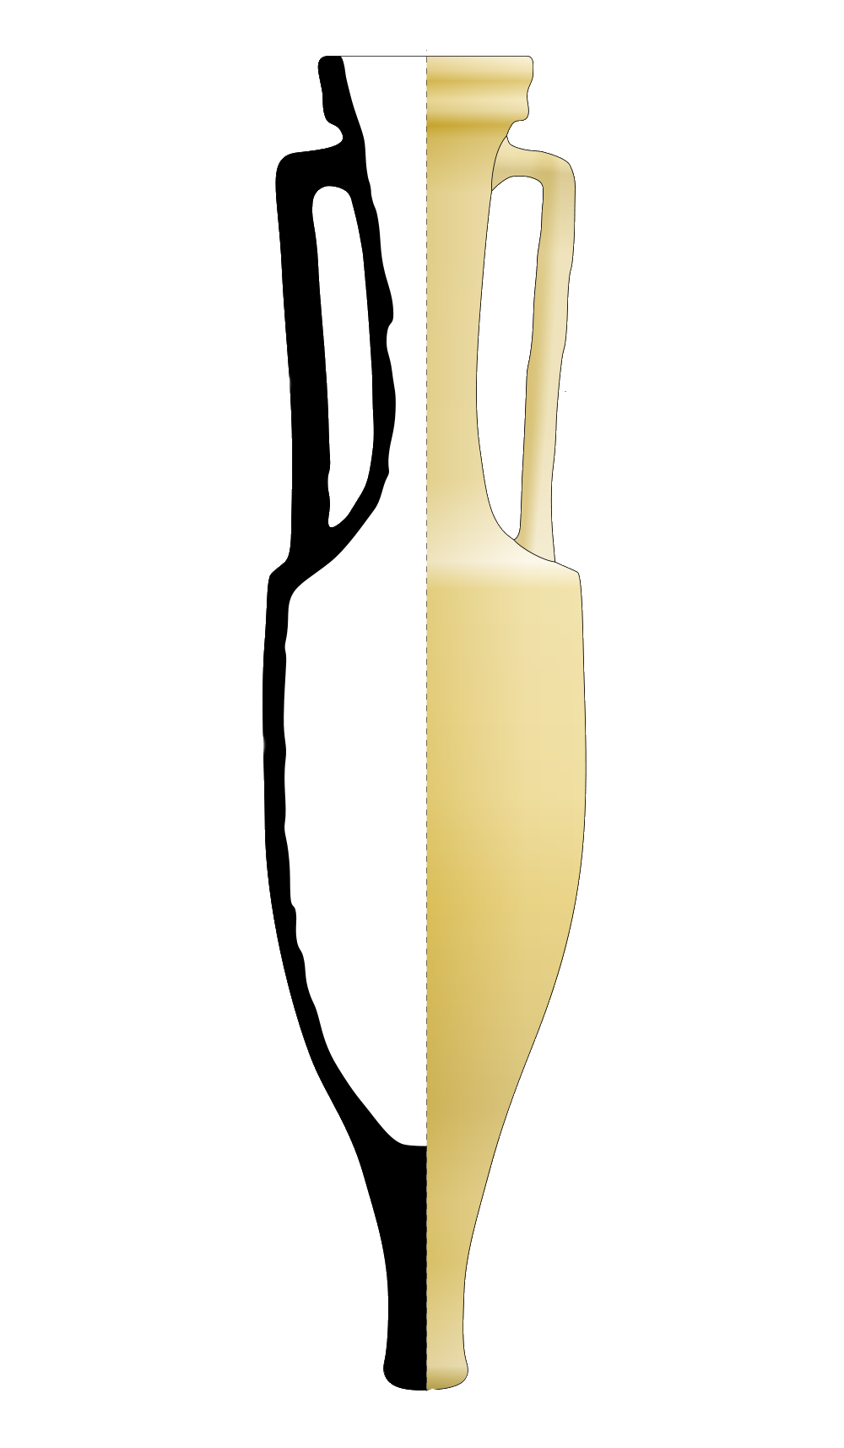
Containers
TEU: 20 ft x 8 ft x 8 ft 6 in = 6.10 x 2.44 x 2.59 m, 30 ton (7% tare)
Dressel 1B: 1.00 to 1.22 m, dia 0.30 m, ca 50 kg (50% tare)
One TEU = nearly 500 amphorae (25 ton)
Notes:
TEU stands for « Twenty foot Equivalent Unit ».
It is about 6 m long and 2.5 m high and wide.
This TEU is used for counting numbers of containers on board ships, in ports, etc.
But the double TEU, of forty feet, is more common.
It is the container you can see on trailers on the roads.
Compared to the Dressel 1B amphora, a TEU would contain about 500 of them.
Note also that the tare is only 7% of the total weight, instead of 50% for an amphora.

Slide 3
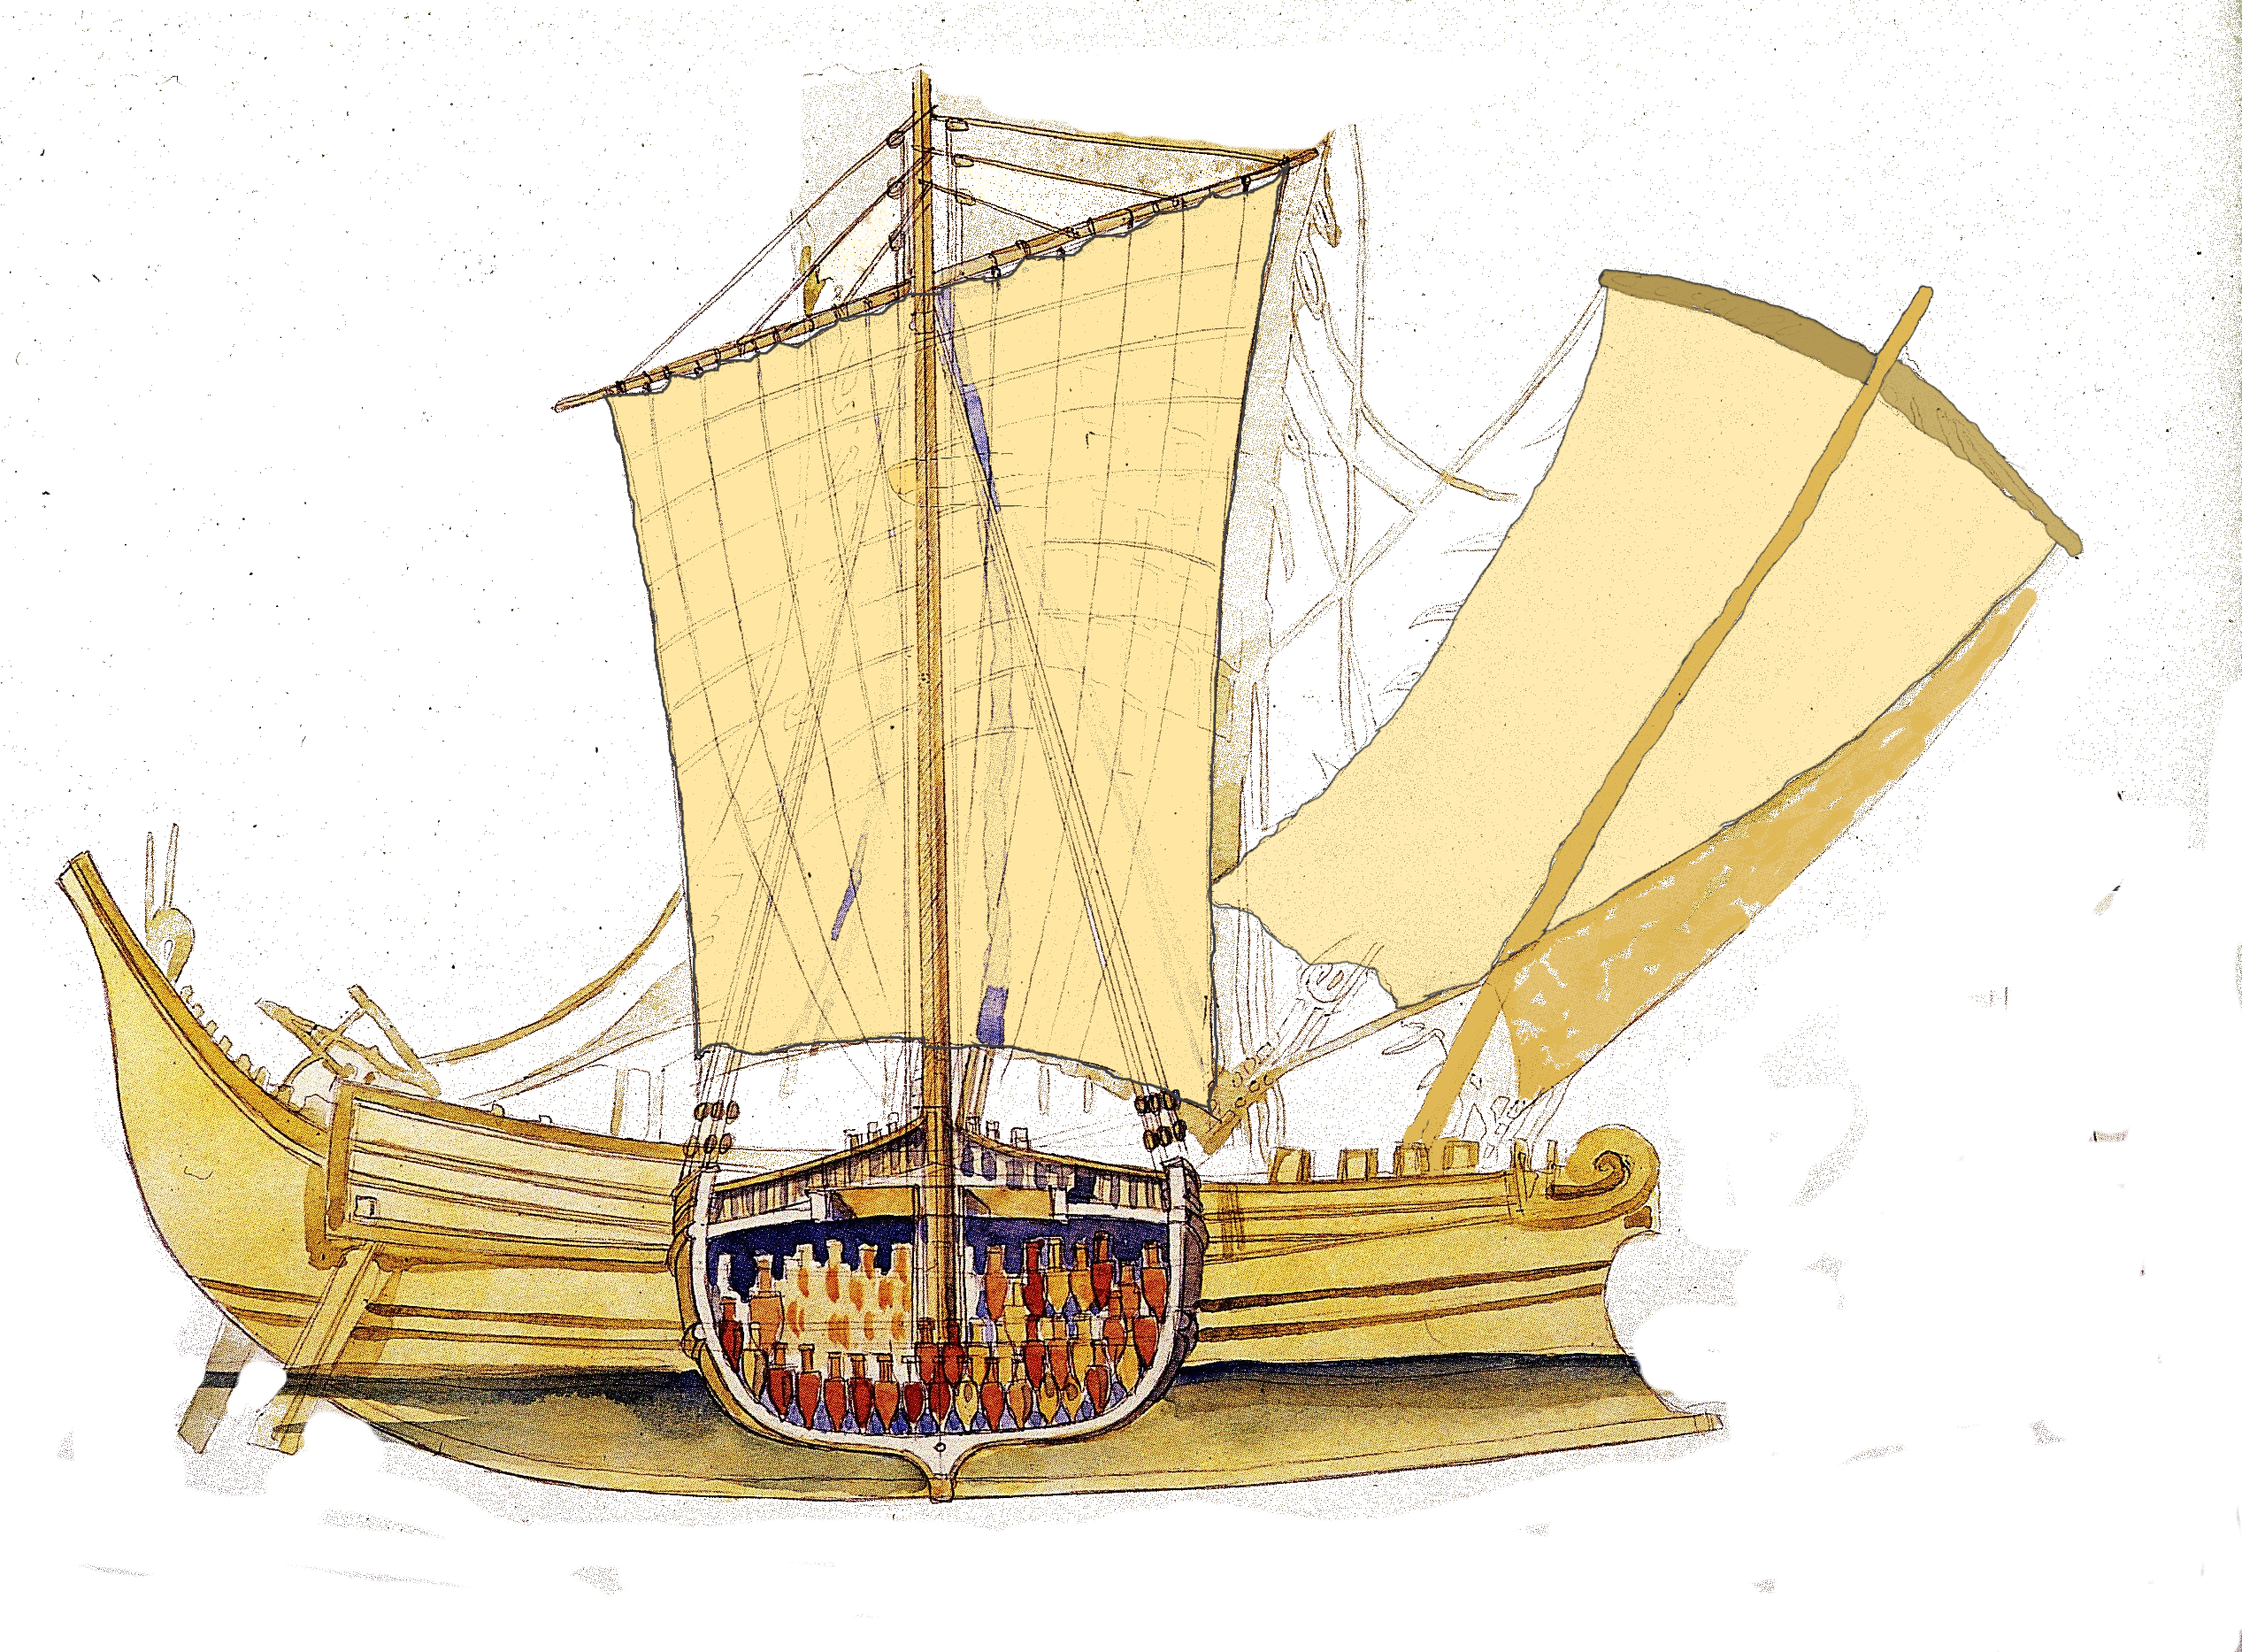
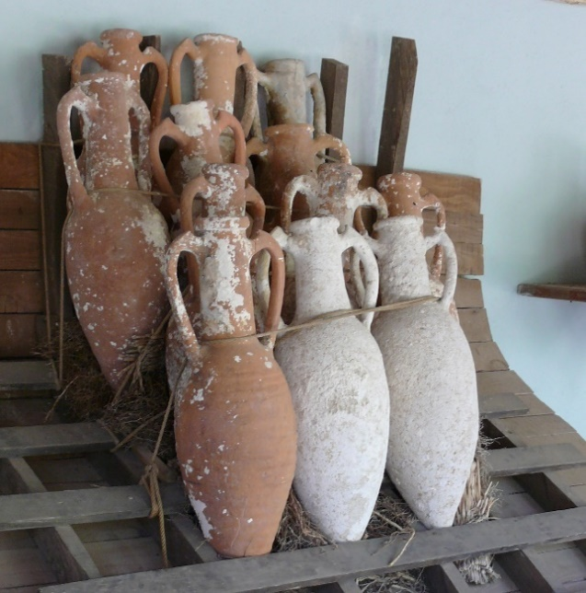
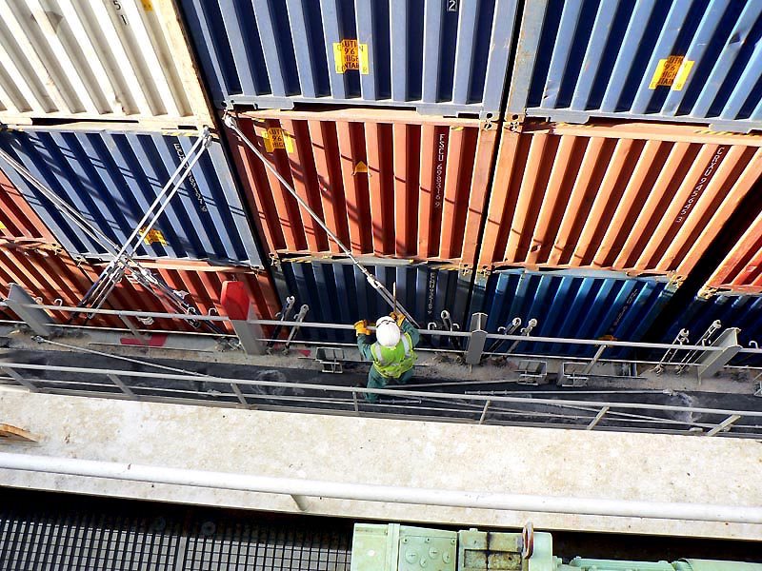
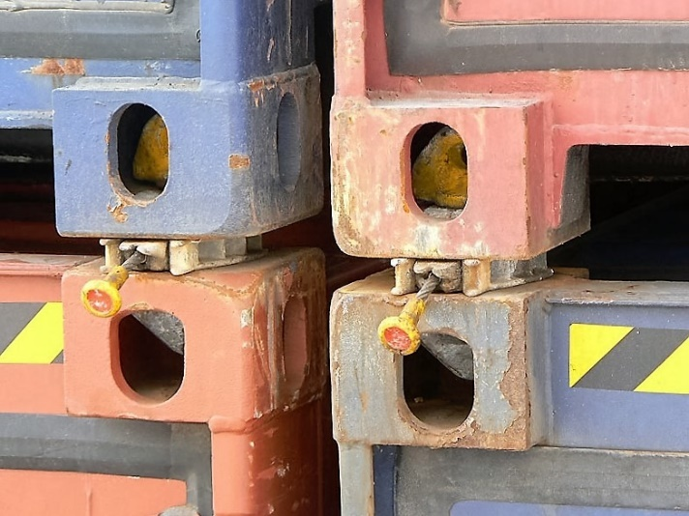
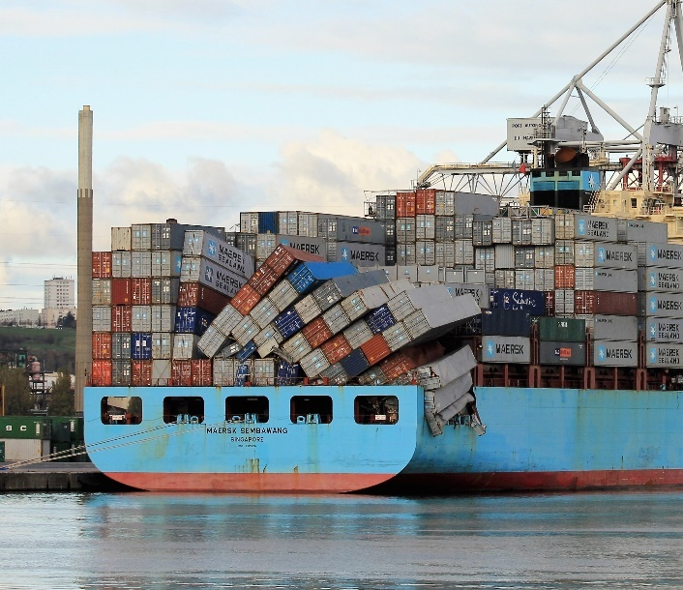
Stowage
Twistlocks
Lashing bars
Bodrum Museum of Underwater Archaeology
Notes:
This gives a general idea of the ships:
The Marco Polo is one of the biggest modern container ships: 400 m long for 200 000 tons
The Madrague de Giens is one of the large ancient ships: 40 m long for 400 tons
Stowage on board is most important in order to keep cargo in good condition:
On ancient ships amphorae were placed on a chock absorbing layer, possibly straw or pozzolana
On modern ships, containers are fastened to each other with twistlocks and tied up with lashing bars
Accidents happen rarely …

Slide 4
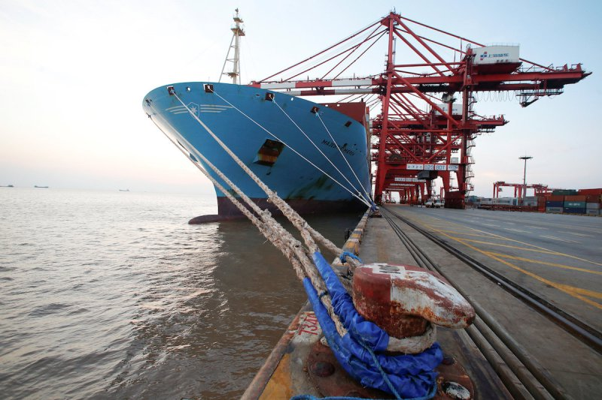
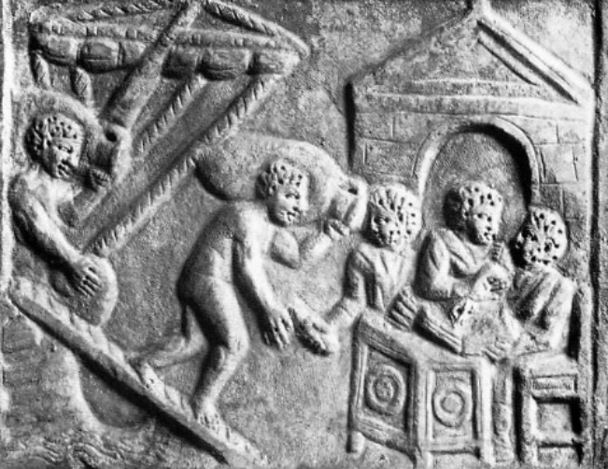
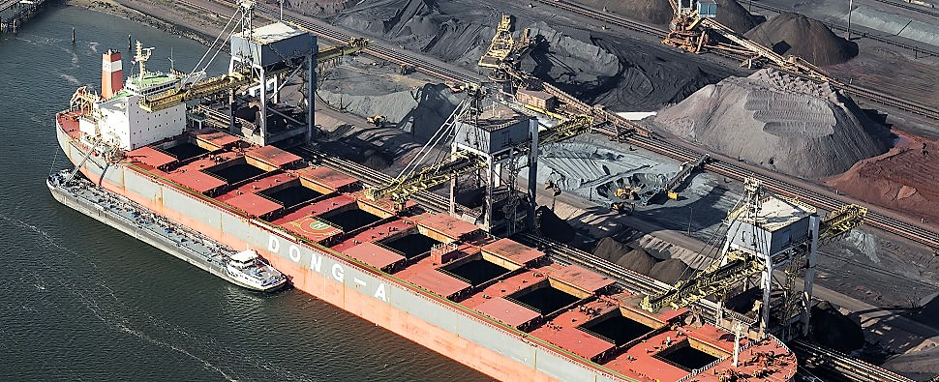
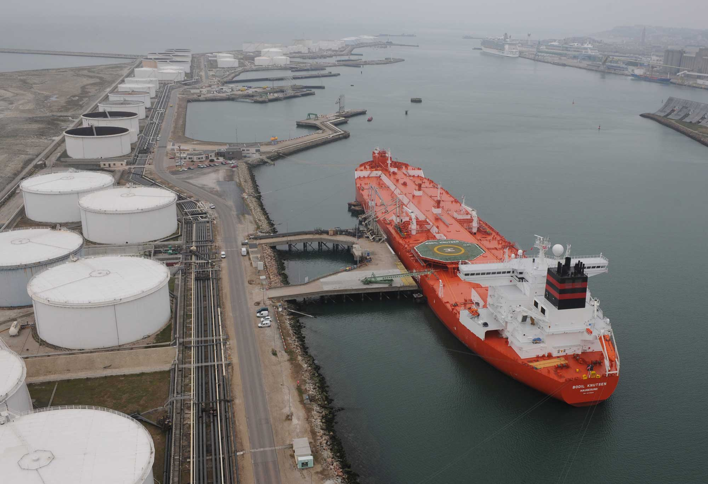
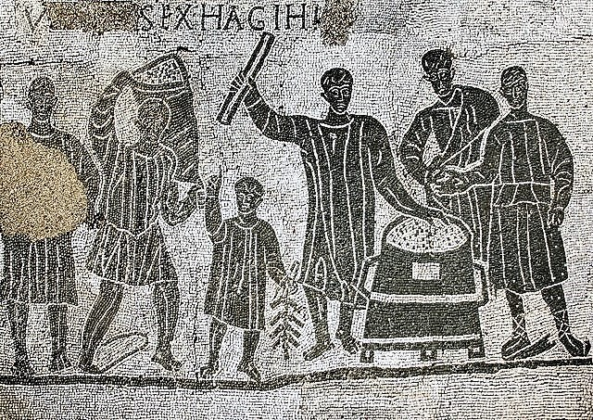
(un)Loading
containers
Ostia
ore & coal
oil
Aula dei Mensores (Ostia)
Notes:
Loading & unloading ancient ships was a fully manual job, except for some cranes used for boxes with wild animals.
Modern ships are loaded & unloaded with gantry cranes:
Up to 5 or 6 cranes on a container ship, so it can be handled within 1 or 2 days
Large cranes and grabs for iron ore & coal
Large pumps for oil
Measurement of quantities is always done at loading & unloading.

Slide 5
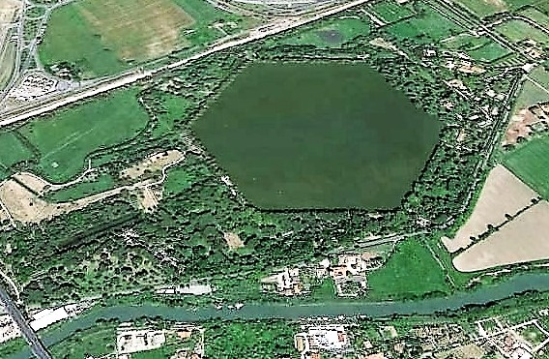
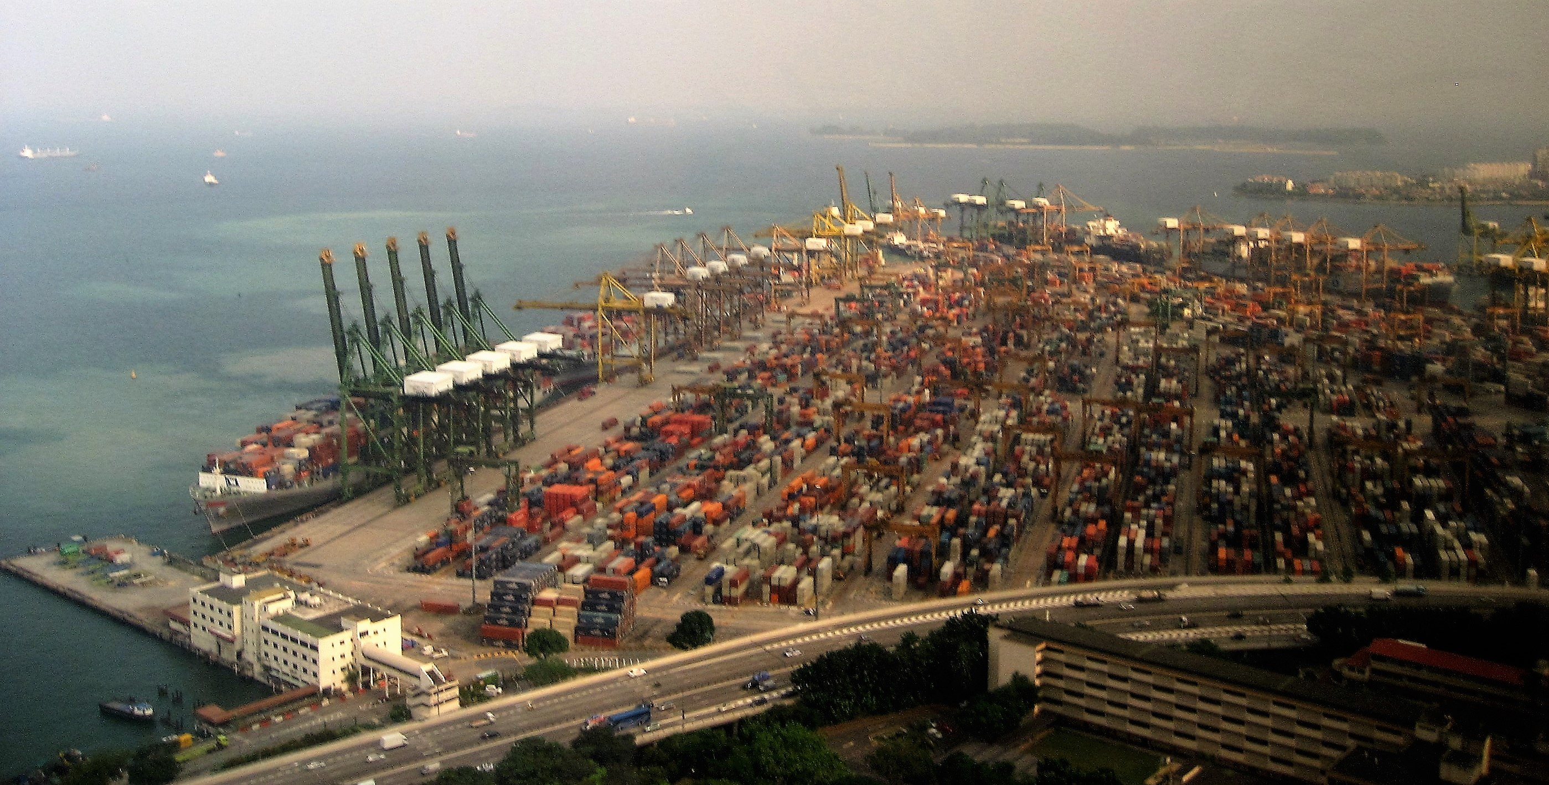
Port area
Singapore’s container terminals total:
nearly 60 berths on
17 km of quay, with
over 200 gantry cranes and
large areas for container storage.
Portus Trajanus:
nearly 300 berths on
2 km of quay,
very few cranes and
a vast storage.
NB: earlier Portus Claudius adds 2-3 km of quays.
Notes:
Without going into discussion now about accurate figures, we can say that:
Portus Trajanus had about 300 berths on 2 km of quays
This can be doubled if Portus Claudius is added
Singapore is one of the largest container terminals:
Only 60 berths, but 17 km of quays, as ship dock alongside

Slide 6
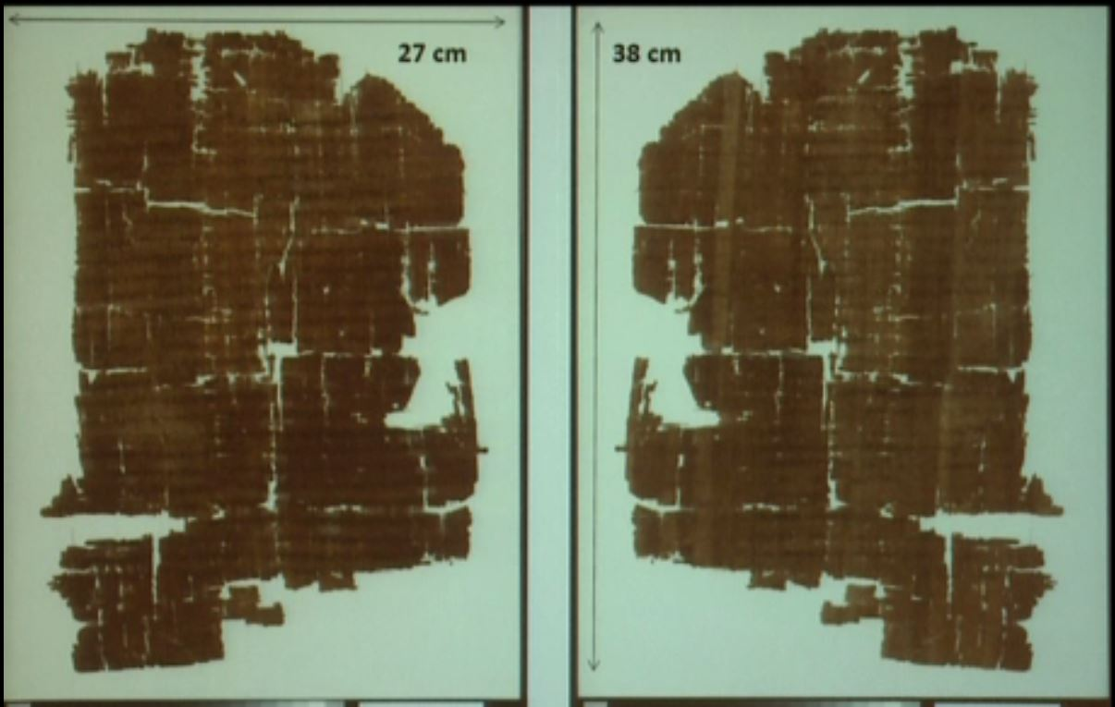
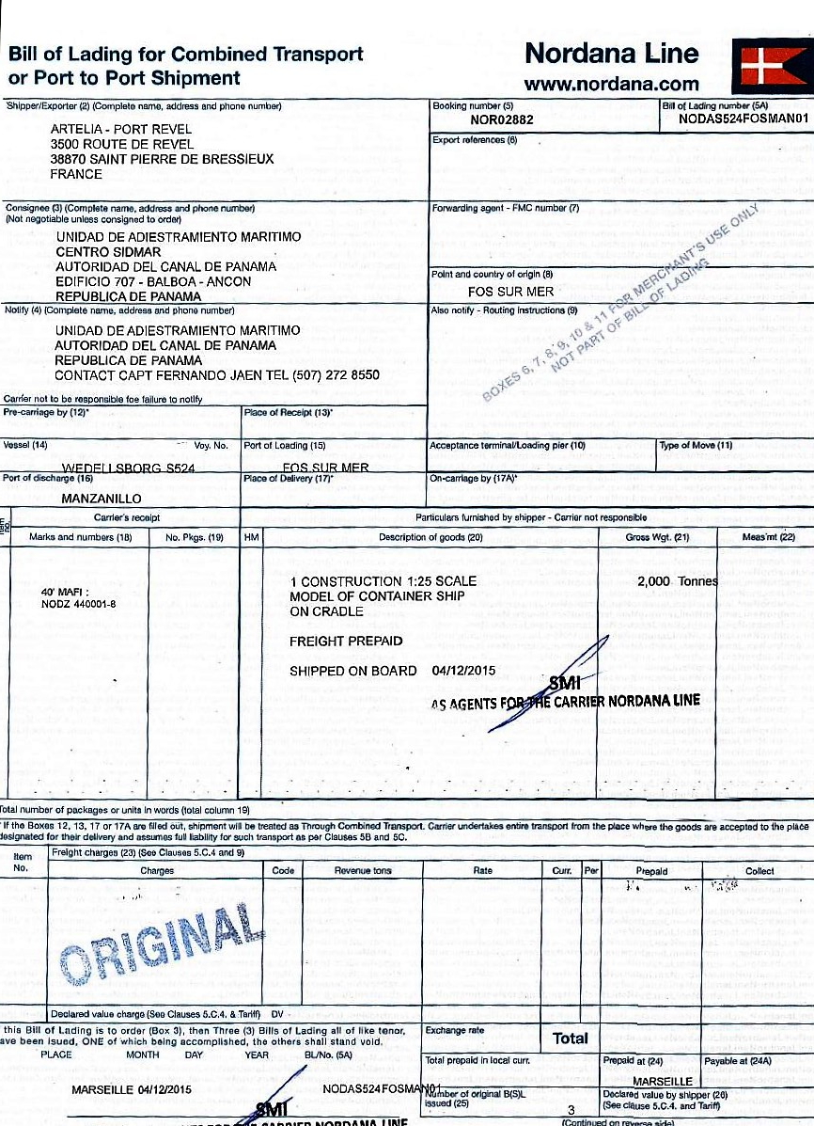
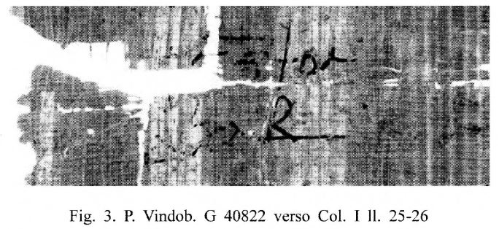
Documents
Modern cargoes valued Euro 100 million:
2 million barrels of oil at $50/barrel (on a 300 000 ton VLCC, around 350 m long),
5000 cars at €20 000/car (on a 180 m car carrier),
1500 TEU average value (on a 180 m container ship).
Hermapollon cargo: 9.2 million Roman sesterces or 60 million Euros
1 Roman sesterce = 6.5 €
Notes:
I refer to Emilia’s presentation.
Transport documents have always been used.
Modern documents use the INCOTERMS definitions.
An ancient document is the famous Muziris papyrus, you probably all know of. Very few docs like that.
Surprising is the high value of cargo on this 600 ton ship: 9 million sesterces: that is 60 million Euro
As a comparison: modern cargoes valued 100 million Euro would be ….

Slide 7
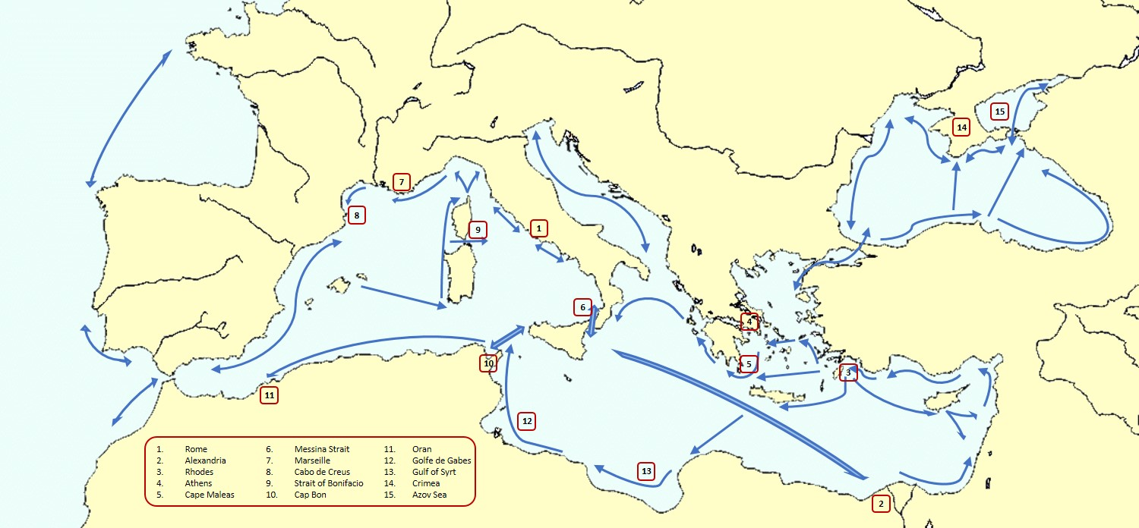
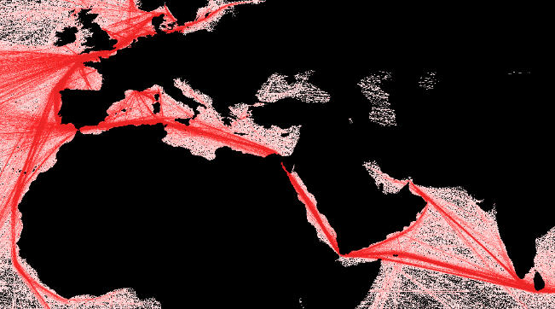
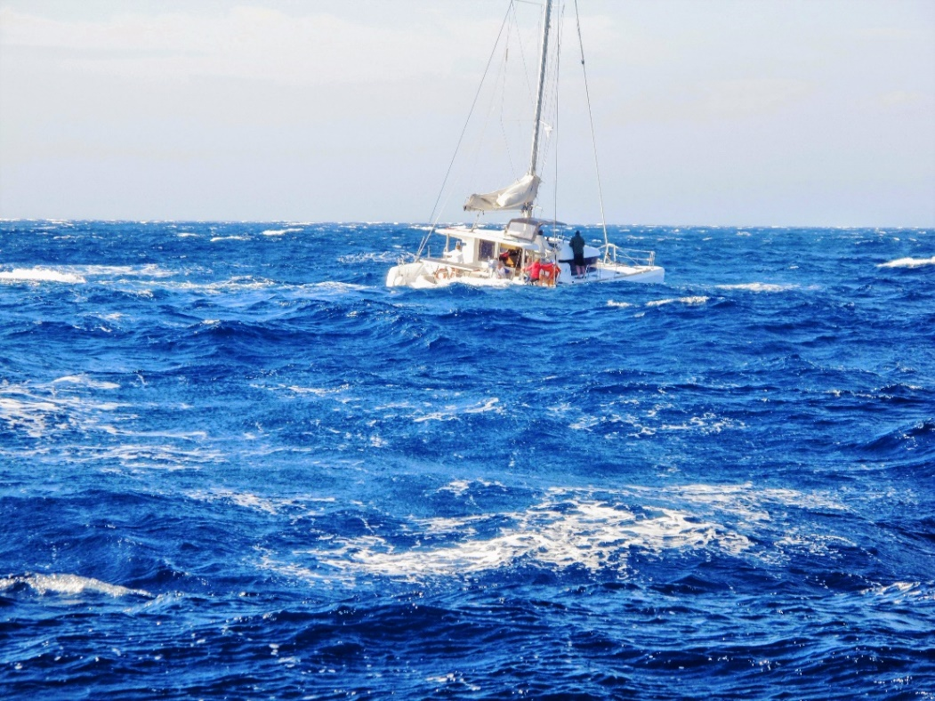
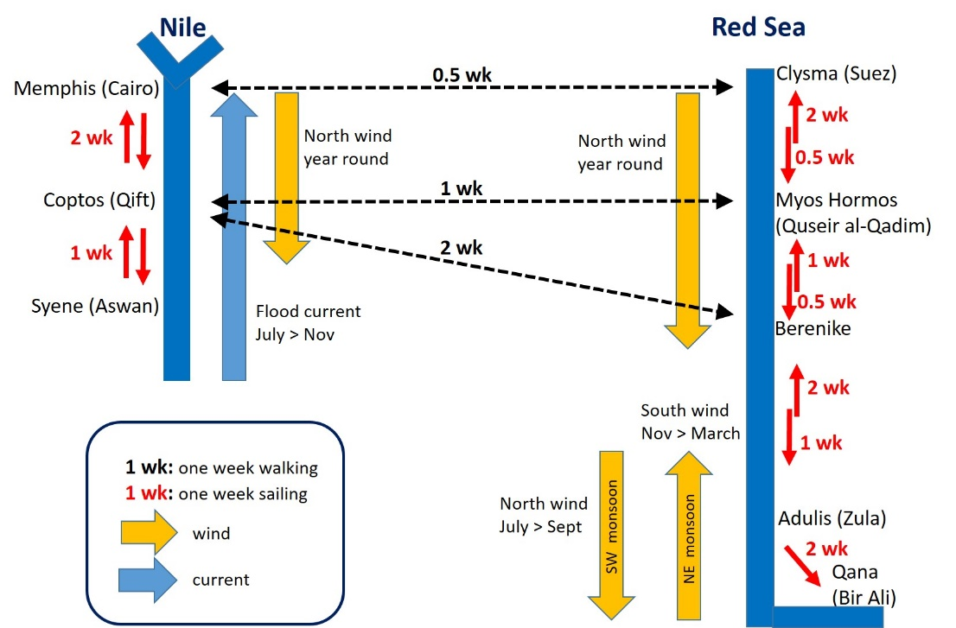
Sailing routes
25-30 knot Meltem near Delos
Notes:
At first glance, ancient & modern sailing routes look somewhat similar, but trade is completely different:
Traffic from China to Europe
Oil & gas from the Gulf
Look at the hard sailing conditions on the Aegean with our modern sailing boats
Let’s have a quick look at the option on the Red Sea ….

Slide 8
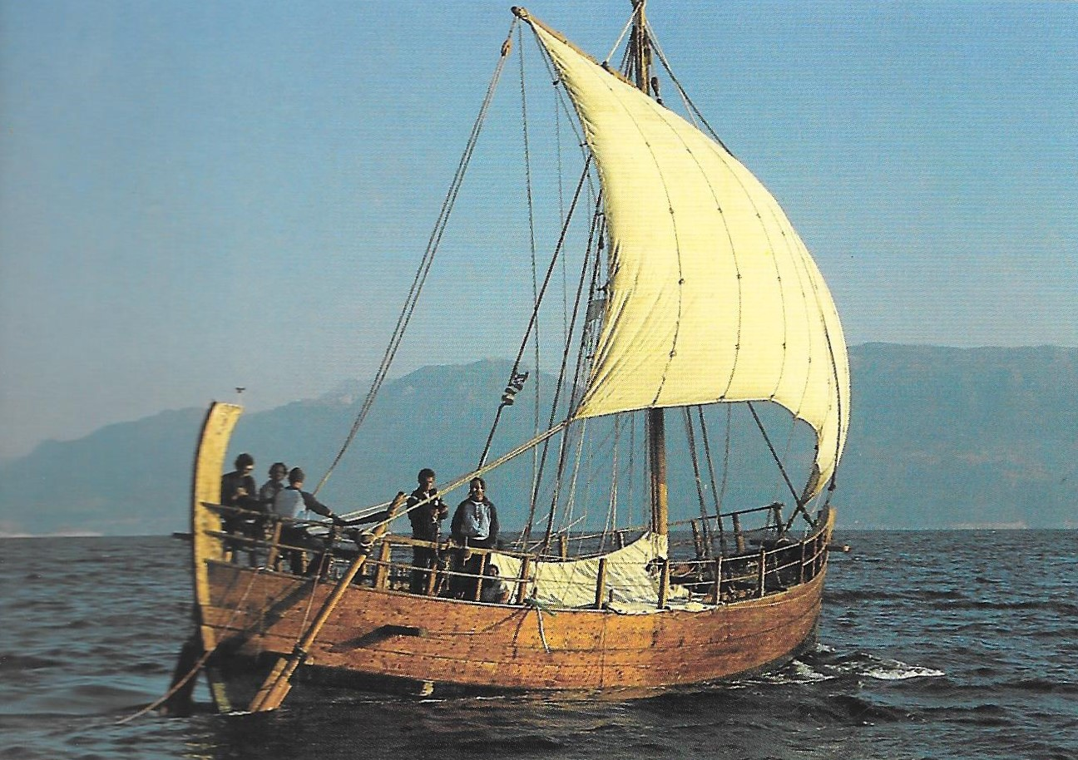
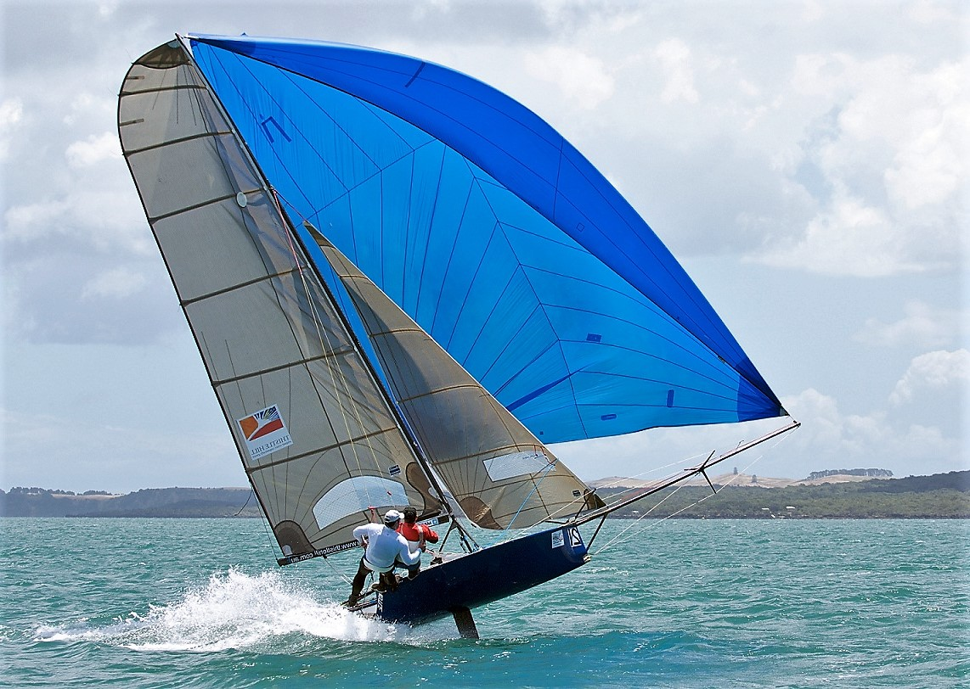
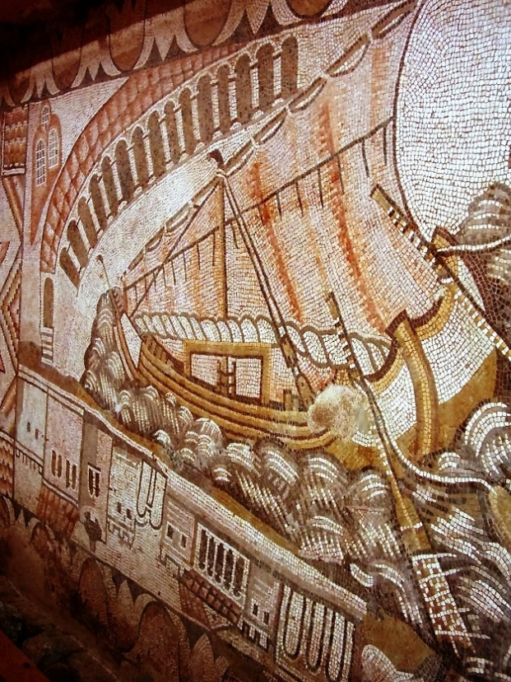
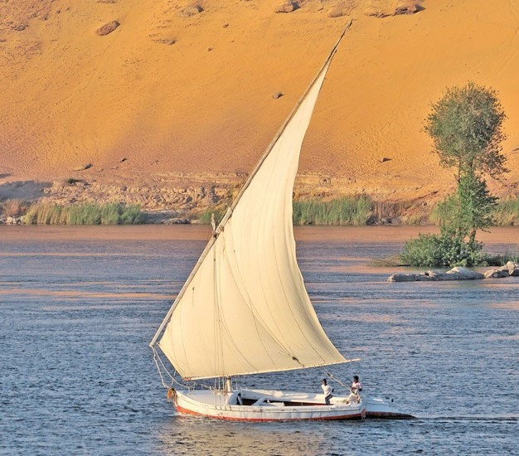
Sailing
Kyrenia II (3rd c. BC) sailing at close reach like a modern sailing boat under spinnaker
Kelenderis mosaic (5th c. AD) discovered by Levent Zoroglu in 1992, showing partially brailed sail with the top yard pointing down to the bow, looking like a lateen rig
Notes:
Let’s talk about sailing.
Especially sailing to windward, that is against the wind with some angle:
Look at Kyrenia, she behaves like a modern sailing boat under spinnaker
Look at the Kelenderis mosaic: look at the lateen sail
Note that square sails and lateen sails have probably been used for many centuries because they both performed similarly.

Slide 9
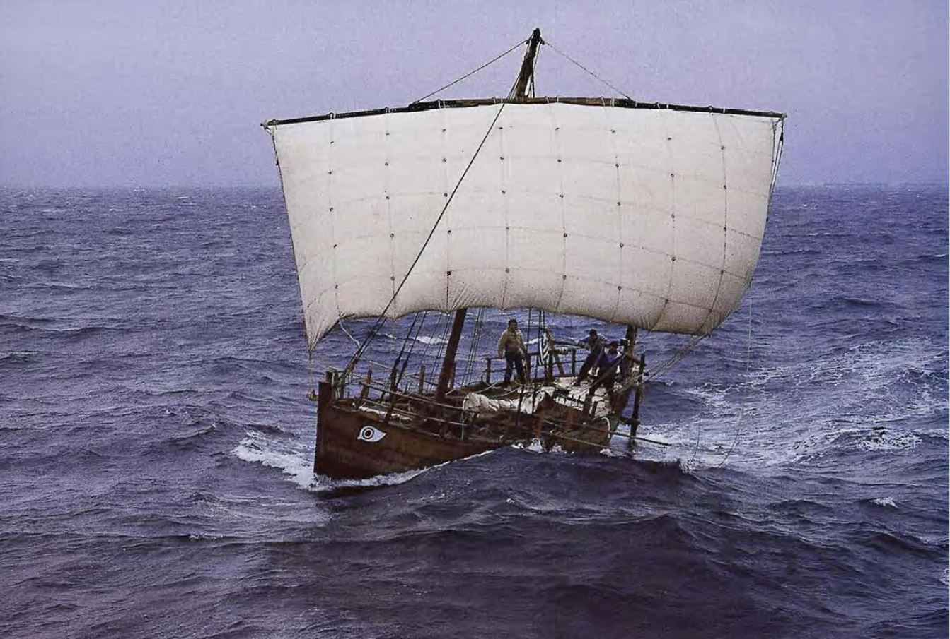
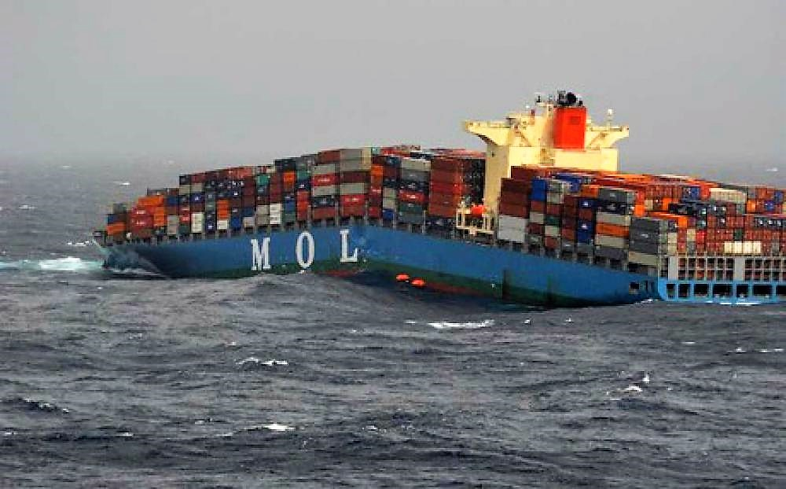
Shipwrecks
Kyrenia II (3rd c. BC) in 1987
MOL Comfort (316 m long) in 2013
18th c.: 0.3 shipwrecks/year with 142 deaths/yr,
19th c.: 1.1 shipwrecks/year with 323 deaths/yr,
20th c.: 1.4 shipwrecks/year with 475 deaths/yr,
21st c.: 3.5 shipwrecks/year with 755 deaths/yr.
500 BC – 500 AD: 1500 shipwrecks, or ca. 1.5 shipwrecks/year,
150 BC – 150 AD: 800 shipwrecks, or ca. 2.7 shipwrecks/year.
Notes:
Now the bad side of sailing: ships lost at sea
See the Kyrenia in a storm in 1987
See the MOL Comfort lost in 2013
The number of shipwrecks per year:
From Andrew’s database, and more shipwrecks will be found in the future …
Note also that the number of ships was probably a factor 10 smaller than today
From modern stats: note the increasing numbers

Slide 10
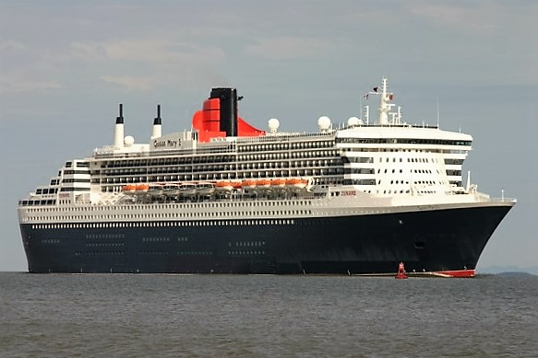
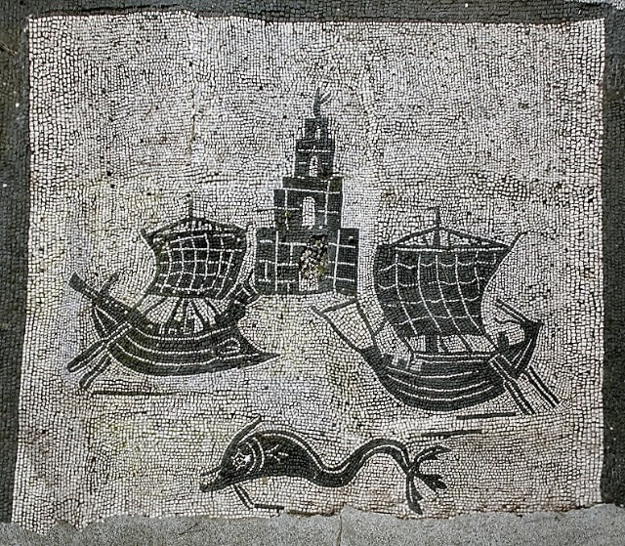
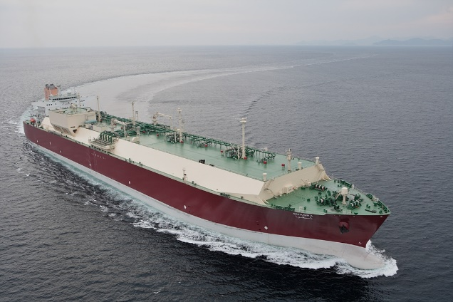
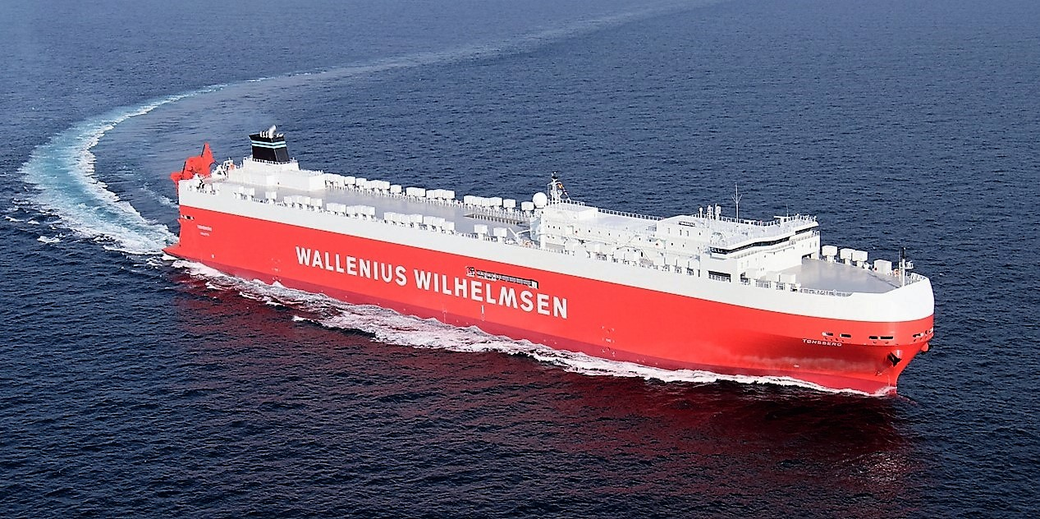
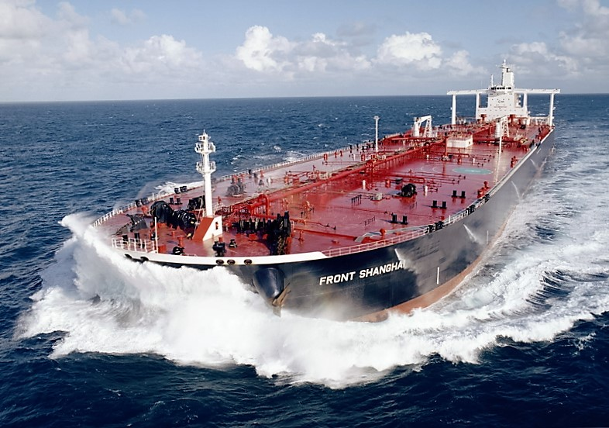
Big ships
Cruise ship Queen Mary 2
Q-Max LNG tanker Shagra
Ostia Corporazioni 46
Car carrier Tonsberg
VLCC Oil tanker Front Shanghai
Notes:
A few big ships that are subject to wind force because their draught of around 10 m.
With a draught of 20 m, the loaded oil tanker does not care about the wind.

Slide 11
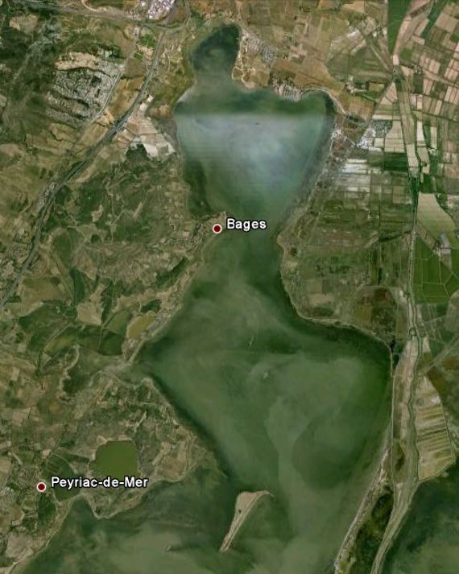
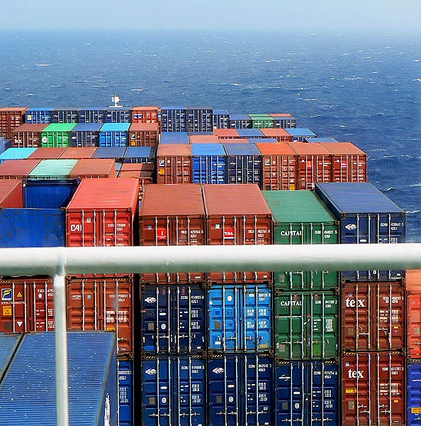
Bages
Narbo
La Nautique
Castélou
What do you see??
Captain, what do you see? Nothing within 500 m!
North
Ile de la
Margotte
Ile de
Planasse
Notes:
What do you see from the bridge of a ship ??
Modern ship: nothing within 500 m !
Ancient ships nearing Narbo: not much either !

Slide 12
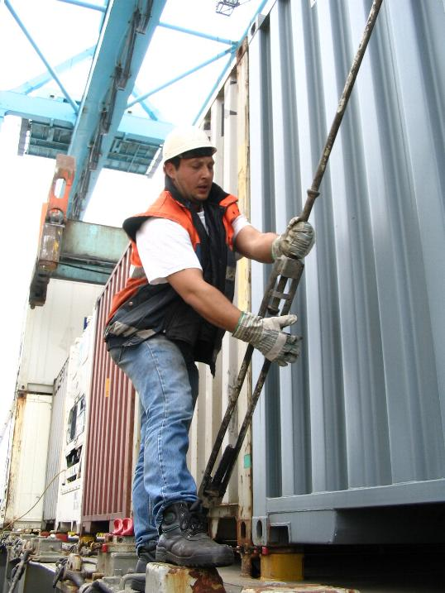
Conclusions
Many aspects of shipping are unchanged since Antiquity:
Loading and unloading a ship has always required a lot of manpower
Stowing and fastening cargo on board always required a lot of care
A specific group of ship owners, agents, traders, custom officers has always been involved
Sailing ships is a risky activity requiring much experience to use wind forces safely and avoid storms
The speed of maritime logistics drastically increased:
On shore, slaves are now replaced by machines: no mistakes, no rebellions, no corruption, and on duty 24/7
Flows of goods have been improved: safer, faster, and on time, thanks to meteorological forecasting
Flows of information have been improved: more detailed, much faster, reliable delivery
Flows of money have been improved: safer, faster (demonetisation). This is perhaps the most important improvement
Notes:
Read & comment !

Slide 13
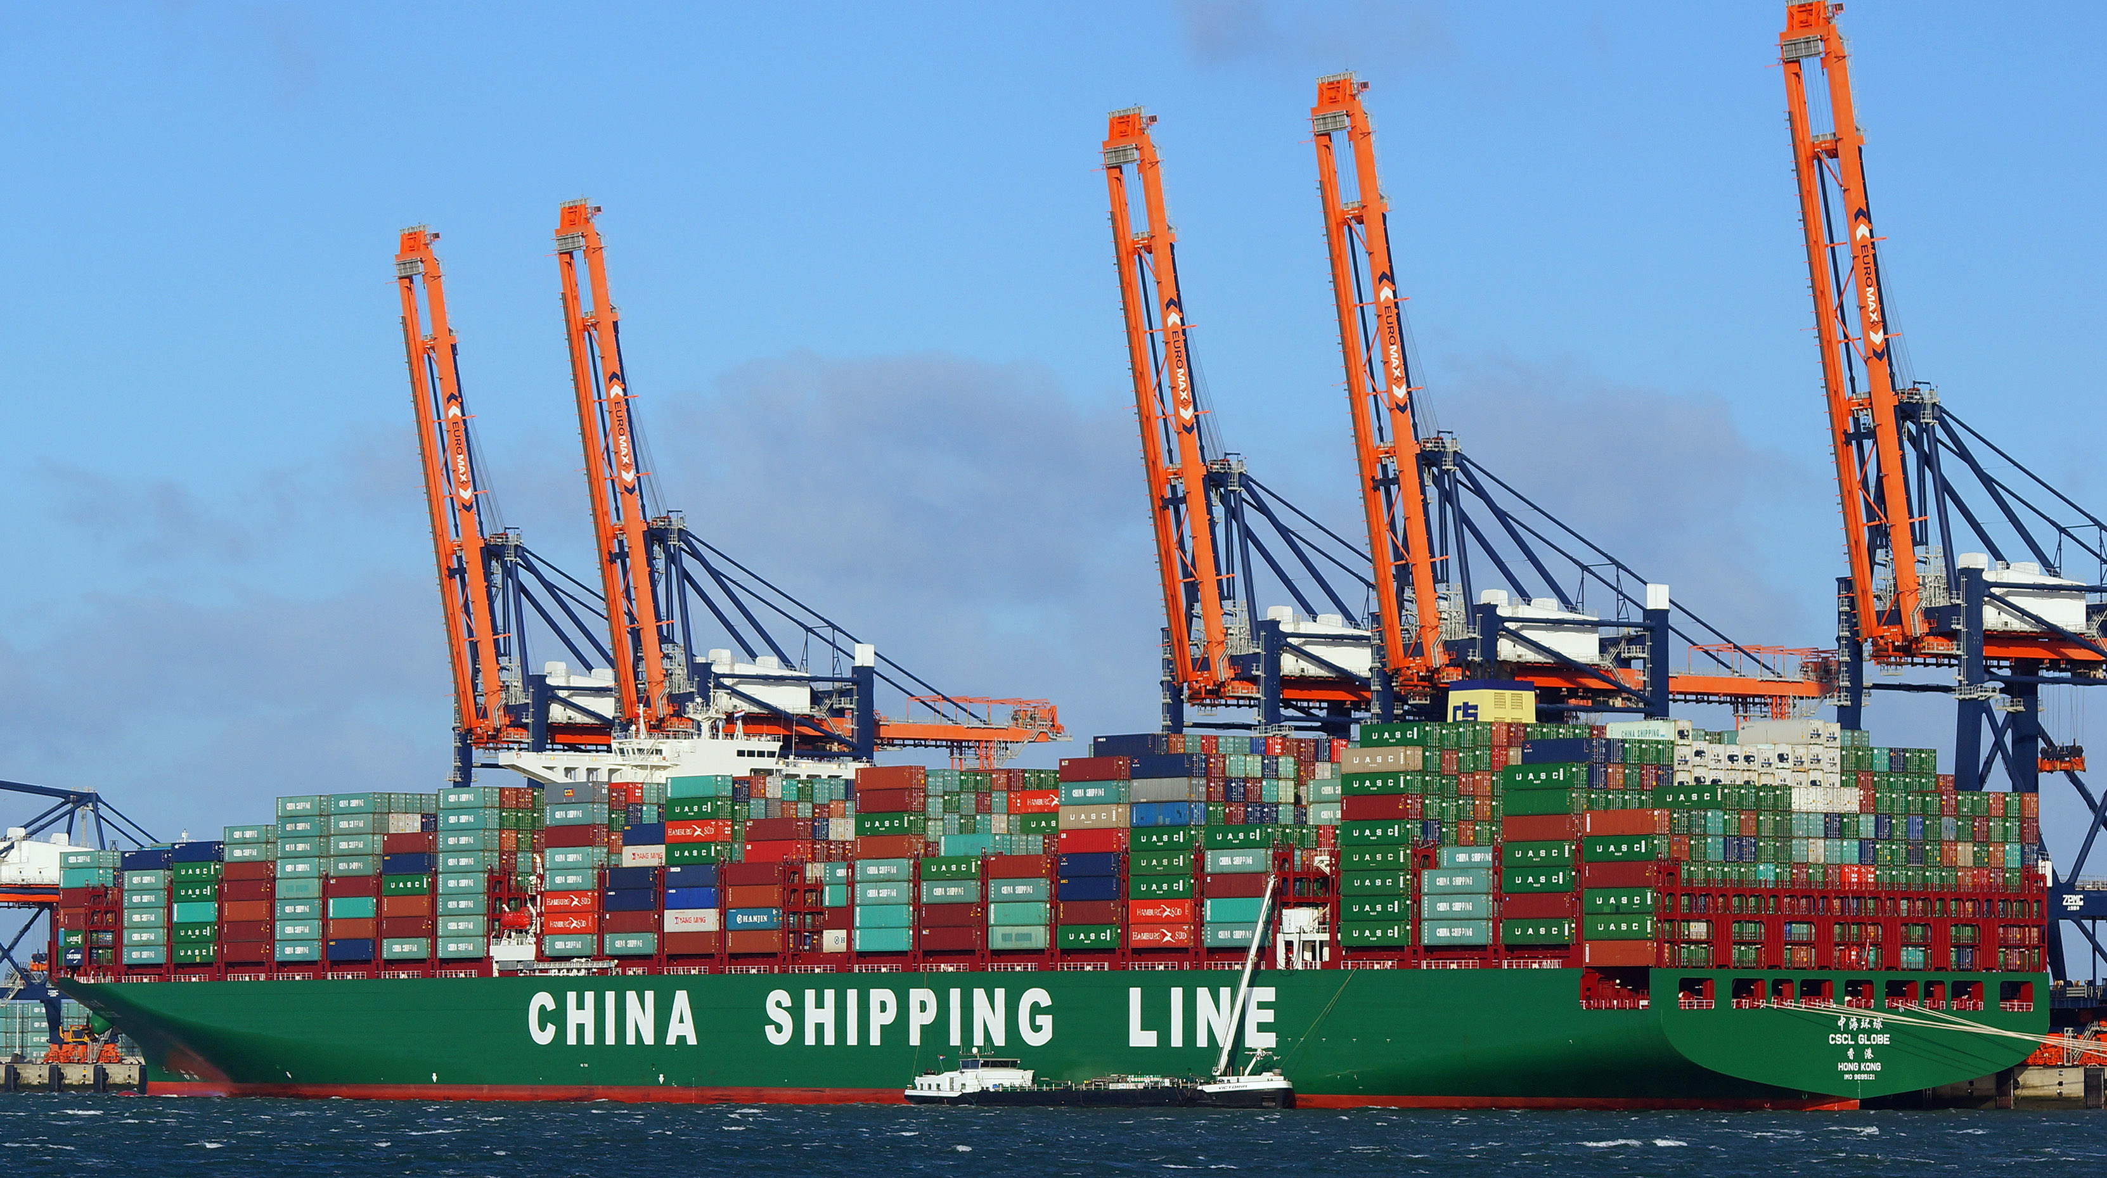
Conclusions
Ancient maritime traffic was carried out with thousands of ships Largest ships:
400 ton Madrague de Giens (40 x 9 m, draught around 3.5 m)
600 ton Albenga or Hermapollon
1200 ton Isis described by Lucian of Samosate (55 x 14 m, draught around 4.5 m)
As noticed by De Romanis, similar volumes of cargo will not be back on the seas before the 16th century
Today’s largest ships carry cargo values like that carried by the Hermapollon, i.e. in the order of 100 million Euros and up to 1 billion Euros,
and the ship length has increased from 40-50 m to 300-400 m, mainly during the 20th century.
Notes:
Read & comment !
Note that around 90% of global cargo volumes are maritime cargo due to cost.

Slide 14
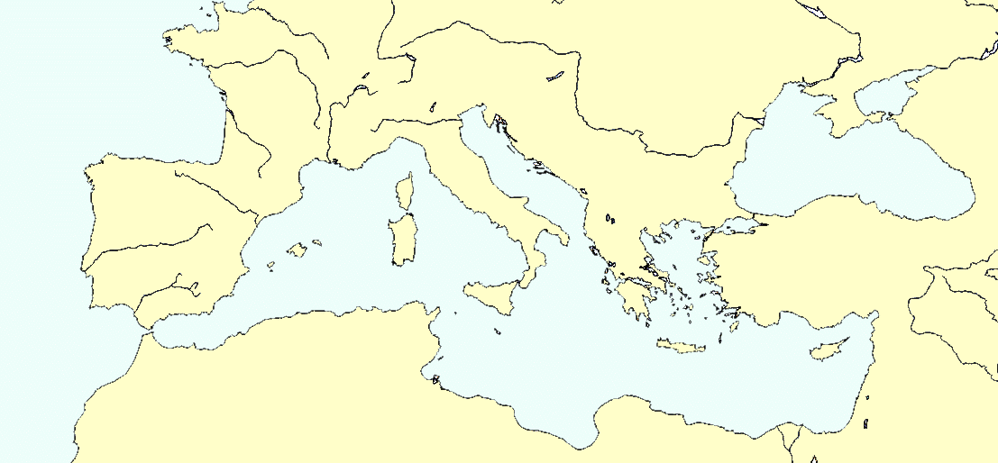
Conclusions
Alexandria was the “greatest emporium of the world”, acc. to Strabo.
Four major nodes should be mentioned:
Rome
Alexandria
Carthago
Gades
A finer-mesh network might be added into the coarse one by including other nodal points like: the Tanaïs river area, Byzantium, Rhodes, Antioch, Athens, Aquileia, Puteoli, Massalia, Arelate, Narbo, Tarraco, Carthago Nova and perhaps Gaza if it was more than a place of transit like Myos Hormos and Berenike.
In addition to Indian places like Muziris (unlocated near Cochin), a lesser known place like Omana (possibly located at ed-Dur, in Umm al-Quwain Emirate) should be mentioned here too in order not to under-estimate ancient traffic in the Gulf.
Notes:
The whole Med could be seen as a Roman harbour !
Read & comment !

Slide 15
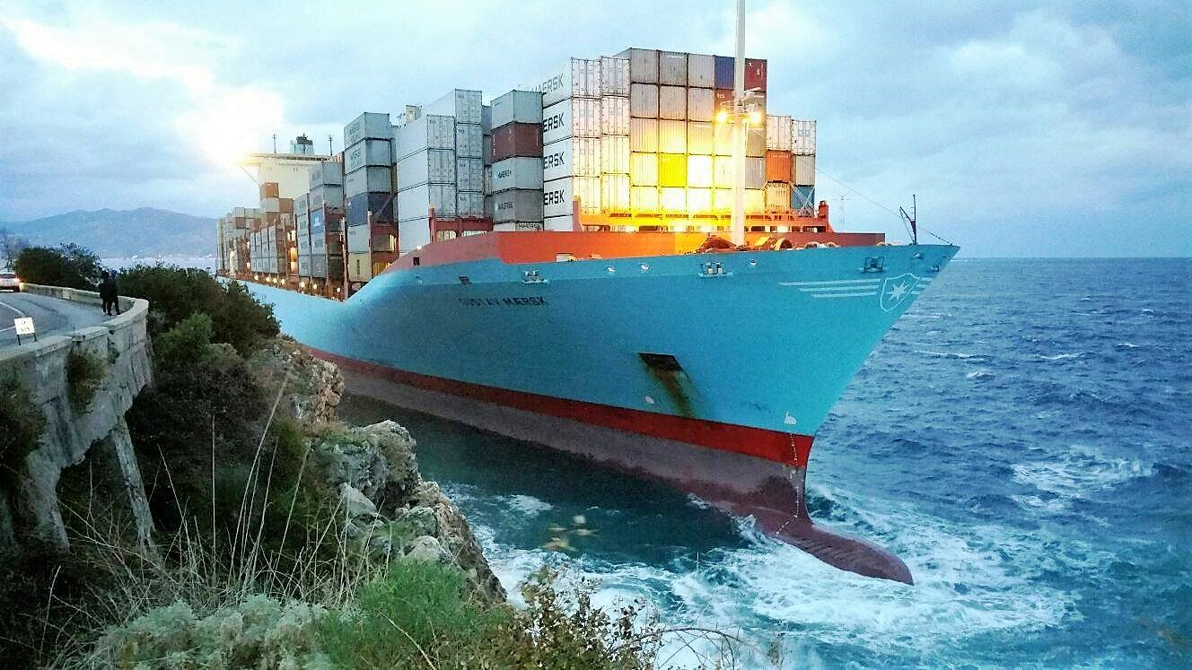
Conclusions
In ancient times, today’s “time is money” was less important than “have a safe trip back home”.
Maersk Gustav at Scylla 10/1/2017 …
www.AncientPortsAntiques.com
Merci de votre attention …
Notes:
Scylla & Charybdis are still there !

