Slide 1
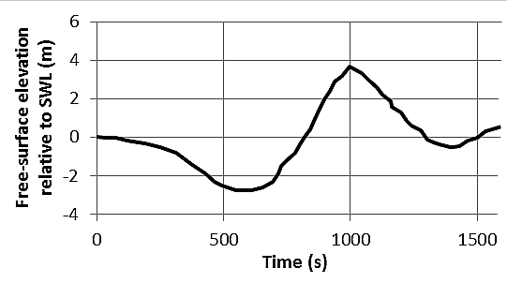
1200 s (20 min.)
crest at +3.7 m
trough at –2.8 m

