Slide 1
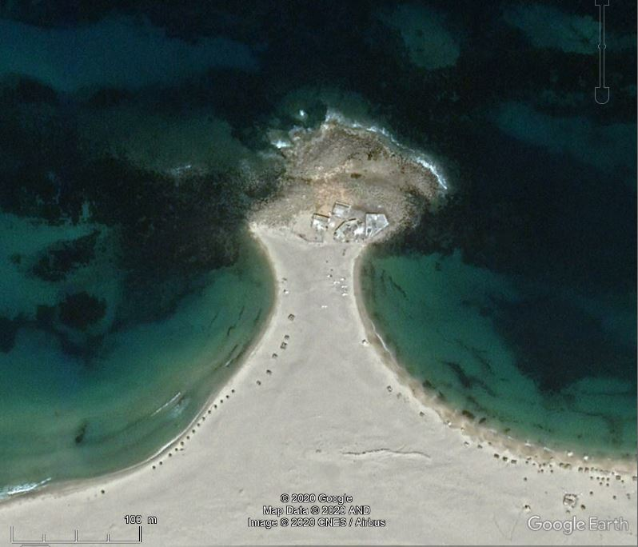
waves

Slide 2
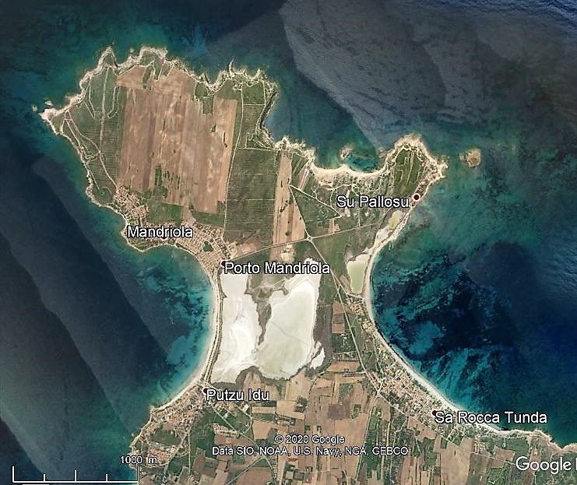
waves

Slide 3
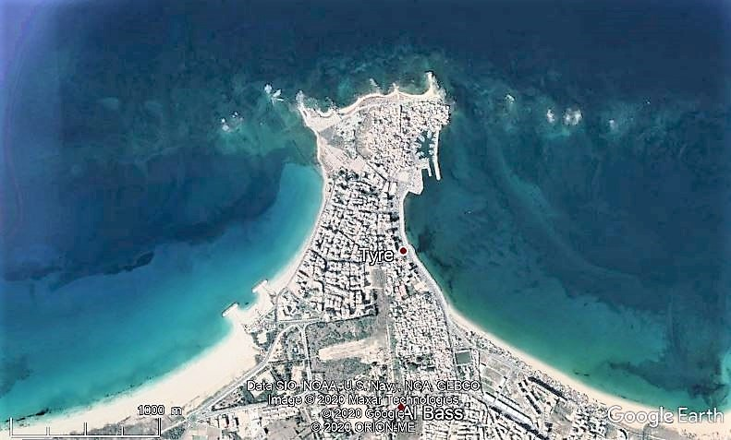
waves

Slide 4
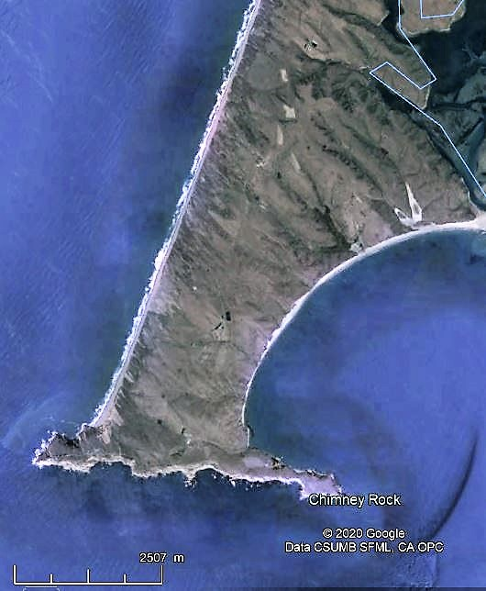
waves

Slide 5
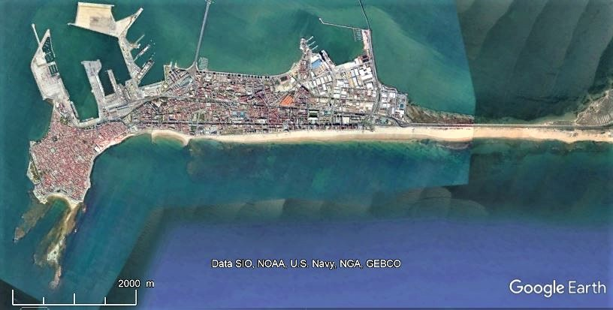
waves

Slide 6
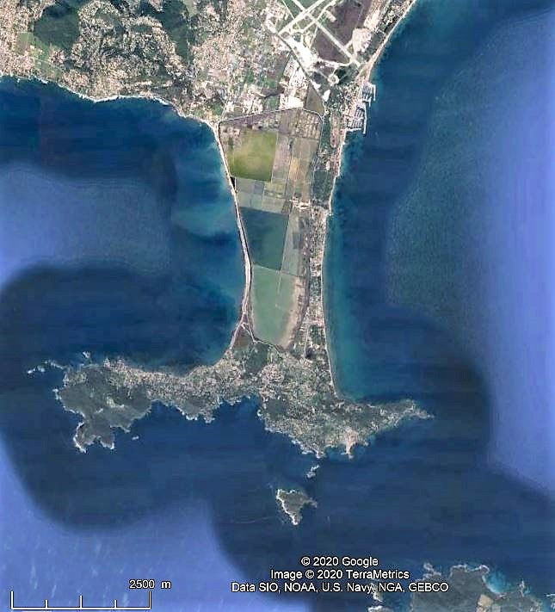
western waves
eastern waves

Slide 7
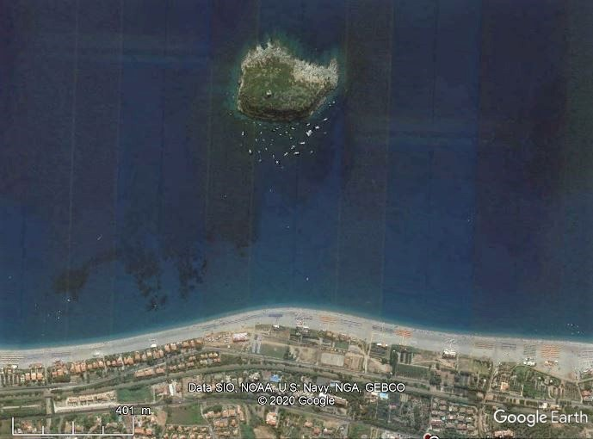
waves

Slide 8
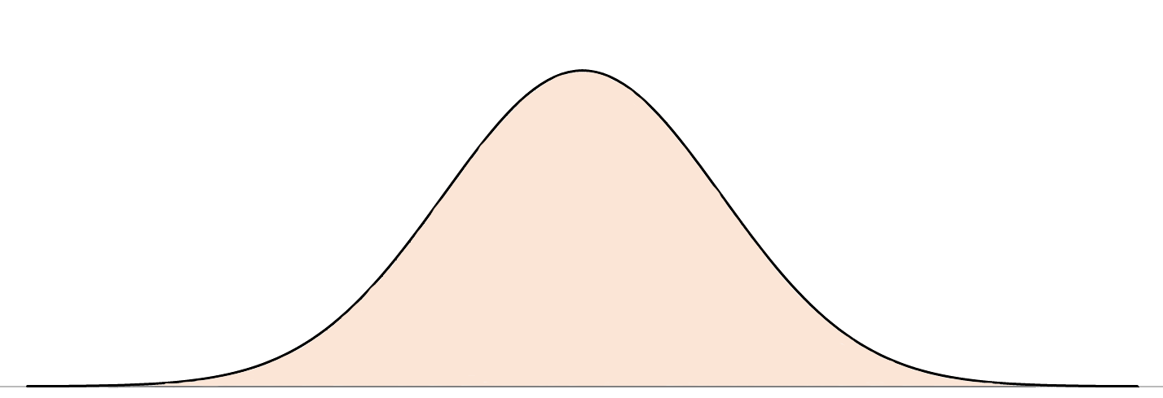
L/D = 0.45
b/D = 0.70
d/D = 0.40
b/L = 1.55
b/d = 1.75
L
D
b
d

Slide 9
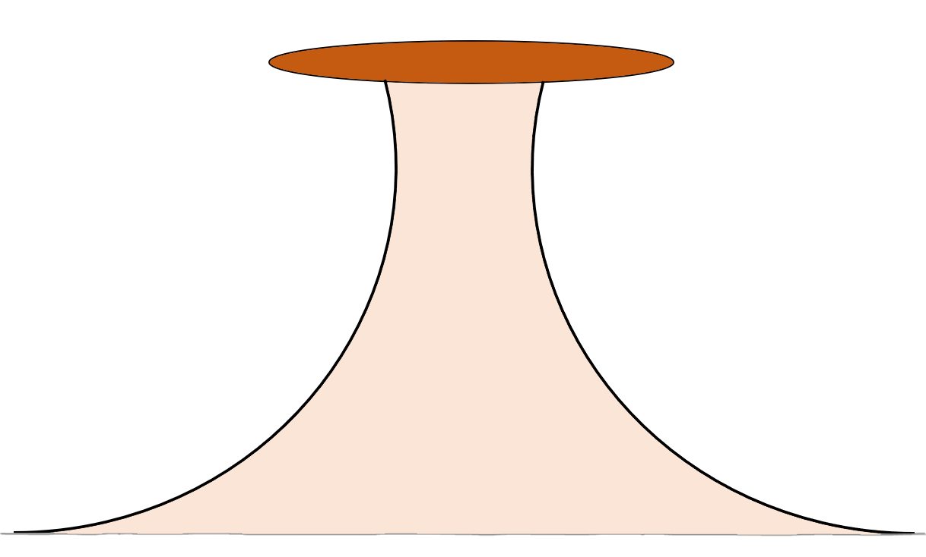
L/D = 0.90
b/D = 0.30
b/L = 0.33
L
b
D

Slide 10
L/D = 0.90
b/D = 0.70
b/L = 0.78
L
b
D

Slide 11
L/D = 0.90
b/D = 0.05
b/L = 0.055
L
D

Slide 12
L/D = 0.5
b/D = 0.5
d/D = 0.5
b/L = 1.00
b/d = 1.00

Slide 13
L/D = 0.5
b/D = 0.875
d/D = 0.125
b/L = 0.44
b/d = 7.00

Slide 17
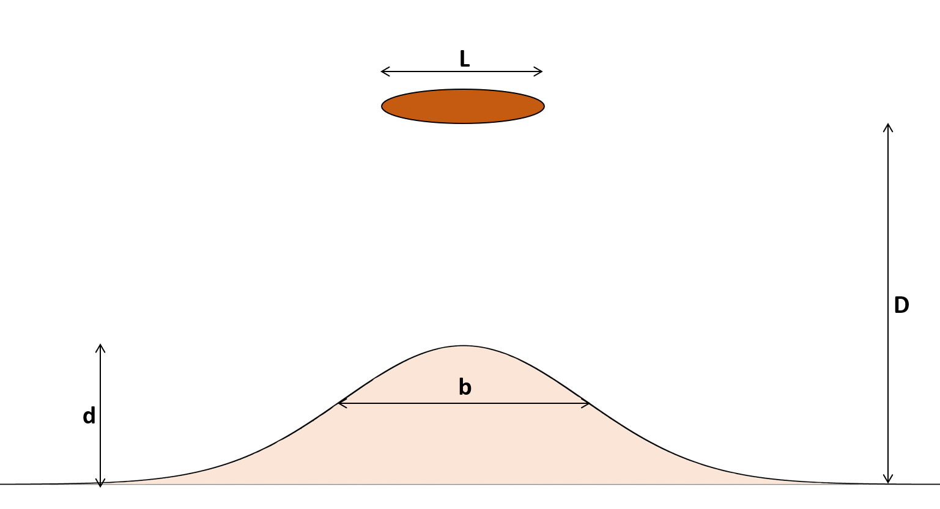
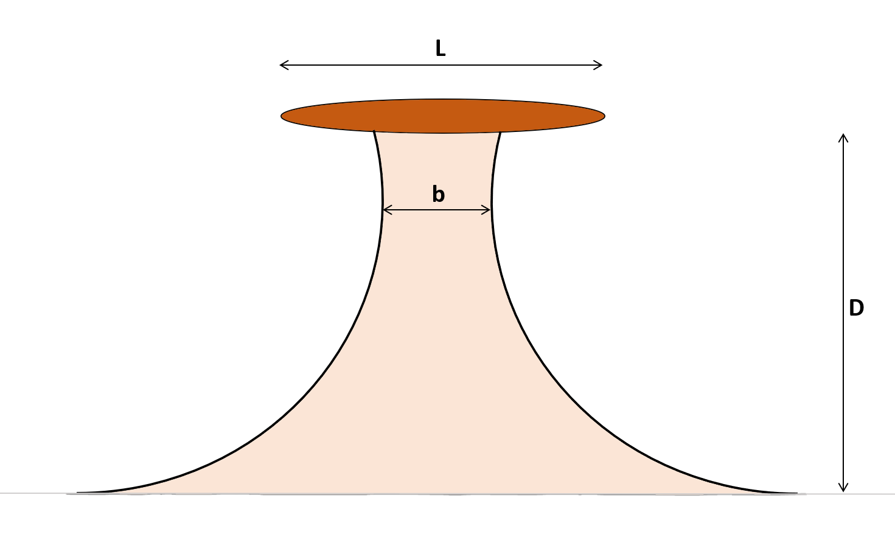
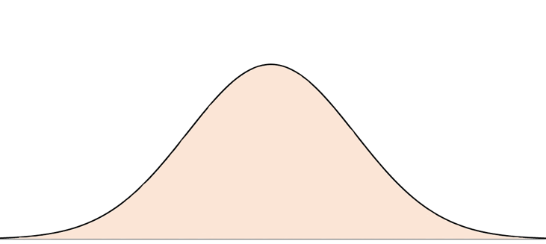
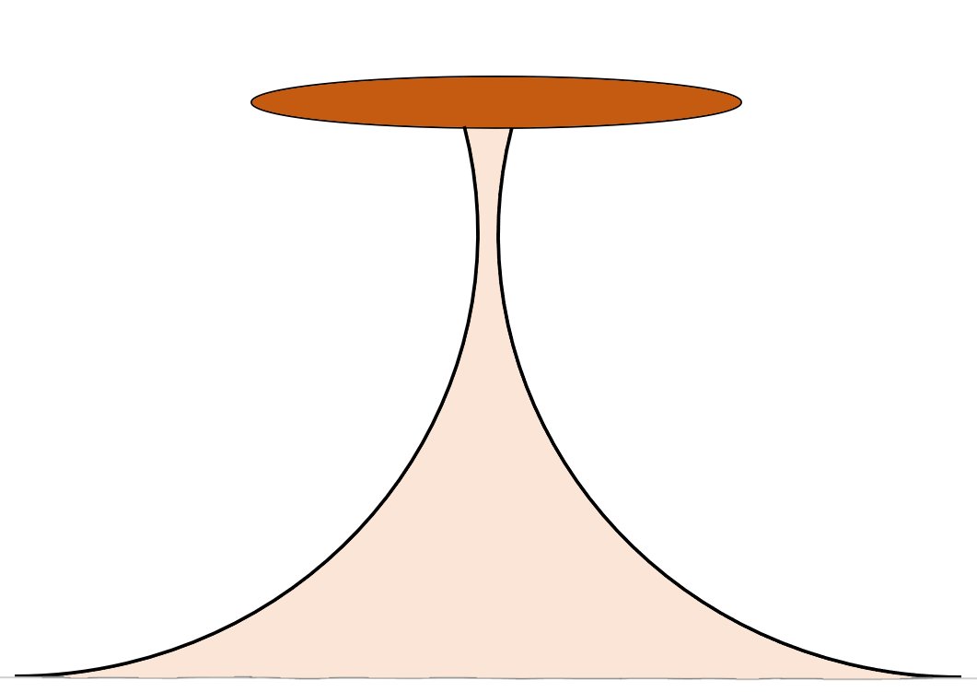
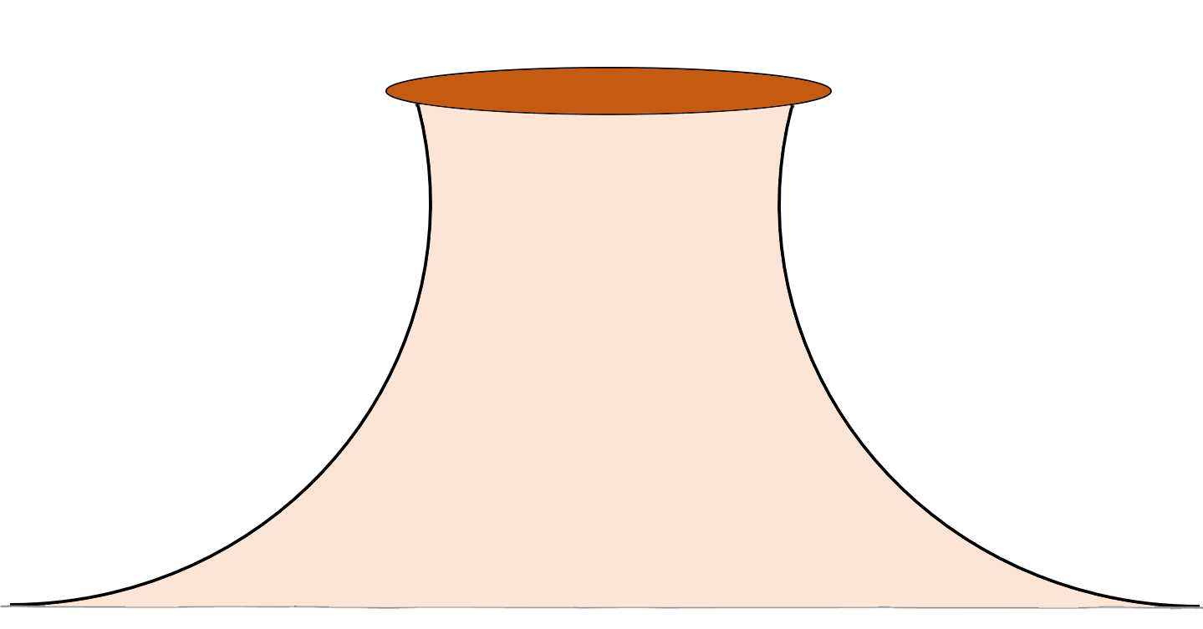

Slide 21
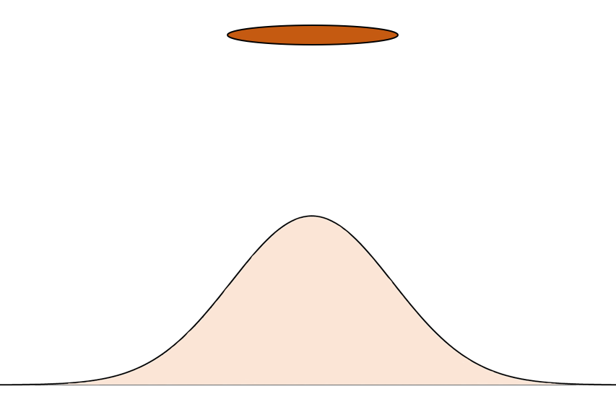
normal isthmuses
fat isthmuses
umbilical isthmuses
salients

Slide 22
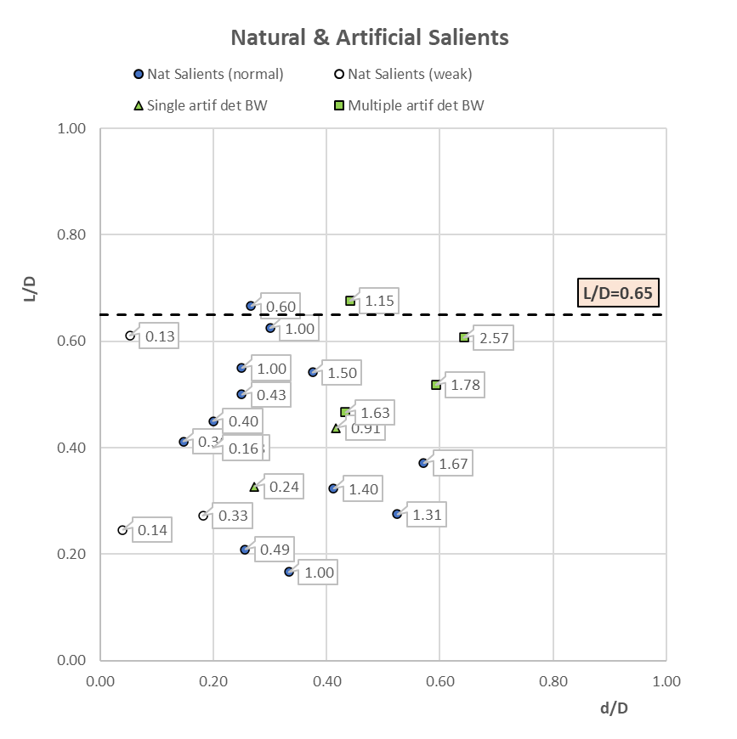
d/b values
tombolos
no salients
developed salients
d/b = 2
d/b = 1
weak salients
d/b = 0.5

Slide 23
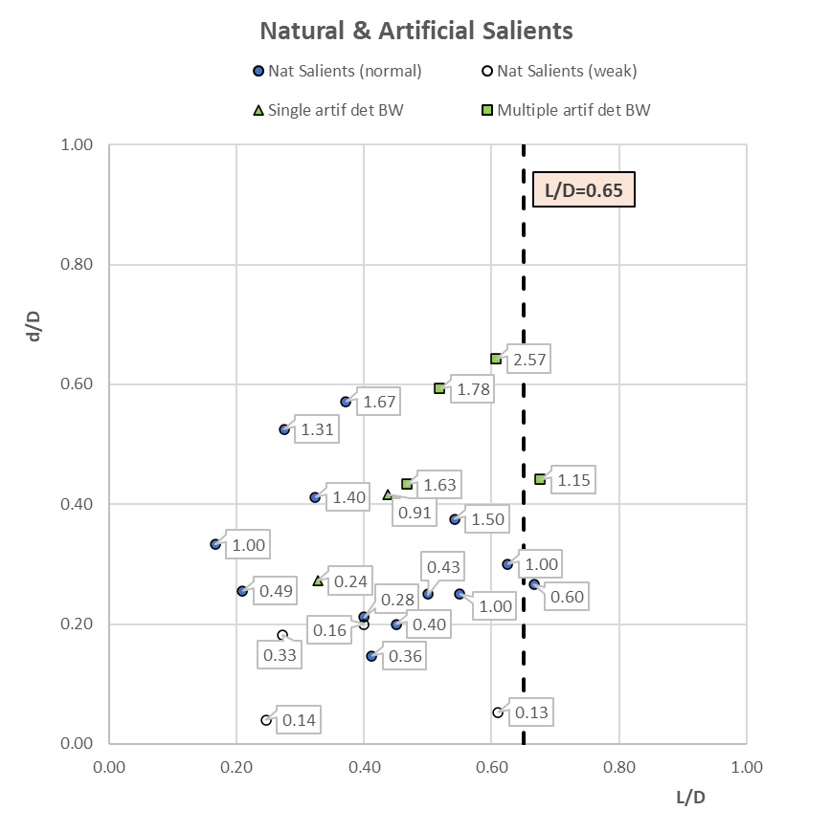
d/b values
tombolos
developed salients
d/b = 2
d/b = 1
weak salients
d/b = 0.5

Slide 24
