Slide 1
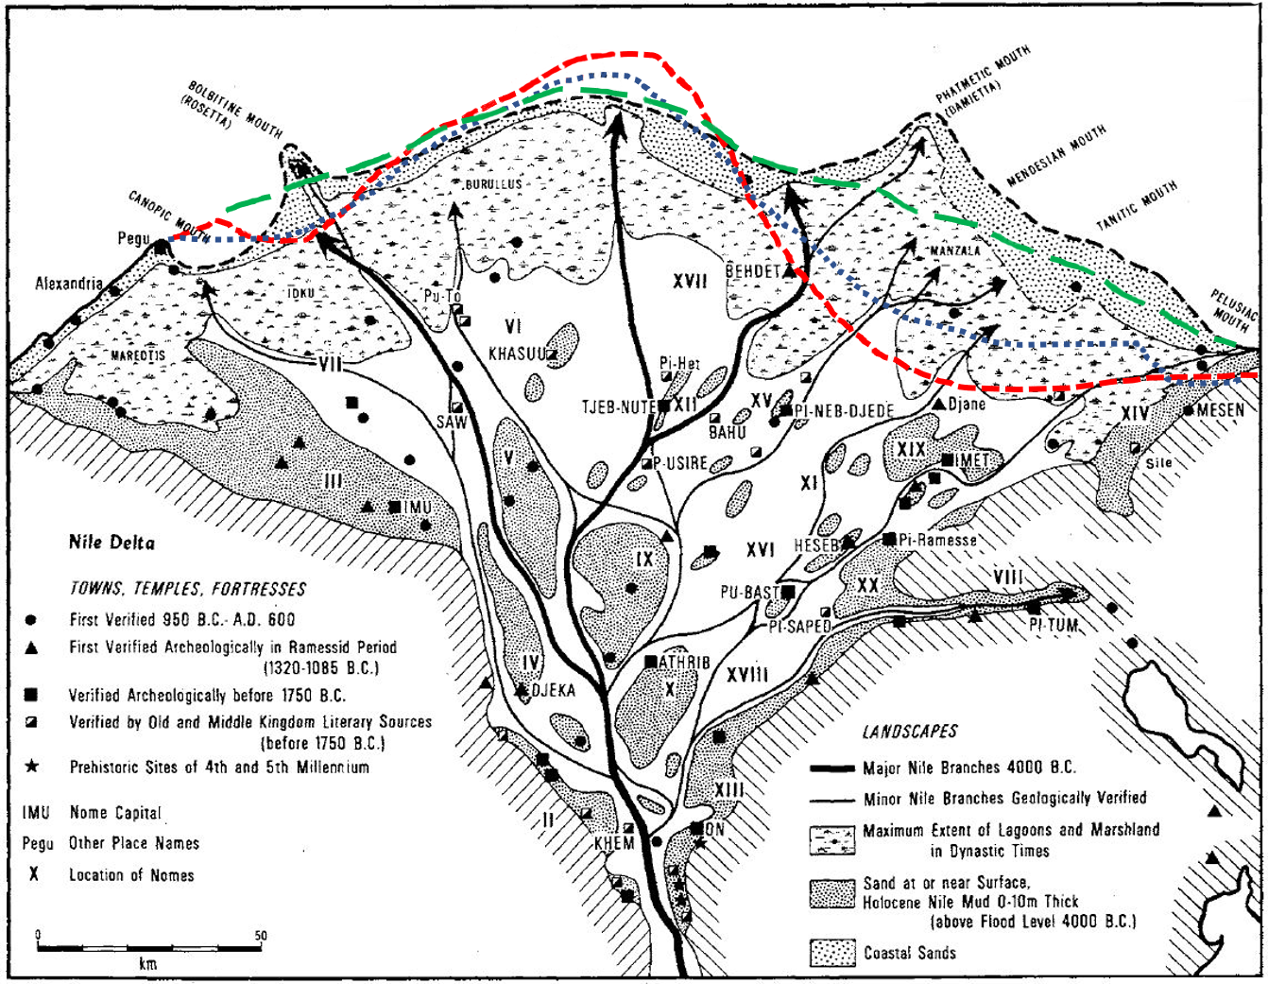
2000 AD
0 AD
2000 BC
4500 BC

Slide 2
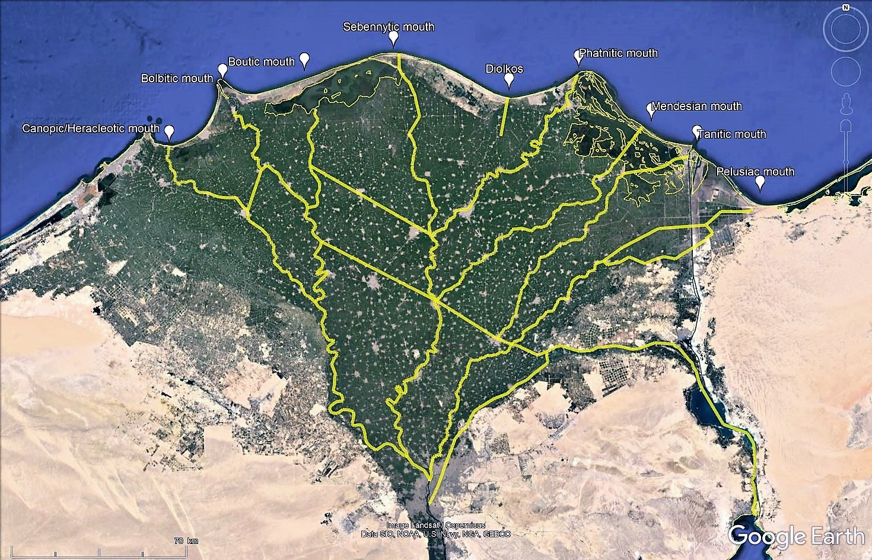
Bolbitic
Sebennytic
Bousiritic-Bucolic?
Taly
Canopic Herakleotic
Boutic
Mendesian
Thermouthiac
Tanitic
Saïtic
Pelusiac
Boubastic
Athribitic
Boubastic
Necho’s canal
Agathodaimon
Trajan’s canal

Slide 3
Bouto
Canopos
2
Saïs
Mendes
Tanis
Pelusion
Bousiris
3
Boubastis
1
Memphis

