Slide 1
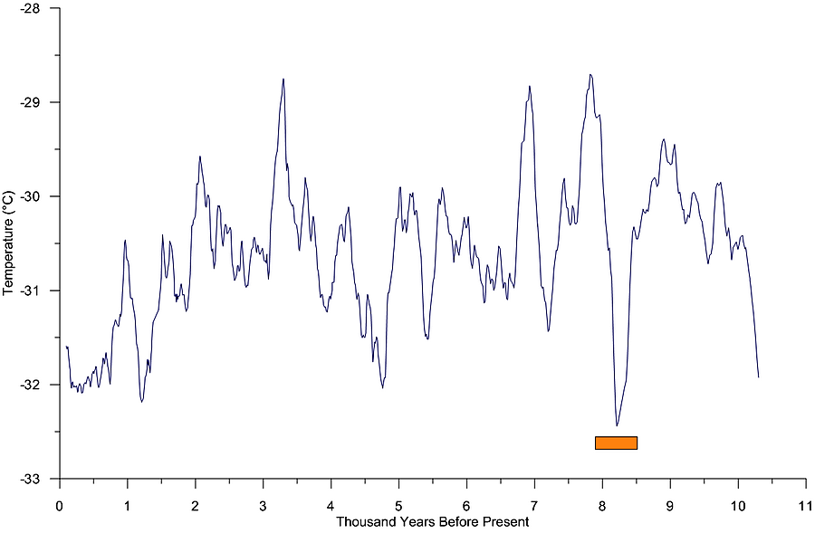
1600 BC: Mycenaeans Hittite
3600 BC: Mesopotamians Indus Valley
500 AD: Byzantines
1200 BC: Sea Peoples
2200 BC: Minoans
3000 BC: Egyptians
650 AD: Arabs
0: Romans
800 BC: Greeks
1850 AD
1250 AD
1000 BC
5000 BC
5800 BC
950 AD
200 BC
100 AD
Little Ice Age
Piora Cold Period
Rom. Warm Period
Medieval Warm Period
Iron Age Cold Period
8200 BP Cold Period
Late Neoglacial Anomaly (LNA)
Early Neoglacial Anomaly (ENA)

Slide 2
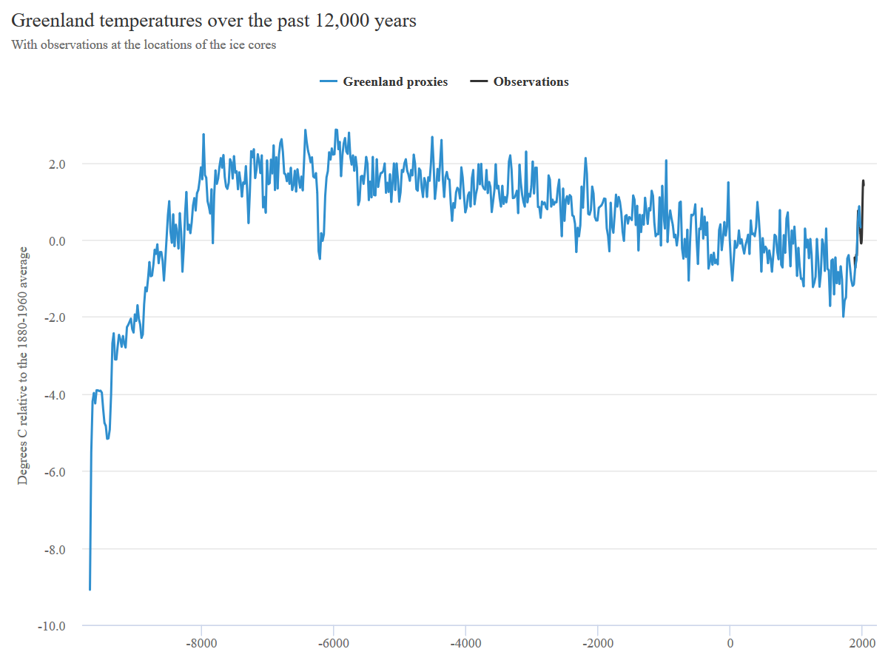

Slide 4
6000 BC: Holocene Thermal Max
3300 BC: Harappa-Indus Valley
3000 BC: Egyptians & Sumerians
4900 BC
4500 BC
3800 BC
2200 BC: Minoans
1600 BC: Mycenaeans & Hittites
1200 BC: Sea Peoples
Roman Warm Period: Romans
500 BC: Greeks
400 AD: Byzantines
Piora Cold Period
900 AD
650 AD: Arabs
Medieval Warm Period
1350 AD
8200 BP Cold Period
Early Neoglacial Anomaly (ENA)
1850 AD
Iron Age Cold Period
Late Neoglacial Anomaly (LNA)
Little Ice Age

